Slide 1
"APIs are contracts, not convenience — version them like you mean it."
SUPPLEMENTARY · MODULE 2
Microservices Design
and REST APIs
Design REST APIs that teams can evolve: resource models, status codes, idempotency, OpenAPI as the contract, and the patterns that keep consumers from coupling to your internals.
🧩
🔗
📄
🛡️
SPRING BOOT MICROSERVICES BOOTCAMP • DAY 1 • MODULE 2
Notes:
KEY TALKING POINTS
------------------
- Linking back to Module 1
Module 1 ended with participants choosing Account Service as the first extraction.
They also reasoned about boundaries and coupling.
Module 2 answers the next question.
Once a boundary is drawn, what does the service expose across it?
Independent deployment only works when contracts are stable and backward-compatible.
So API design is where the Module 1 benefits are either protected or lost.
A badly designed API recreates a distributed monolith, meaning services that must still change and release together.
- What this module covers
Participants learn to model resources and clean URIs.
They use HTTP methods and status codes correctly.
They design DTOs, or data transfer objects, so internal entities do not leak.
They apply loose coupling, high cohesion, and bounded contexts.
They compare REST with messaging.
They design idempotent operations for safe retries.
And they treat an OpenAPI document as the contract consumers rely on, including versioning.
The emphasis throughout is practical design decisions, not theory.
- Why it matters for Lab 1
Lab 1 builds a versioned Account Service API under /api/v1/accounts on port 8081, documented with OpenAPI and Swagger UI.
It changes account status through actions such as freeze, activate, and close.
It never uses HTTP DELETE, because closed accounts are kept.
Every one of those choices is a Module 2 design decision.
So participants should listen for the reasons, because they will apply them within hours.
REAL-WORLD EXAMPLES
-------------------
- Open banking regulations in several markets require banks to share account and payment data with authorised third parties.
They must do it through documented APIs.
Those APIs must stay stable across releases.
That is why versioning, clear status codes, and published specifications are treated as contract commitments, not implementation details.
USE-CASE SCENARIO
-----------------
Set up the module with the capstone.
Transaction Service, built on Day 2, must call Account Service before recording a transaction.
It checks that the account exists and is ACTIVE.
Now suppose Account Service returns its JPA entity directly, renames a field, or reports every error as a generic server error.
Then Transaction Service breaks on the next Account release, and independent deployment is gone.
Module 2 gives participants the tools to prevent that.
They are a resource-oriented URI, a DTO, meaningful status codes, and an OpenAPI contract both teams can rely on.

Slide 2
FROM BUSINESS REQUIREMENTS TO SERVICE DESIGN · DOMAIN-DRIVEN DESIGN AS A SERVICE DESIGN TOOL
📌
THE SEVEN-STEP PATH
🏦
WHY START WITH BUSINESS REQUIREMENTS
📌
CORE DDD CONCEPTS
1. Understand the business requirement
2. Identify business capabilities
3. Define the domain and bounded contexts
4. Identify service boundaries
5. Design service responsibilities and contracts
6. Choose a communication and data strategy
7. Validate and refine the design
• Domain: the overall business area a system supports
• Subdomain: a focused slice of the domain (core, supporting, or generic)
• Bounded context: a boundary where a model has one specific meaning
• Ubiquitous language: shared business terms used consistently inside a context
• Aggregate: a consistency boundary for related domain objects
• Domain event: a meaningful business fact, such as AccountOpened
• Technology-first design produces services that mirror database tables, not business capabilities
• Requirements reveal the true nouns of the domain: Customer, Account, Transaction, Loan
• Design validated against real workflows is far less likely to need costly rework later
KEY TAKEAWAY A seven-step path takes a business requirement from raw need to a validated, ready-to-build service design. • DDD concepts -- domain, bounded context, ubiquitous language, aggregate -- turn business understanding into service boundaries.
1
© 2026 by Innovation In Software Corporation
Notes:
TOPIC 1 OF 2: From Business Requirements to Service Design
------------------------------------------
KEY TALKING POINTS
------------------
- THE SEVEN-STEP PATH
Walk the steps as a funnel.
Steps one and two stay in business language.
What is the bank trying to achieve?
Which capabilities support it, such as opening accounts, moving money, and assessing risk?
Step three draws bounded contexts.
A bounded context is an area where one model and its words keep one meaning.
Step four turns those contexts into service boundaries.
Step five writes down responsibilities and API contracts.
Only at step six do we choose REST, events, and database ownership.
Step seven checks the design against real workflows and loops back.
Stress that the path repeats.
Teams return to earlier steps when validation exposes a gap.
- WHY START WITH BUSINESS REQUIREMENTS
When teams start from the schema, they get services that mirror tables.
Those services change together every sprint, because tables are not business capabilities.
Requirements reveal the nouns the business actually uses, such as Customer, Account, Transaction, and Loan.
Those nouns become resources and contexts.
Test the design against a real workflow, such as opening an account and posting a first transaction.
That catches missing responsibilities on a whiteboard, where fixing them is cheap.
The same gaps are expensive if you find them later.
By then three services are deployed and consumers depend on them.
REAL-WORLD EXAMPLES
-------------------
- Take a typical account-opening modernization.
The team first maps what a branch banker and a mobile customer actually do.
That covers identity checks, product selection, and initial funding, all before naming any service.
Those capabilities then define the new service boundaries, not the legacy table layout.
- Amazon moved from a monolithic retail application to services owned by small teams.
This move is well documented, and it followed the same logic.
Each team owned a business function and its data behind an interface.
So boundaries came from what the business did, not from how the original database was organized.
USE-CASE SCENARIO
-----------------
Start the capstone with a single requirement: flag risky banking transactions before money moves.
Steps one and two produce three capabilities.
They are maintain accounts, record transactions, and assess transaction risk.
Step three draws three bounded contexts.
Step four makes them Account Service, Transaction Service, and Risk Assessment Service.
Step five defines contracts, starting with Account Service on port 8081 under /api/v1/accounts.
Step six decides how the services talk.
Transaction Service calls Account Service synchronously, meaning it waits for the answer, to check the account is usable.
It also publishes events to Kafka for downstream work.
Step seven validates the design with a workflow.
A transaction against a FROZEN account must be rejected with a business error.
The design has to show which service decides that.
TOPIC 2 OF 2: Domain-Driven Design as a Service Design Tool
------------------------------------------
KEY TALKING POINTS
------------------
- CORE DDD CONCEPTS
Translate each term into banking.
The domain is retail banking.
Subdomains are slices like accounts, payments, or fraud.
Each one is labelled core, supporting, or generic.
A bounded context is a boundary.
Inside it, a word like account has exactly one meaning.
Ubiquitous language means the code uses the business's own words.
So PENDING, ACTIVE, FROZEN, and CLOSED in Account Service match what operations staff say.
An aggregate is a group of data that must change together in one transaction, such as an account and its status.
A domain event records a past business fact, like AccountOpened.
Other services can react to it.
REAL-WORLD EXAMPLES
-------------------
- Eric Evans introduced Domain-Driven Design in his book of the same name.
Its vocabulary is now standard when teams split systems into microservices.
Many teams run Event Storming workshops, a technique created by Alberto Brandolini.
In these workshops, business experts and engineers place domain events on a wall to discover contexts.
- In card processing, authorization and settlement are separate business facts.
They have different timing and rules.
Model them as distinct domain events.
That keeps fraud screening independent from reconciliation.
Fraud screening needs the authorization immediately, while reconciliation works later on settled records.
USE-CASE SCENARIO
-----------------
In Lab 1 a developer names a boolean field isBlocked.
The operations team, however, talks about frozen accounts.
Support tickets become confusing.
Nobody can say whether blocked means FROZEN, CLOSED, or still PENDING.
The team fixes the problem with ubiquitous language, meaning the code uses the business's own words.
The status field uses exactly the terms PENDING, ACTIVE, FROZEN, and CLOSED.
The rules about moving between them live inside Account Service.
That service treats the account and its status as one aggregate.
The team also notes a future option.
A domain event, such as an account being frozen, could let other capstone services react without polling Account Service.
The vocabulary on this slide turns a naming argument into a design decision.

Slide 3
DOMAINS, SUBDOMAINS, AND BUSINESS CAPABILITIES · UNDERSTANDING BOUNDED CONTEXTS
📌
DOMAIN HIERARCHY
🎯
THREE KINDS OF SUBDOMAIN
• Domain -> Subdomain -> Business Capability -> Candidate Service
• Banking domain example: customer management, accounts, transactions, lending, fraud, notifications
• Core: the competitive differentiator -- invest heavily, build in-house
• Supporting: necessary but not differentiating -- build with moderate investment
• Generic: common, well-solved problems -- prefer buying or reusing
📌
WHAT A BOUNDED CONTEXT IS
🏦
BANKING EXAMPLE: 'CUSTOMER' MEANS DIFFERENT THINGS
• A boundary within which a domain model has one specific, consistent meaning
• Prevents teams from forcing a single shared model across the whole enterprise
• Bounded contexts usually align 1:1 with service boundaries
• Account Service: accounts, status machine, customerId as a field (no separate Customer Service)
• Account Service: a customer ID linked to accounts
• Fraud Service: risk signals and behavior patterns
• Marketing Service: preferences and campaign eligibility
KEY TAKEAWAY Core, supporting, and generic subdomains each deserve a different level of investment and a different build-vs-buy decision. • The word 'customer' means something different to Customer, Account, Fraud, and Marketing services -- each owns its own model.
2
© 2026 by Innovation In Software Corporation
Notes:
TOPIC 1 OF 2: Domains, Subdomains, and Business Capabilities
------------------------------------------
KEY TALKING POINTS
------------------
- DOMAIN HIERARCHY
Read the arrow chain left to right as a narrowing funnel.
The domain is the whole business area.
Subdomains are its major slices.
Capabilities are specific things the business does inside a slice.
Only at the end do we reach a candidate service.
The word candidate matters.
A capability might become its own service.
It might share a service with a closely related capability.
Or it might stay in an existing system for now.
Use the banking list to show that fraud and notifications are subdomains in their own right.
They are not features buried inside accounts.
- THREE KINDS OF SUBDOMAIN
Core subdomains are where the bank competes.
So they justify in-house engineers and careful modelling.
Transaction risk assessment is the capstone's clearest core candidate.
Supporting subdomains are necessary but do not set the bank apart.
Internal operational reporting is one example, so build them simply.
Generic subdomains are solved problems like identity management or message brokering.
So buy or reuse them.
That is why the course uses Keycloak and Red Hat AMQ Streams.
It does not write an identity server or a broker.
The classification drives budget, staffing, and how much custom code is justified.
REAL-WORLD EXAMPLES
-------------------
- Most banks treat identity and access management as a generic subdomain.
They deploy products such as Keycloak or a commercial identity provider instead of writing their own.
Then they spend engineering effort on areas that set them apart, like fraud decisioning or the mobile payments experience.
- Card networks and payment rails are external infrastructure that a bank connects to.
The bank's own logic for deciding whether to approve a transfer is core.
That logic uses account history and risk signals.
This is where in-house teams, experimentation, and model tuning pay off.
USE-CASE SCENARIO
-----------------
On day one of the capstone, a sponsor asks a question.
Why does the team plan to spend most of Day 5 on Risk Assessment Service, and so little effort on identity?
The architect walks the sponsor through this slide.
Risk assessment is core, because it is where the bank differentiates.
So it gets careful design and model serving on Red Hat OpenShift AI.
Account Service is supporting.
It must be correct and well tested.
But a clean Spring Boot service with Flyway and PostgreSQL is enough.
Identity and messaging are generic.
So the platform uses Keycloak and AMQ Streams instead of custom code.
The sponsor now sees that effort follows business value, not technical interest.
TOPIC 2 OF 2: Understanding Bounded Contexts
------------------------------------------
KEY TALKING POINTS
------------------
- WHAT A BOUNDED CONTEXT IS
A bounded context is a fence around a model.
Inside the fence, account means exactly one thing with one set of rules.
It prevents a common trap: the enterprise Customer class with hundreds of fields.
Every team must agree on that class before anything changes.
Services usually map to one context each.
That is why Lab 1 describes Account Service as a bounded context.
It owns accounts and does not post transactions or score risk.
Share identifiers across contexts, never the full internal model.
- BANKING EXAMPLE: 'CUSTOMER' MEANS DIFFERENT THINGS
The same real person appears in several models.
The capstone has no separate Customer Service.
So Account Service carries a synthetic customerId such as CUST-0001 as a plain field.
It does not own names, addresses, or contact details.
The first two bullets both describe Account Service, so present them as one idea.
A fraud context cares about device history and unusual behavior.
Marketing cares about preferences and offer eligibility.
Each context keeps only what it needs.
That limits the spread of sensitive data.
It also lets each team change its model independently.
REAL-WORLD EXAMPLES
-------------------
- In lending, a customer is a borrower with income, debt obligations, and a credit grade.
In customer profile management, the same person is a name, an address, and an identity-verification record.
Forcing both views into one shared record causes a problem.
Every lending change would need sign-off from the profile team.
- Data-privacy obligations favor bounded contexts.
Picture a marketing system that holds only preferences and consent flags, with no balances or fraud markers.
It exposes less if it is breached.
It is also simpler to audit, because it never held the sensitive data in the first place.
USE-CASE SCENARIO
-----------------
In Lab 2, Transaction Service needs to know whether an account can accept a transaction.
A developer suggests packaging the Account entity class from Lab 1 into a shared jar and importing it.
That would pull in every account field and JPA annotation.
The team applies bounded contexts instead.
Transaction Service defines its own small view with just the account ID, status, and currency.
Lab 3 later refers to exactly such an AccountView.
Account Service stays the owner of the full model.
So it can add fields or refactor its entity without breaking Transaction Service.
Each service's language also stays precise.

Slide 4
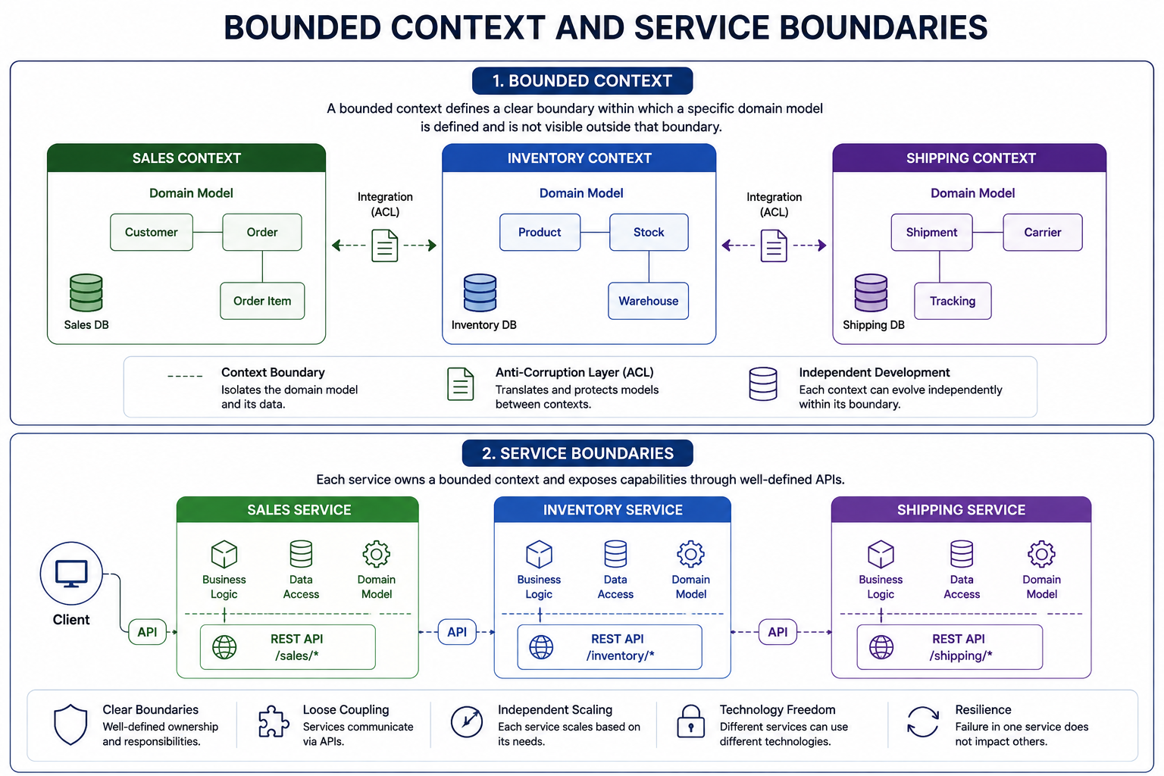
3
© 2026 by Innovation In Software Corporation
Notes:
KEY TALKING POINTS
------------------
- 1. Bounded Context
A bounded context is a boundary inside which a model has one precise meaning.
Sales models Customer, Order, and Order Item.
Inventory models Product, Stock, and Warehouse.
Shipping models Shipment, Carrier, and Tracking.
The same real-world thing, an order, is a sale in one context and a shipment in another.
Neither context should import the other's classes.
Each context also has its own database icon: Sales DB, Inventory DB, and Shipping DB.
That is the data ownership rule drawn as a picture.
- Integration (ACL)
Between the contexts sit dashed arrows and a document icon labelled Integration (ACL).
ACL stands for anti-corruption layer.
When Sales needs stock information, it does not use Inventory's Stock class.
Instead, it translates Inventory's contract into its own terms at the edge.
That translation keeps a change in one model from spreading into another.
In Spring Boot, the ACL is often just a client class plus a mapper.
The mapper converts the other service's response DTO into a local value object.
- 2. Service Boundaries
The bottom half maps each context to a deployable service.
Each box contains business logic, data access, and a domain model.
All of that sits behind one REST API: /sales/*, /inventory/*, and /shipping/*.
The client reaches Sales through an API.
Services reach each other only through the API pills between the boxes.
They never go through each other's data access layer.
The subtitle states the rule plainly.
Each service owns a bounded context and exposes its capabilities through well-defined APIs.
- Benefits strip
The bottom row names five payoffs.
Clear boundaries mean well-defined ownership and responsibilities.
Loose coupling means services communicate through APIs.
Independent scaling means each service scales on its own needs.
Technology freedom means services can differ internally.
Resilience means a failure in one service does not take down the others.
Remind participants that resilience only holds if calls between boxes have timeouts and fallbacks.
The integration slides covered those.
REAL-WORLD EXAMPLES
-------------------
- In a bank, customer means different things to different teams.
To onboarding, it is a profile with contact details and KYC data.
To lending, it is a borrower with income and debt ratio.
To fraud, it is a behavior profile with device history.
Forcing one shared Customer class across all three creates constant cross-team change requests.
- Banks that integrate a core banking platform often place a translation layer between it and newer digital services.
Legacy codes and field names are then converted once at the edge.
They do not leak into every new application.
USE-CASE SCENARIO
-----------------
Translate the diagram to the capstone.
The Account context owns accounts and their PENDING, ACTIVE, FROZEN, CLOSED lifecycle in its own database.
The Transaction context owns transactions and their RECEIVED to SUBMITTED status.
The Risk context owns assessments and dispositions.
Transaction Service's AccountClient is its small anti-corruption layer.
It maps Account Service's response to only what Transaction needs: the account ID and whether it is ACTIVE.
Exercise 1.2 asks participants to draw exactly this.
Account owns accounts only, not transactions and not risk scores.

Slide 5
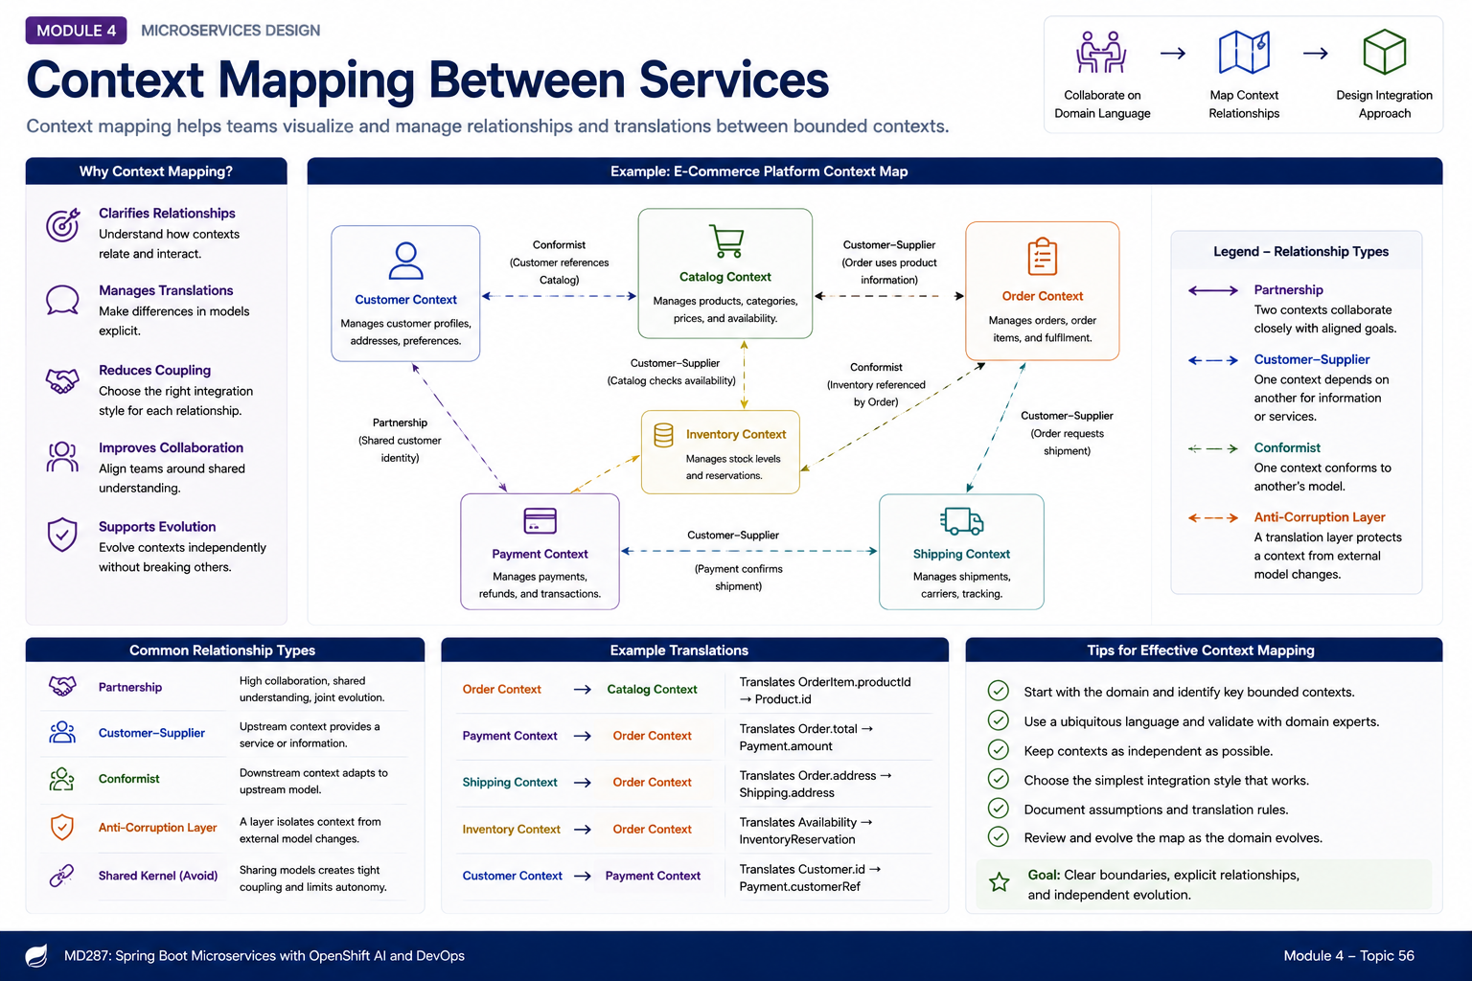
4
© 2026 by Innovation In Software Corporation
Notes:
KEY TALKING POINTS
------------------
- COMMON CONTEXT-MAPPING RELATIONSHIPS
Partnership means two teams move together as equals and coordinate releases.
Customer-supplier means the downstream team is a real customer of the upstream team.
Its needs shape the upstream API.
For example, Transaction Service asks Account Service for a field it needs.
Conformist means the downstream team accepts the upstream model as it is.
That is common with card networks or regulators.
An anticorruption layer is translation code that stops a legacy or vendor model from leaking in.
A shared kernel is a small shared model.
The diagram marks it avoid, so teach it as a last resort.
REAL-WORLD EXAMPLES
-------------------
- Banks with mainframe core systems commonly place an anticorruption layer in front of them.
A modern service exposes clean account JSON.
Behind that, it translates to and from legacy record layouts.
So no new service ever learns the legacy field names or codes.
- Payment teams often act as conformists toward external standards.
Messages exchanged with card networks or ISO 20022 payment schemes must follow those published formats.
So internal services translate at the edge instead of negotiating the model.
USE-CASE SCENARIO
-----------------
In the capstone, Transaction Service is downstream of Account Service in a customer-supplier relationship.
During Lab 2 planning, the transaction team asks for currency in the account response.
They need it to validate transactions.
The account team adds it as a backward-compatible field.
They do not let Transaction Service query account_db.
Later in the week, Risk Assessment Service needs transaction data in the shape its model on OpenShift AI expects.
The risk team does not let the model's feature format leak into Transaction Service.
Instead, it writes a small translation layer that maps transaction data into model inputs.
That is an anticorruption layer.
When the model's inputs change, only that mapper changes.

Slide 6
IDENTIFYING SERVICE BOUNDARIES · SERVICE GRANULARITY AND THE “RIGHT-SIZED” SERVICE
📌
BOUNDARY-DESIGN QUESTIONS
⚠️
WARNING SIGNS OF POOR BOUNDARIES
• What business capability does this service own?
• What data does it own?
• Who owns the service (which team)?
• What APIs does it expose, and what events does it publish or consume?
• How often does it change, and does it need independent scaling?
• Frequent cross-service changes required for a single feature
• Shared database tables between services
• Services that cannot be deployed independently
• Duplicated business rules across services
📌
THE GRANULARITY SPECTRUM
⚖️
SIGNALS FOR RIGHT-SIZING
• Too fine-grained: excessive network calls, chatty integration, high operational overhead
• Right-sized: aligned to a business capability, independently deployable, manageable to own
• Too coarse-grained: a distributed monolith -- separate processes, still tightly coupled
• Team can own, understand, and change the service independently
• Service has a single, cohesive business responsibility
• Data and API boundaries are clean, without leaking internals
KEY TAKEAWAY Six boundary-design questions -- capability, data, ownership, APIs, events, change rate -- turn a vague service idea into a defined one. • Right-sized services balance independent deployability against the operational overhead of running too many tiny services.
5
© 2026 by Innovation In Software Corporation
Notes:
TOPIC 1 OF 2: Identifying Service Boundaries
------------------------------------------
KEY TALKING POINTS
------------------
- BOUNDARY-DESIGN QUESTIONS
Run these as a checklist on any proposed service.
Capability and data come first.
A service that cannot say what it owns is not really a service yet.
Team ownership matters because a service without one owning team decays.
APIs and events form its public face, and everything else stays private.
Change rate and scaling expose hidden splits.
Suppose one part changes weekly and another quarterly.
Or one needs many replicas at month end and the other does not.
Either case argues for separating them.
- WARNING SIGNS OF POOR BOUNDARIES
Each sign is a symptom you can see in real delivery.
If one feature routinely needs pull requests in three services, the boundary cuts through a capability.
Shared tables mean ownership exists only on paper.
Schema changes then need a committee.
If two services must deploy together, you have a distributed monolith.
That means separate services that still behave like one big application.
Duplicated business rules drift apart and give customers inconsistent outcomes.
An example is two services each deciding what makes an account usable.
Ask learners to check their own release history and ticket trails for these patterns.
REAL-WORLD EXAMPLES
-------------------
- A common smell in banking programs is a balance or overdraft rule built into two services.
One is a payments service and the other is an account service.
When the policy changes, only one gets updated.
Customers then see a transfer approved in one channel but declined in another.
- Some teams must book a joint release window for two services every time either one changes.
That shows deployment coupling.
It often surfaces in change-advisory reviews.
There, a supposedly independent service cannot be approved on its own.
USE-CASE SCENARIO
-----------------
Run the boundary questions on Account Service before Lab 1.
Capability: maintain accounts and their status lifecycle.
Data: the accounts table in account_db, managed by Flyway.
API: the /api/v1/accounts contract.
It covers create, read, nickname update, and the activate, freeze, and close actions.
Non-responsibilities: posting transactions and scoring risk.
Later, someone proposes a shortcut.
When a transaction looks risky, Transaction Service would set the account to FROZEN directly in account_db.
The warning signs flag it at once as a shared table plus a duplicated status rule.
The team rejects it.
The freeze goes through Account Service's own freeze endpoint, so status rules live in one place.
TOPIC 2 OF 2: Service Granularity and the “Right-Sized” Service
------------------------------------------
KEY TALKING POINTS
------------------
- THE GRANULARITY SPECTRUM
Present it as a dial with failure at both ends.
Too fine, and a single business request fans out into many network hops.
Each hop adds latency, a failure mode, a pipeline, dashboards, and an on-call rotation.
Too coarse, or split along the wrong lines, and you get separate processes that still share data.
They must also release together.
That is a distributed monolith: all the cost of distribution and none of the independence.
Right-sized sits in the middle.
It covers one business capability and is deployable on its own.
It is also small enough for one team to understand completely.
- SIGNALS FOR RIGHT-SIZING
These are practical tests, not metrics.
First, can the owning team explain the service end to end?
Can it ship a change without waiting for another team?
If so, it passes.
Second, can you state its responsibility in one sentence without stringing unrelated jobs together?
If so, it passes.
Third, do consumers only ever touch its API and events, never its tables or internal classes?
If so, it passes.
Remind the room there is no correct number of lines or endpoints.
The tests are about ownership, cohesion, and clean interfaces.
REAL-WORLD EXAMPLES
-------------------
- Segment, the customer data company, publicly described consolidating many small per-destination microservices back into a single service.
It did this after the operational overhead of running and changing them grew too high.
It is a well-known example of a too fine-grained split being corrected.
- Amazon's two-pizza team idea is a useful sizing heuristic, meaning a rule of thumb.
A service should be small enough for one small team to own it completely.
That includes running it in production.
The team should not need constant coordination with other teams.
USE-CASE SCENARIO
-----------------
During capstone design, one learner proposes splitting Account Service into three services.
They are AccountCreationService, AccountStatusService, and AccountNicknameService.
The group tests the idea against the signals.
All three would share the same account data and rules.
For example, a nickname cannot be updated on a CLOSED account.
So they would have to call each other or share a database.
That is too fine.
Another learner proposes merging Transaction Service and Risk Assessment Service into one TransactionRiskService.
That fails too.
The risk model changes on a different schedule and depends on OpenShift AI.
That is too coarse.
The group settles on the course's three services.
Each owns one capability and is deployable on its own.

Slide 7
DECOMPOSING BY BUSINESS CAPABILITY · DECOMPOSING BY SUBDOMAIN · DECOMPOSING AN EXISTING MONOLITH
📌
CAPABILITY-BASED DECOMPOSITION
📌
SUBDOMAIN-BASED DECOMPOSITION
📌
THE FOUR-STEP DECOMPOSITION PROCESS
• List the business capabilities the organization performs, independent of org chart or technology
• Each capability becomes a candidate service: Customer Management, Account Management, Payments, Lending
• Capabilities are more stable over time than teams, technologies, or database schemas
• Identify core subdomains (competitive advantage) and invest most heavily there
• Identify supporting subdomains and build them with moderate investment
• Identify generic subdomains and prefer buying, reusing, or outsourcing
• Each subdomain typically becomes one or more services with a clear owner
1. Analyze the existing monolith's modules, data, and dependencies
2. Identify natural seams along business capability and data-ownership lines
3. Extract one service incrementally, starting with a low-risk, high-value seam
4. Validate the extraction against real workflows before repeating the process
KEY TAKEAWAY Mapping what the business does -- open accounts, process payments, manage loans -- produces natural, durable service boundaries. • Subdomain-based decomposition complements capability-based decomposition, weighting investment by business differentiation. • Analyze the monolith, identify seams, extract incrementally, and validate at each step -- decomposition is a journey, not an event.
6
© 2026 by Innovation In Software Corporation
Notes:
TOPIC 1 OF 3: Decomposing by Business Capability
------------------------------------------
KEY TALKING POINTS
------------------
- CAPABILITY-BASED DECOMPOSITION
A capability is what the business does, stated as a verb and a noun.
It does not matter who does it or how.
Banks have opened accounts, moved money, and lent money for a very long time.
Meanwhile org charts, database vendors, and programming languages have all changed.
So boundaries anchored to capabilities survive reorganizations and technology refreshes.
The examples on the slide are candidate services, not a final answer.
Some capabilities merge, and some split later.
Encourage learners to write capabilities from the customer's point of view.
They should do this before looking at any existing system.
REAL-WORLD EXAMPLES
-------------------
- The Banking Industry Architecture Network (BIAN) publishes a service landscape.
It catalogues standard banking capabilities.
Many banks use it as a reference when mapping services.
The capability names do not depend on any vendor product or internal team structure.
- In card servicing, think of capabilities like issue card, authorize purchase, dispute transaction, and replace a lost card.
They stay the same whether the bank runs them on a mainframe or on OpenShift.
That stability makes them sound service boundaries during modernization.
USE-CASE SCENARIO
-----------------
Before writing code, the capstone team lists what the risk platform must do for the business.
It must maintain customer accounts and their status.
It must record banking transactions.
It must assess the risk of each transaction.
Each capability becomes a candidate service: Account Service, Transaction Service, and Risk Assessment Service.
Midway through the imaginary project, the bank moves its risk engineers into a new data science organization.
The service boundaries do not have to change at all.
They follow the capability, not the reporting line.
Only the owning-team label on Risk Assessment Service is updated.
That durability is the point of decomposing by capability.
TOPIC 2 OF 3: Decomposing by Subdomain
--------------------------------------
KEY TALKING POINTS
------------------
- SUBDOMAIN-BASED DECOMPOSITION
Capability mapping answers what the pieces are.
Subdomain classification answers how much each piece deserves.
Core subdomains get the strongest engineers, the richest domain modelling, and custom code.
Supporting subdomains get simple, maintainable implementations without gold plating, meaning no extra polish they do not need.
Generic subdomains get products or shared platforms.
Building them adds cost without advantage.
The last bullet matters for boundaries.
A large subdomain such as payments may need several services.
But each must still have one clearly named owning team.
Use both techniques together on the same map.
REAL-WORLD EXAMPLES
-------------------
- A bank typically reuses a notification platform for generic capabilities like email and SMS delivery.
It builds supporting capabilities, like branch appointment booking, simply.
It concentrates custom engineering on core areas such as real-time fraud decisioning.
- Message brokering is a generic concern.
That is why this course uses Red Hat AMQ Streams, a supported Kafka distribution, instead of building a broker.
The business events that flow through it are different.
They are designed in-house because they carry the bank's own domain.
USE-CASE SCENARIO
-----------------
Picture the capstone team planning the week with a fixed budget of engineering hours.
Risk Assessment Service is core.
The bank's differentiation lives in how well it spots risky transactions.
So it earns careful design and model serving on OpenShift AI.
Transaction Service is core or supporting, depending on the bank's strategy.
Account Service is supporting.
It must be correct, audited, and well tested.
But a clean Spring Boot service with Flyway and PostgreSQL is enough.
Identity through Keycloak, messaging through AMQ Streams, and the OpenShift platform are generic.
So nobody builds them.
A stakeholder may ask why the team is not writing its own token server.
This slide is the answer.
TOPIC 3 OF 3: Decomposing an Existing Monolith
------------------------------------------
KEY TALKING POINTS
------------------
- THE FOUR-STEP DECOMPOSITION PROCESS
Step one is discovery.
Look at package structure, which tables each module reads and writes, and call paths.
Static analysis and database access logs help here.
Step two looks for seams.
A seam is a place where a capability already touches a mostly separate set of tables.
Step three picks the first extraction carefully.
It should be valuable enough to matter, low-risk enough to survive mistakes, and measurable afterwards.
Step four proves it worked using real journeys.
Nobody starts the next extraction before that.
Each loop teaches the team something that makes the next one faster.
REAL-WORLD EXAMPLES
-------------------
- Netflix is a well-documented case.
A serious database corruption problem disrupted its DVD shipping business.
After that, it moved from a monolithic data-centre application to cloud-hosted services over several years.
It migrated functionality piece by piece, not in one cutover.
- Banks modernizing statement generation often extract it early.
It reads account and transaction data but rarely writes back.
So it is a lower-risk seam.
Success is also easy to verify.
Compare the statements produced by the old and new paths.
USE-CASE SCENARIO
-----------------
Imagine the bank's current risk checks live inside a monolithic core application.
In step one, the team finds that the transaction-posting module calls a scoring routine directly.
Both work on the same tables.
In step two, they notice a seam.
Scoring reads transaction data but only writes back a score.
In step three, they extract that seam as Risk Assessment Service.
It is the highest-value and most self-contained piece.
In step four, they run it alongside the old routine on synthetic transactions.
They compare the scores before letting it influence any decision.
Only after that comparison holds up do they look for the next seam, perhaps account management.

Slide 8
THE STRANGLER FIG MIGRATION PATTERN · LOOSE COUPLING IN PRACTICE
📌
FOUR-STAGE STRANGLER FIG MIGRATION
✅
WHY IT WORKS
1. Place a routing layer (facade or gateway) in front of the monolith
2. Build new services for individual capabilities alongside the monolith
3. Redirect traffic for each capability to the new service as it becomes ready
4. Retire the corresponding monolith code once the new service fully replaces it
• The monolith keeps serving traffic throughout the migration -- low risk, reversible steps
• Each capability can be migrated, tested, and validated independently
📌
TIGHTLY COUPLED VS. LOOSELY COUPLED
🔗
COMMON COUPLING RISKS TO AVOID
• Tightly coupled: Account Service reads directly from customer_db
• Loosely coupled: Transaction Service calls the Account Service API or consumes account events
• Database coupling -- sharing tables across services
• Deployment coupling -- services that must deploy together
• API contract coupling -- breaking changes ripple across consumers
• Temporal coupling -- one service must be up for another to finish work
KEY TAKEAWAY Route traffic incrementally to new services while the monolith keeps running, avoiding the risk of an all-at-once cutover. • Transaction Service should call Account Service's API, not reach into account_db -- coupling risk hides in shared data, not just shared code.
7
© 2026 by Innovation In Software Corporation
Notes:
TOPIC 1 OF 2: The Strangler Fig Migration Pattern
------------------------------------------
KEY TALKING POINTS
------------------
- FOUR-STAGE STRANGLER FIG MIGRATION
Martin Fowler named the pattern after strangler fig vines.
These vines grow around a host tree until they replace it.
Stage one is the key enabler.
Once every client calls a routing layer, you control where each request goes without changing any client.
Stage two builds the replacement for one capability next to the old code.
Stage three shifts traffic, often gradually.
For example, internal users move first and then customers.
Stage four is the one teams skip: deleting the old code path.
That step is what actually removes cost and risk.
- WHY IT WORKS
The monolith stays live, so customers never face a big-bang weekend cutover.
If the new service misbehaves, the routing rule flips back.
That makes each step reversible and gives change boards a clear rollback plan.
Capabilities move one at a time.
So testing, performance checks, and reconciliation are scoped to that one capability.
Be honest about the trade-off.
For a while the bank runs two paths and must keep their data in sync.
That needs deliberate planning.
REAL-WORLD EXAMPLES
-------------------
- Core banking replacements are sometimes attempted as a single big-bang migration.
These are widely regarded as among the riskiest projects a bank can undertake, because every customer moves at once.
Incremental, capability-by-capability routing is favored precisely to avoid that all-or-nothing exposure.
- An API gateway or an OpenShift Route with path-based routing can front a legacy application.
Requests to one path, such as account lookup, go to a new Spring Boot service.
Every other path still reaches the monolith.
More paths move over later through configuration.
USE-CASE SCENARIO
-----------------
Suppose account lookup and account creation still live inside the bank's monolith.
Stage one: the team places a gateway in front of it, so every client calls the gateway.
Stage two: they build Account Service, exactly as in Lab 1, exposing /api/v1/accounts.
Stage three: they route GET account requests from internal operations users to the new service.
They compare the responses with the monolith.
Then they move all read traffic, and later account creation.
If a mismatch appears, one routing change sends traffic back.
Transaction processing stays on the monolith until Transaction Service is ready.
Stage four: once nothing calls the old account code, the team deletes it.
They record that date in the plan.
TOPIC 2 OF 2: Loose Coupling in Practice
----------------------------------------
KEY TALKING POINTS
------------------
- TIGHTLY COUPLED VS. LOOSELY COUPLED
The tight example is a service reaching past an API into another team's tables.
The moment the owner renames a column, the reader breaks.
Nobody knew the dependency existed.
In the capstone, the same mistake would be Transaction Service querying account_db to check status.
The loose version asks Account Service through GET /api/v1/accounts/{accountId}.
Or it reacts to events the owner publishes.
The owner can then refactor its schema freely, as long as the contract holds.
Both examples on the slide illustrate this one principle.
- COMMON COUPLING RISKS TO AVOID
Database coupling is the strongest form and gets its own slide shortly.
Deployment coupling appears as release trains, where services must ship together.
API contract coupling appears when a provider removes or renames a field and every consumer breaks.
That is why backward-compatible changes and versioning matter.
Temporal coupling means both services must be up at the same moment.
If Account Service is down, a synchronous transaction request fails.
Lab 3 handles that with a timeout, a circuit breaker, and a safe 503 response.
Messaging reduces it where an immediate answer is not needed.
REAL-WORLD EXAMPLES
-------------------
- A payments team that writes directly to account ledger tables to update balances creates hidden coupling.
When the account team migrates the ledger schema, payments fail in production.
Calling a funds-reservation API instead lets the account team own how balances change.
- Notifications are a classic place to remove temporal coupling.
A transfer completes and publishes an event.
The email or push message is sent afterwards.
So an outage at the messaging vendor never blocks money movement.
USE-CASE SCENARIO
-----------------
On Day 2, under time pressure, a developer proposes giving Transaction Service a JDBC connection to account_db.
The goal is to check account status, because it seems faster than an HTTP call.
The team walks through the risks.
A later Flyway migration in Account Service could rename the status column.
That would silently break Transaction Service.
So the team uses the Account Service API.
That fixes database coupling but exposes temporal coupling.
If Account Service is down, transactions cannot be validated.
Lab 3 answers this with a timeout and a circuit breaker.
POST /api/v1/transactions returns 503 ACCOUNT_SERVICE_UNAVAILABLE and publishes no Kafka event.
It never invents an ACTIVE account.
Every coupling type becomes a visible, managed decision.

Slide 9
HIGH COHESION IN PRACTICE · AVOIDING SHARED BUSINESS LOGIC
📌
LOW COHESION VS. HIGH COHESION
✅
WHY IT MATTERS
• Low cohesion: a BankingUtilityService mixing customer lookup, account update, email, reporting, and fraud scoring
• High cohesion: separate Customer, Account, Notification, Reporting, and Fraud Detection services
• Cohesive services are easier to understand, test, own, and evolve
• Business-capability alignment is the most reliable path to high cohesion
📌
THE HIDDEN RISK OF SHARED LOGIC
✅
WHAT CAN SAFELY BE SHARED
• A shared library with domain rules becomes a de facto deployment dependency
• Changing the rule means coordinating releases across every consuming service
• Business rules belong inside the service that owns the corresponding capability
• Generic technical utilities: logging, tracing, HTTP client wrappers
• Not shared: validation rules, pricing logic, eligibility rules, workflow decisions
KEY TAKEAWAY Account Service should own account behavior end to end; a catch-all utility service confuses ownership and slows every change. • A shared library of business rules forces every consuming service to redeploy together -- the opposite of independent deployability.
8
© 2026 by Innovation In Software Corporation
Notes:
TOPIC 1 OF 2: High Cohesion in Practice
---------------------------------------
KEY TALKING POINTS
------------------
- LOW COHESION VS. HIGH COHESION
The BankingUtilityService is the service nobody wants to own.
It has five unrelated jobs, five reasons to change, and five sets of stakeholders.
They all compete for the same release window.
A fraud-scoring tweak can break statement reports.
The high-cohesion version gives each job its own home and a focused team.
Cohesion is the partner of loose coupling.
Coupling is about how services depend on each other.
Cohesion is about whether everything inside one service belongs together.
The capstone's Account Service is cohesive because it handles only account behavior.
- WHY IT MATTERS
A new engineer can understand a cohesive service quickly.
They can test it with a focused suite and know which team to page when it fails.
Changes stay local because related rules live together.
The teach guide offers a quick test.
Would the same business team naturally own all these rules?
If yes, they may belong together.
If not, split them.
Aligning to business capabilities makes that answer obvious far more often.
Aligning to technical layers, such as a generic data service or utility service, does not.
REAL-WORLD EXAMPLES
-------------------
- A common-services module in an enterprise system often grows to include address validation, PDF statement rendering, and fee calculation.
Every fee change then requires regression testing of statements.
That slows the fee changes the business needs quickly.
- Card rewards calculation and card authorization both involve cards.
But they change for different reasons.
Rewards change with marketing campaigns, while authorization changes with fraud and network rules.
Separate cohesive services let a rewards promotion launch without touching the authorization path.
USE-CASE SCENARIO
-----------------
Halfway through Lab 1, a learner suggests adding two things to Account Service.
One is to send an email whenever an account is frozen.
The other is to generate a monthly account report.
The group applies the cohesion test.
Email delivery is a notification capability.
Reporting is its own capability, with different consumers and schedules.
The Lab 1 guide also says not to add Customer or Notification services.
So Account Service stays focused on creating, reading, and updating accounts.
It also handles the activate, freeze, and close actions.
The group notes one option for a fuller platform.
A notification service could react to account events later, without Account Service knowing it exists.
TOPIC 2 OF 2: Avoiding Shared Business Logic
------------------------------------------
KEY TALKING POINTS
------------------
- THE HIDDEN RISK OF SHARED LOGIC
Shared business libraries look like good reuse.
You write the eligibility check once and import it everywhere.
The catch comes when the rule changes.
Every service that imports the jar must upgrade, rebuild, and redeploy.
Until they all do, services disagree about the rule.
That is deployment coupling in disguise.
The better answer is to keep the rule in the owning service.
Others ask through its API or react to its events.
In the capstone, only Account Service decides which status transitions are legal.
- WHAT CAN SAFELY BE SHARED
The dividing line is whether the code encodes business policy.
Some code changes for technical reasons and behaves the same for everyone.
Examples are logging setup, OpenTelemetry tracing configuration, correlation-ID filters, and HTTP client wrappers with sensible timeouts.
A shared library is reasonable for these.
Other code changes for business reasons and belongs to one owner.
Examples are validation rules, fee and pricing formulas, eligibility checks, and workflow decisions.
Even technical libraries should stay small and versioned.
Then each team can upgrade on its own schedule.
REAL-WORLD EXAMPLES
-------------------
- Picture an overdraft-eligibility library imported by mobile, branch, and payments services.
When credit policy changes, some teams upgrade the same day and others weeks later.
Until every service redeploys, the same customer is eligible in one channel and not in another.
- Many platform teams publish a shared Spring Boot starter.
It preconfigures Micrometer metrics, structured logging, and tracing.
That is safe sharing, because it carries no banking rules.
Each service can also adopt a new version independently.
USE-CASE SCENARIO
-----------------
A Transaction Service developer wants to avoid calling Account Service.
So they copy Lab 1's status-transition rules into a shared jar, and both services import it.
The rules include which statuses may take part in money movement.
Weeks later the account team refines the rules and ships Account Service.
But Transaction Service still runs the old jar.
For a while, the two services disagree about whether an account is eligible.
The fix is to delete the shared rules.
Account Service stays the single owner of status logic.
Transaction Service asks it for the account's current status through the API.
The only shared library left adds correlation IDs and logging, which carries no business policy.

Slide 10
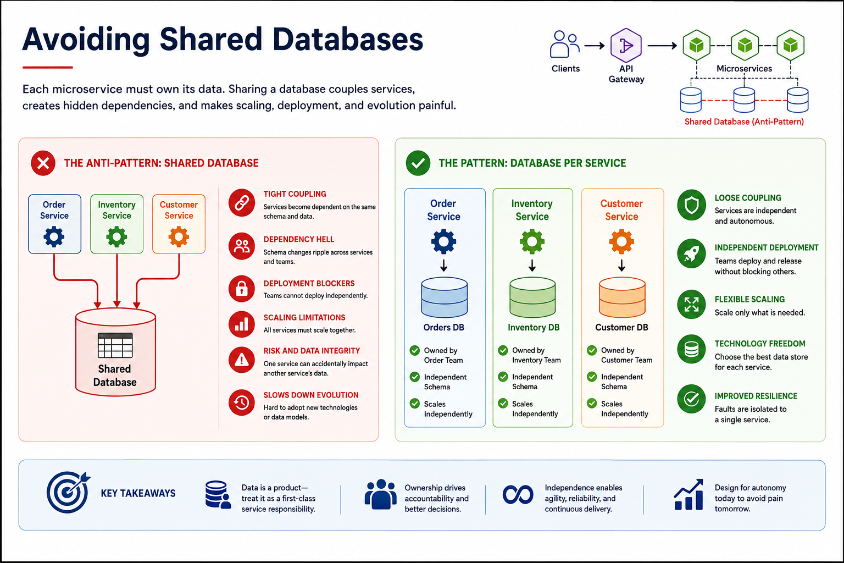
9
© 2026 by Innovation In Software Corporation
Notes:
KEY TALKING POINTS
------------------
- WHY SHARED DATABASES ARE DANGEROUS
When services share tables, the schema becomes a public contract that nobody versions.
Renaming a column for one service can break the others at runtime.
This is often discovered in production.
Scaling and tuning are shared too.
One service's heavy report query can slow another's customer-facing reads.
And no service can move to a different store alone.
Ownership becomes impossible to enforce, because anyone with credentials can write any row.
In a bank that is a serious problem for audit trails and data-integrity controls.
- THE ALTERNATIVE: DATABASE PER SERVICE
Database per service means each service's tables are private.
Only its own code can reach them.
Other services get data through its API when they need an answer now.
They use domain events when they can react later.
In the capstone, only Account Service talks to account_db, and each other service gets its own database.
It feels slower at first, because you build an endpoint instead of writing a join.
Hold the line anyway.
The payoff is independent Flyway schema changes, independent deployment, and clear accountability.
REAL-WORLD EXAMPLES
-------------------
- A long-lived shared customer database that feeds many applications is a classic modernization obstacle.
No column can be changed safely, because nobody knows every reader.
So untangling data ownership often takes longer than rewriting the application code.
- Amazon has described moving away from direct database access between teams.
Each service's data is reachable only through its interface.
So one team's schema change or load spike does not break or slow other teams.
USE-CASE SCENARIO
-----------------
On Day 2, a learner runs all the services locally and notices that account_db is reachable from Transaction Service.
So they point Transaction Service straight at the accounts table to read status.
It works in the demo.
Then the account team ships a Flyway migration that restructures the status column.
Transaction creation starts failing with SQL errors no one on the transaction team understands.
The group replaces the query with a call to the Account Service API.
Later, Risk Assessment Service needs transaction history, and the same rule applies.
It uses Transaction Service's API or events, never its tables.
Databases may share a PostgreSQL server during development.
Even then, each service keeps its own database and credentials.

Slide 11
SERVICE OWNERSHIP AND GOVERNANCE · STATELESS VS. STATEFUL SERVICES
📌
OWNERSHIP RESPONSIBILITIES
🏛️
LIGHTWEIGHT GOVERNANCE
• A single team owns each service's code, data, deployment, and on-call responsibility
• Ownership includes documenting the API contract and its SLAs
• Ownership includes deciding when and how the service evolves
• Enterprise-wide standards: naming, security, versioning, observability
• Governance should enable teams, not create a bottleneck for every decision
📌
STATELESS SERVICES
💾
STATEFUL COMPONENTS
• Do not rely on local, in-memory state from a previous request
• Easier to scale horizontally, restart, and load balance
• State needed for correctness is externalized: database, cache, token
• Most business services are stateful in that they manage persistent data
• The question is where state lives -- not whether it exists
• Stateful components (PostgreSQL, Kafka) need backup and recovery plans; Redis is lecture-only in this course
KEY TAKEAWAY Every service needs a named owning team, a documented contract, and a small set of enterprise-wide standards it must follow. • Stateless services keep no required local memory between requests; stateful components persist data and need extra operational care.
10
© 2026 by Innovation In Software Corporation
Notes:
TOPIC 1 OF 2: Service Ownership and Governance
------------------------------------------
KEY TALKING POINTS
------------------
- OWNERSHIP RESPONSIBILITIES
Ownership means one named team answers for everything about the service.
That covers the code, the database, the pipeline, and the pager when it fails in the middle of the night.
That team also publishes the contract, such as the OpenAPI document Lab 1 exposes through Swagger UI.
It also publishes the service levels consumers can expect.
The owner decides how the API evolves, including deprecation timelines.
Shared ownership across several teams usually means no ownership.
Incidents then stall while people work out whose problem it is.
- LIGHTWEIGHT GOVERNANCE
Governance should standardize the few things that must be consistent across the bank.
First, naming conventions for resources and events.
Second, security, such as JWT validation against Keycloak.
Third, versioning rules like the /api/v1 path segment.
Fourth, observability basics such as Actuator health, Micrometer metrics, and correlation IDs.
Everything else stays with the team, including internal design and library choices within approved limits.
Good governance is automated where possible, through templates and pipeline checks.
It should not be a review board that every change must queue for.
REAL-WORLD EXAMPLES
-------------------
- Amazon's practice is widely cited: the team that builds a service also operates it in production.
That makes reliability a design concern for the developers.
It is not a hand-off to a separate operations group.
- Many large enterprises publish API design guidelines.
They lint OpenAPI specifications automatically in the pipeline.
So naming, error formats, and security schemes are checked on every pull request.
Teams do not wait for a periodic architecture review.
USE-CASE SCENARIO
-----------------
Assign the capstone as if it were a real program.
The Account Service team owns account_db, the OpenAPI contract, and the Actuator health endpoint.
It also owns the decision to add a field that the transaction team requests.
The Transaction Service and Risk Assessment Service teams own theirs in the same way.
Governance stays thin but firm across all three.
Every path starts with /api/v1 and every request carries an X-Correlation-Id header.
JWT scopes such as accounts.read and transactions.write control access.
Health endpoints are always exposed.
Suppose Transaction Service starts returning 503 because Account Service is down.
Nobody debates who responds.
The Account Service owners are paged, and the correlation ID links the logs across both services.
TOPIC 2 OF 2: Stateless vs. Stateful Services
------------------------------------------
KEY TALKING POINTS
------------------
- STATELESS SERVICES
Stateless describes the service instance, not the business.
An Account Service pod keeps no memory of earlier requests that it needs for correctness.
So OpenShift can run several replicas and replace one during a rolling update.
It can route the next call to any pod.
A request gets what it needs from the request itself, such as the JWT and path parameters.
Or it gets it from an external store such as PostgreSQL.
That is why stateless pods scale horizontally, by adding more copies, and recover simply by restarting.
- STATEFUL COMPONENTS
Almost every banking service is stateful in the business sense: accounts and transactions must persist.
The design question is where that state lives.
Put it in components built for durability.
Use PostgreSQL for records and Kafka through AMQ Streams for event streams.
Give those components backups, restore testing, replication, and monitoring.
Redis appears in the source material as an example of an external cache.
But it is lecture-only here, and the labs do not install it.
The working rule: stateless application pods, stateful data platforms.
REAL-WORLD EXAMPLES
-------------------
- Kubernetes and OpenShift treat Deployments as interchangeable replicas that can be rescheduled at any time.
Databases usually run as StatefulSets with persistent volumes, or as managed services.
This mirrors the split between stateless applications and stateful data.
- Web banking sessions once lived in application-server memory with sticky load balancing.
They are now commonly replaced by token-based authentication.
So a customer is not logged out when the node serving them is patched or restarted.
USE-CASE SCENARIO
-----------------
Later in the week, the capstone services are deployed to OpenShift.
The team scales Account Service to more than one replica and starts a rolling update during a demo.
Requests keep succeeding.
Every pod reads accounts from PostgreSQL and validates the caller's token itself.
Then a learner admits adding a static map to cache the last account each user viewed.
That map differs on every pod and disappears on restart, so it has to go.
The team also lists what cannot simply be redeployed from an image.
That means the PostgreSQL databases and the Kafka cluster run by AMQ Streams.
Those get persistent storage, backups, and monitoring.
The three Spring Boot pods stay disposable.

Slide 12
DESIGNING STATELESS MICROSERVICES · MANAGING STATE IN DISTRIBUTED APPLICATIONS
📌
DESIGNING FOR STATELESSNESS
⚠️
COMMON MISTAKES
• Client sends request with token -> service validates token -> service reads required data from database/cache -> service returns response
• Use tokens for authentication context, not server-side session memory
• Store cache data in an external, shared cache when state must be shared
• Keeping user sessions only in memory
• Storing workflow state in local variables across requests
• Assuming requests always reach the same service instance
📌
GOOD VS. RISKY STATEFUL DESIGN
✅
OPERATIONAL REQUIREMENTS FOR STATE
• Good: Account Service pod -> Account database (survives pod restart)
• Risky: Account Service pod stores pending transactions only in memory (lost on failure)
• Backup and recovery plans for every stateful dependency
• Monitoring for PostgreSQL, Kafka, and the three Spring Boot services
• Treat caches carefully -- cached state can become stale
KEY TAKEAWAY Any pod can serve any request when authentication uses tokens and persistent data lives in an external store, not local memory. • A pod storing pending transactions only in memory loses that data the moment it fails -- durable state needs a durable home.
11
© 2026 by Innovation In Software Corporation
Notes:
TOPIC 1 OF 2: Designing Stateless Microservices
------------------------------------------
KEY TALKING POINTS
------------------
- DESIGNING FOR STATELESSNESS
Walk the flow as four hops, with nothing remembered between requests.
The token carries who the caller is and which scopes they hold.
In this course it is a JWT from Keycloak or the client's identity provider.
So the service validates the token on every call instead of looking up a session.
Everything else comes from durable storage.
Several instances may truly need shared transient data.
If so, it goes in an external cache, not in each pod's memory.
Lab 3 applies this when Transaction Service relays the caller's JWT to Account Service.
- COMMON MISTAKES
Each mistake works perfectly on a laptop running one instance.
That is why they slip through.
In-memory sessions log users out when a pod restarts or a request lands on another replica.
Workflow state held in fields or static maps, such as a half-finished transfer, vanishes on redeploy.
It also differs between replicas.
Assuming the same instance breaks as soon as OpenShift scales out or runs a rolling update.
The fix is always the same.
State lives in the request, the token, or an external store.
REAL-WORLD EXAMPLES
-------------------
- Teams moving Java web applications from a single application server into containers often hit session loss.
Users are logged out during rolling deployments.
This goes on until sessions are replaced with tokens or moved to an external session store.
- Multi-step loan applications typically save each step's progress in a database keyed by application ID.
A customer can then start on a phone and finish on a laptop.
They can reach any server instance without losing answers.
USE-CASE SCENARIO
-----------------
A learner wants to reduce calls to Account Service.
So they add an in-memory map to Transaction Service that remembers each account's status from the last lookup.
Two Transaction Service replicas are running.
A teller freezes an account through Account Service.
One pod has never cached that account and correctly rejects the next transaction.
The other still remembers ACTIVE and lets a transaction through.
The same customer gets different answers depending on which pod the router chose.
The team removes the map.
Transaction Service asks Account Service each time, protected by Lab 3's timeout and circuit breaker.
If caching is ever needed, it will be an external cache with an explicit staleness limit.
TOPIC 2 OF 2: Managing State in Distributed Applications
------------------------------------------
KEY TALKING POINTS
------------------
- GOOD VS. RISKY STATEFUL DESIGN
The good arrow is deliberately boring.
The pod writes to PostgreSQL.
When OpenShift restarts the pod, the new one reads the same rows.
The risky version keeps pending transactions in a Java collection inside the pod.
A crash, an out-of-memory kill, or a routine rolling deployment silently erases customer money movements.
With several replicas, each pod also holds a different partial list.
In banking this is not a performance bug.
It is a data-loss incident with audit and customer consequences.
- OPERATIONAL REQUIREMENTS FOR STATE
Moving state out of pods concentrates responsibility in the data layer.
PostgreSQL needs backups and, just as important, tested restores.
Kafka needs persistent storage and replication so events survive a broker failure.
Monitoring must cover both the stateful platforms and the three Spring Boot services.
Use Actuator health and Micrometer metrics for that.
Caches need caution.
A cached account status can still say ACTIVE after the account was frozen.
Decide explicitly how stale a value may be.
Never treat a cache as the source of truth.
REAL-WORLD EXAMPLES
-------------------
- Card authorization systems are designed to record each authorization decision durably.
Suppose that record lived only in memory and was lost in a failure.
Then the bank could not match the hold on a customer's funds to the later settlement.
- Auditors and regulators in banking expect evidence that backups can actually be restored.
That is why institutions commonly run restore tests.
They do not only check that backup jobs completed successfully.
USE-CASE SCENARIO
-----------------
Picture an OpenShift deployment later in the week.
Suppose Transaction Service accepts a transaction and holds it in memory while it waits for a risk score before saving it.
A rolling update restarts the pod at that moment.
The customer was told the transaction was accepted, yet no record exists anywhere.
The team redesigns it.
Transaction Service first saves the transaction in its own PostgreSQL database with a pending status.
Then it publishes an event to Kafka, and scoring happens afterwards.
A restart is now harmless, because the record and the event are both durable.
The team also adds monitoring for the database and for Kafka consumer lag.
That way a stalled scoring pipeline is noticed quickly.

Slide 13
SYNCHRONOUS VS. ASYNCHRONOUS COMMUNICATION · CHOOSING A SERVICE COMMUNICATION STRATEGY
📌
SYNCHRONOUS REQUEST-RESPONSE
⚡
ASYNCHRONOUS MESSAGING
📌
DECISION FACTORS
• One service calls another and waits for a response
• Simple, testable, gives an immediate answer
• Creates runtime dependency: latency, timeouts, cascading failures
• A service publishes an event and does not wait for consumers
• Supports loose coupling, multiple consumers, and background processing
• Introduces eventual consistency and duplicate-message handling
• Does the caller need an immediate answer, or can it react later?
• How many consumers need to know about this event?
• Can the workflow tolerate eventual consistency?
• How critical is decoupling the producer from consumer availability?
KEY TAKEAWAY Choosing sync or async is a tradeoff between immediacy and coupling -- the right choice depends on what the business need actually is. • Immediate, user-facing answers favor REST; background reactions and fan-out favor messaging -- most systems need both.
12
© 2026 by Innovation In Software Corporation
Notes:
TOPIC 1 OF 2: Synchronous vs. Asynchronous Communication
------------------------------------------
KEY TALKING POINTS
------------------
- SYNCHRONOUS REQUEST-RESPONSE
The caller sends a request and waits until the other service answers.
This waiting is called blocking.
That is why it feels natural.
It reads like a method call.
You can test it with a single HTTP request.
It also gives a clear yes or no right away.
The cost is a runtime dependency.
The caller only succeeds if the other service is up and fast at that moment.
If Account Service takes five seconds, Transaction Service takes at least five seconds.
If Account Service is down, the failure travels back to the customer.
Only timeouts and fallbacks can stop it.
- ASYNCHRONOUS MESSAGING
The producer writes an event to a broker such as Kafka and moves on.
It does not wait for anyone to process it.
Any number of consumers can subscribe later.
A consumer that is down simply catches up when it restarts.
That gives you loose coupling, fan-out, and background processing.
Fan-out means one event reaches many consumers.
The price is eventual consistency.
For a short time, different services disagree about the state.
Brokers also deliver at least once.
So a consumer may see the same event twice, and it must handle that safely.
REAL-WORLD EXAMPLES
-------------------
- Card authorisation at a point-of-sale terminal has to be synchronous.
The merchant cannot hand over the goods until the issuer answers.
The answer, approve or decline, must arrive within the terminal's timeout window.
- After a deposit posts, a bank usually publishes an event.
Downstream systems consume it on their own schedule.
Examples are statement generation, customer alerts, and analytics.
None of them need to hold up the deposit confirmation.
USE-CASE SCENARIO
-----------------
In Lab 2, Transaction Service receives POST /api/v1/transactions.
Before it saves anything, it calls Account Service on port 8081 and waits.
This call is synchronous.
The service cannot accept a transaction against a FROZEN or CLOSED account, so the immediate answer matters.
Once the row is stored as RECEIVED, it publishes TransactionSubmitted to the transactions.submitted topic.
It then returns 201 without waiting.
On Day 5, Risk Assessment Service consumes that event in its own consumer group.
It scores the event later.
One request uses both styles, each where it fits.
TOPIC 2 OF 2: Choosing a Service Communication Strategy
------------------------------------------
KEY TALKING POINTS
------------------
- DECISION FACTORS
Walk the four questions in order.
First, can the caller continue without the answer?
If not, use a synchronous call.
An account status check before accepting money movement is an example.
Second, do several teams need to know something happened?
If so, messaging saves the producer from calling each one.
Third, would a few seconds of disagreement between services break a business rule?
If so, be careful with async.
Fourth, must the producer keep accepting work while downstream systems are down or being deployed?
Then decoupling through a broker becomes the deciding factor.
Answer the questions for each interaction, not once for the whole system.
REAL-WORLD EXAMPLES
-------------------
- A balance inquiry in a mobile app needs an immediate answer.
It also has one consumer.
So a synchronous REST call is the obvious choice.
A large-transaction alert may need to reach fraud, compliance reporting, and customer notification.
That suggests an event.
- Loan application intake often confirms receipt synchronously.
It then runs credit checks and document verification asynchronously.
The reason is that underwriting can take much longer than a user will wait on a screen.
USE-CASE SCENARIO
-----------------
Put the capstone through the four questions.
Does Transaction Service need to know right now whether account ACC-123 is ACTIVE?
Yes, so it makes a REST call.
How many services care that a transaction was submitted?
Today, Transaction Service's own consumer updates the status.
On Day 5, Risk Assessment Service also reacts.
That is fan-out, and it points to Kafka.
Can risk scoring be eventually consistent?
Yes.
The customer gets RECEIVED right away, and a HOLD disposition can follow.
Should Transaction Service keep accepting requests while Risk Assessment is being redeployed?
Yes.
So the event path is the right one.

Slide 14
API-BASED INTEGRATION · MESSAGING-BASED INTEGRATION
📌
HOW API COMMUNICATION WORKS
🛡️
REQUIRED SAFEGUARDS
• Transaction Service calls GET /accounts/5001 and waits for the response
• Widely supported, easy to test, compatible with REST and HTTP status codes
• Timeouts, retries on safe operations only, and circuit breakers
• Correlation IDs, authentication, and authorization on every call
• Avoid long synchronous call chains across many services
📌
HOW MESSAGING COMMUNICATION WORKS
⚠️
CONSUMER DESIGN REQUIREMENTS
• Producer publishes a message or event through a broker
• Producer does not need to know when or whether each consumer processes it
• Events are named in past tense: CustomerCreated, PaymentFailed
• Consumers must be idempotent and tolerant of duplicate messages
• Use dead-letter queues for repeated processing failures
• Monitor broker health and message backlog
KEY TAKEAWAY Transaction Service calling Account Service's API is easy to build and test, but both services must be healthy at the same time. • Account Service publishes AccountOpened without knowing who is listening -- Notification, Reporting, and Fraud services react independently.
13
© 2026 by Innovation In Software Corporation
Notes:
TOPIC 1 OF 2: API-Based Integration
-----------------------------------
KEY TALKING POINTS
------------------
- HOW API COMMUNICATION WORKS
Transaction Service needs to know whether an account exists and is active.
So it sends a GET and waits for the JSON reply.
This is the most familiar integration style.
Every language has an HTTP client.
You can test it with curl or Swagger UI.
HTTP status codes already say found, not found, or forbidden.
In Spring Boot 3, this is usually a RestClient or WebClient call.
The lab uses RestClient with a base URL from configuration.
The account path sits under /api/v1/accounts.
- REQUIRED SAFEGUARDS
Each bullet answers a specific failure.
A timeout stops a slow dependency from tying up your threads.
Retries are safe on GET.
But retrying a POST that moves money can duplicate it.
To prevent that, the POST needs an idempotency key, a unique ID that marks repeats.
A circuit breaker stops hammering a service that is clearly down.
It fails fast instead.
A correlation ID lets you follow one request across both services' logs.
Authentication and authorization apply to service-to-service calls too, not just to users.
Finally, every extra synchronous hop multiplies the ways a request can fail.
REAL-WORLD EXAMPLES
-------------------
- Netflix open-sourced Hystrix, a latency and fault-tolerance library built around circuit breakers.
It did so after dealing with dependency failures in its service landscape.
Hystrix is now in maintenance mode.
Resilience4j is a commonly used successor in the Java ecosystem.
- Suppose a payment API retries a timed-out POST without an idempotency key.
It risks charging a customer twice.
That is why many payment providers accept an Idempotency-Key header.
On a repeat, they return the original result.
USE-CASE SCENARIO
-----------------
Lab 2 builds exactly this call.
Transaction Service's AccountClient calls Account Service.
It already has a 2 second connect timeout and a 3 second read timeout configured.
It carries X-Correlation-Id, so both services log the same ID.
On Day 3, Lab 3 wraps that call in a Resilience4j circuit breaker.
It also adds JWT security.
When Account Service is stopped, Transaction Service returns 503 ACCOUNT_SERVICE_UNAVAILABLE.
It does not publish an event.
It never approves money movement just because the check could not run.
TOPIC 2 OF 2: Messaging-Based Integration
-----------------------------------------
KEY TALKING POINTS
------------------
- HOW MESSAGING COMMUNICATION WORKS
The producer hands a message to a broker, such as Kafka on Red Hat AMQ Streams.
Then its job is done.
It does not call the notification service or the reporting service.
Each of those subscribes on its own.
Past-tense names matter.
An event records a business fact that already happened, such as AccountOpened.
It is not a request for someone to do something.
Consumers decide what that fact means to them.
The producer does not even know they exist.
So adding a new consumer needs no change to the producer.
- CONSUMER DESIGN REQUIREMENTS
Brokers usually guarantee at least once delivery.
So the same event can arrive twice after a retry or a rebalance.
An idempotent consumer is one that handles repeats safely.
It records the event IDs it has processed and skips repeats.
Some messages fail every time, perhaps because the payload is malformed.
Move those to a dead-letter topic, a side topic for failed messages.
That way they do not block everything behind them.
Finally, messaging hides problems.
If a consumer stops, nothing errors on the producer side.
Watching consumer lag and broker health is how you find out.
REAL-WORLD EXAMPLES
-------------------
- Picture a new checking account being opened.
One AccountOpened event can trigger a welcome email and a first-statement schedule.
It can also add an entry in the customer analytics platform.
Each team owns its own consumer.
- Card fraud platforms commonly consume a stream of authorisation events.
They use them to update behavioral profiles.
If that consumer falls behind, authorisations still succeed.
But the profiles go stale.
That is why consumer lag is a monitored metric.
USE-CASE SCENARIO
-----------------
In Lab 2, Transaction Service publishes TransactionSubmitted inside an envelope.
The envelope holds eventType, eventVersion, eventId, correlationId, occurredAt, and payload.
Its consumer ignores an eventId it has already processed.
A deliberately bad message lands on transactions.submitted.DLT.
Participants inspect it with the Kafka console consumer.
On Day 5, Risk Assessment Service subscribes with its own consumer group, risk-assessment-service.
So it receives its own copy of every event.
Transaction Service code does not change at all to gain that new consumer.

Slide 15
HYBRID INTEGRATION MODELS · SERVICE DEPENDENCIES AND DEPENDENCY GRAPHS
📌
COMMON HYBRID PATTERNS
✅
DESIGN GUIDELINES
📌
WHY DEPENDENCY GRAPHS MATTER
• Sync request + async event: handle the request synchronously, then publish an event
• Async command + sync query: send a command asynchronously, query status synchronously
• Event notification + sync lookup: notify via events, fetch full details via API when needed
• Async processing + sync callback: process long-running work async, callback or poll for the result
• Use synchronous calls for short, user-facing interactions
• Use asynchronous messaging for decoupled, long-running, or fan-out work
• Propagate correlation IDs across both sync and async paths
• Visualizing call chains reveals services with too many downstream dependencies
• Highlights single points of failure that many services depend on
• Helps teams reason about blast radius before making a change
KEY TAKEAWAY Handle a request synchronously, then publish an event; or send a command asynchronously and query its status synchronously later. • A dependency graph shows which services call which, exposing long chains, single points of failure, and unexpected coupling.
14
© 2026 by Innovation In Software Corporation
Notes:
TOPIC 1 OF 2: Hybrid Integration Models
---------------------------------------
KEY TALKING POINTS
------------------
- COMMON HYBRID PATTERNS
Each pattern pairs a style with the part of the workflow it suits.
Sync request plus async event: answer the user, then tell everyone else.
Async command plus sync query: accept a job, then let the client check its status through GET.
Event notification plus sync lookup: keep events small, carrying just an ID.
Interested consumers then fetch full details from the owner's API.
Async processing plus callback or poll: use this for work that takes minutes.
Return an acknowledgment such as 202 Accepted, and deliver the result later.
- DESIGN GUIDELINES
The first two bullets restate the choice rule.
Keep user-facing interactions short and synchronous.
Push anything slow, fan-out, or decoupled onto messaging.
The third bullet is the one teams forget.
A correlation ID must travel from the HTTP header into the event envelope.
From there it goes on into the consumer's logs.
Otherwise the trail stops at the broker.
Then nobody can tie a delayed risk decision back to the original customer request.
REAL-WORLD EXAMPLES
-------------------
- Wire transfer submission in online banking usually confirms right away that the request was received.
It then runs sanctions screening and release asynchronously.
The customer checks status on a transfers page.
That is an async command with a sync query.
- Many webhook-based payment platforms send a small event saying a payment changed.
They expect the merchant to call back to the API for the authoritative details.
That is event notification plus sync lookup.
USE-CASE SCENARIO
-----------------
The capstone is already a hybrid.
A client posts a transaction.
Transaction Service validates the account synchronously and saves it as RECEIVED.
It returns 201 and publishes TransactionSubmitted.
That is sync request plus async event.
Moments later, the client calls GET /api/v1/transactions/{id} and sees SUBMITTED.
On Day 5, an operations user queries GET /api/v1/assessments/{transactionId} on Risk Assessment Service.
That shows the async risk result.
The X-Correlation-Id sent at the start appears in the logs of all three services.
TOPIC 2 OF 2: Service Dependencies and Dependency Graphs
------------------------------------------
KEY TALKING POINTS
------------------
- WHY DEPENDENCY GRAPHS MATTER
Picture a service with arrows to eight others.
It is fragile, because any of those eight can slow it or break it.
Now picture a service that everything points to, such as an identity or customer lookup.
It is a single point of failure, and its outage takes down many journeys.
Before you change or redeploy a service, the graph answers two questions.
Who calls me?
What breaks if I am slow?
That is the blast radius, meaning how far the damage spreads.
In practice, these graphs come from architecture diagrams.
In production, they come from distributed traces through OpenTelemetry.
Traces show real call paths rather than intended ones.
REAL-WORLD EXAMPLES
-------------------
- Distributed tracing tools built on OpenTelemetry can generate service maps from live traffic.
Teams often discover a call they did not know existed.
One example is a reporting job calling a customer-facing API at month end.
- In many banks, a central customer or entitlements lookup sits behind most digital journeys.
Mapping dependencies makes clear why that one service needs stricter availability targets.
It also needs more capacity planning than a statement archive.
USE-CASE SCENARIO
-----------------
Draw the capstone graph on the whiteboard.
Transaction Service has a synchronous edge to Account Service and an async edge to Kafka.
Risk Assessment Service has an async edge from Kafka.
It also has a synchronous edge to the OpenShift AI model endpoint.
Now ask what happens if Account Service is down.
New transactions get 503, but existing risk assessments still work.
What if the model endpoint is slow?
Risk Assessment uses its safe fallback, and transaction intake is unaffected.
The graph shows that the synchronous edges are where outages spread.

Slide 16
PREVENTING EXCESSIVE SERVICE CHAINING · API COMPOSITION PATTERN · BACKEND-FOR-FRONTEND PATTERN
📌
WHY CHAINING IS RISKY
✅
WAYS TO REDUCE CHAINING
• A -> B -> C -> D means A's response time depends on every downstream service
• A single slow or failing service in the chain can cascade failure upstream
• Use API composition or a BFF to flatten fan-out calls
• Replace synchronous chains with events where immediacy is not required
• Set aggressive timeouts and circuit breakers on every hop
📌
HOW API COMPOSITION WORKS
📌
WHY USE A BFF
• A composition layer calls multiple services (often in parallel) and merges the results
• The client makes one call instead of orchestrating several
• Useful for read-heavy views that combine data from many owning services
• Each client type gets an API shaped for its own needs, not a lowest-common-denominator contract
• Reduces over-fetching and under-fetching for constrained clients like mobile
• Isolates client-specific logic away from core domain services
KEY TAKEAWAY Each synchronous hop in a chain adds latency and a new way for the whole request to fail -- shorten chains or break them with async patterns. • A composer service calls several downstream services in parallel and merges their results into a single client-facing response. • Mobile, web, and partner clients often need different shapes of the same data -- a BFF per client type keeps each API simple and fit for purpose.
15
© 2026 by Innovation In Software Corporation
Notes:
TOPIC 1 OF 3: Preventing Excessive Service Chaining
------------------------------------------
KEY TALKING POINTS
------------------
- WHY CHAINING IS RISKY
Latency adds up along a chain, and availability multiplies.
Say each of four services is sometimes slow.
The chance that at least one is slow on a given request is higher than for any single one.
It gets worse.
While D is slow, C holds a thread waiting on it.
B holds a thread waiting on C, and A holds one waiting on B. So a single slow service can use up thread pools all the way up.
That is a cascading failure.
It often starts with a dependency nobody considered critical.
- WAYS TO REDUCE CHAINING
There are three tools.
First, flatten the chain.
Instead of A calling B which calls C, a composition layer or BFF calls B and C in parallel.
Depth becomes breadth.
Second, break the chain with events.
Do this when the downstream step does not need to finish before you respond, such as notifications or audit.
Third, some synchronous hops must stay.
Give each one a tight timeout and a circuit breaker.
Then it fails fast and predictably instead of hanging.
Aggressive here means a timeout sized to the caller's own deadline, not a default.
REAL-WORLD EXAMPLES
-------------------
- Picture a mobile account overview that calls a profile service.
That service calls accounts, which calls a card service, which calls rewards.
The whole overview becomes slow whenever rewards is slow.
Many teams move rewards to a separately loaded panel or an async-updated read model.
- Retail banking transfer flows often confirm the transfer after validating funds.
They then emit events for notifications and audit.
They do not wait for the email service to respond before telling the customer it worked.
USE-CASE SCENARIO
-----------------
Imagine a well-meaning change.
Account Service starts calling a new Customer Profile Service to check KYC status on every GET.
That service in turn calls a sanctions list service.
Now Transaction Service's account check is three hops deep.
Its 3 second read timeout starts firing whenever sanctions lookups slow down.
The fix in design review is to keep Account Service's check local.
The profile team publishes a KYC status event, and Account Service stores it.
That way the chain stays one hop.
TOPIC 2 OF 3: API Composition Pattern
-------------------------------------
KEY TALKING POINTS
------------------
- HOW API COMPOSITION WORKS
A composer receives one request.
It fires calls at the same time to, say, accounts, recent transactions, and risk flags.
It waits for all of them or for a deadline.
Then it stitches together a single response.
The calls run in parallel, so total latency is closer to the slowest call than to the sum.
The client stays simple.
It does not need to know which service owns which field.
Composition works best for reads.
For writes that span services, it does not give you a transaction.
Sagas, a series of local steps with undo actions, are the tool for that.
The composer also needs a plan for a partial result when one call fails.
REAL-WORLD EXAMPLES
-------------------
- Think of a banking home screen that shows balances, recent card activity, and a pending loan application.
It is commonly served by a composition endpoint.
That endpoint queries account, card, and lending services in parallel.
- A customer 360 view for a branch teller or contact center is a classic composition case.
It has one screen and many owning systems.
The data is mostly read.
The screen must show partial information if one backend is unavailable.
USE-CASE SCENARIO
-----------------
An operations analyst wants one screen for a flagged transaction.
It shows account status from Account Service and transaction details from Transaction Service.
It also shows the risk disposition from Risk Assessment Service.
The UI could call three services with three tokens and three error formats.
Instead, a small composer calls all three in parallel, each with its own timeout.
Suppose Risk Assessment is slow.
The composer returns the account and transaction data with the risk section marked unavailable.
It does not fail the whole page.
TOPIC 3 OF 3: Backend-for-Frontend Pattern
------------------------------------------
KEY TALKING POINTS
------------------
- WHY USE A BFF
A web dashboard might want a full transaction history table.
A phone widget needs just three fields over a slow network.
One generic API has two bad options.
It sends the phone too much, which is over-fetching.
Or it makes the phone call several times, which is under-fetching.
A BFF owned by the mobile team builds exactly the payload the app needs.
It also keeps things like screen-specific formatting or app version quirks out of Account Service.
Account Service should stay focused on accounts.
The usual risk is a BFF that grows business rules.
So keep domain logic in the domain services.
REAL-WORLD EXAMPLES
-------------------
- The Backend for Frontends name is widely linked to SoundCloud.
Engineers there described giving client teams their own API layer.
Sam Newman has also written about the pattern in detail.
- Banks commonly expose different APIs to their own mobile apps and to third-party aggregators or open-banking partners.
Partners need a stable, standards-shaped contract.
The app, by contrast, changes with every release.
USE-CASE SCENARIO
-----------------
Suppose the capstone gets two front ends.
One is an internal operations console for reviewing HOLD dispositions.
The other is a lightweight mobile alert for customers.
The console BFF combines transaction details with the full risk explanation for a reviewer.
The mobile BFF returns only amount, merchant, and a short status message.
It never exposes model scores.
Account, Transaction, and Risk Assessment Services each keep one clean contract.
Each front-end team changes its own BFF without asking the core teams for new endpoints.

Slide 17
API GATEWAY PATTERN · SERVICE DISCOVERY CONCEPTS · CENTRALIZED VS. DECENTRALIZED ORCHESTRATION
📌
WHAT AN API GATEWAY PROVIDES
📌
WHY SERVICE DISCOVERY MATTERS
• A single entry point for client traffic into the microservices landscape
• Routing to the correct backend service based on the request
• Cross-cutting concerns: authentication, rate limiting, request/response policies
• Service instances scale up, scale down, and restart with new network addresses
• A discovery mechanism (registry, DNS, or platform-native discovery) tracks healthy instances
• Callers resolve a logical service name instead of a hard-coded IP address
📌
CENTRALIZED COORDINATION
🌐
DECENTRALIZED COORDINATION
• One coordinator service directs each step of a multi-service workflow
• Easier to visualize, monitor, and reason about the overall flow
• Each service reacts to events and decides its own next step
• More resilient to a single coordinator failing, but harder to trace end to end
KEY TAKEAWAY Centralizing routing, authentication, and policy enforcement at the edge keeps individual services simpler and more consistent. • In a dynamic, containerized environment, service instances come and go -- discovery keeps callers pointed at healthy, current instances. • A central orchestrator gives visibility and control; decentralized coordination avoids a single point of control but is harder to trace.
16
© 2026 by Innovation In Software Corporation
Notes:
TOPIC 1 OF 3: API Gateway Pattern
---------------------------------
KEY TALKING POINTS
------------------
- WHAT AN API GATEWAY PROVIDES
External clients should not need to know that accounts live in one service and transactions in another.
They should not have to call a dozen hostnames.
The gateway presents one address.
It routes each request by path or header to the right backend.
Every request passes through it.
So it is the natural place to validate tokens and enforce rate limits.
It can also terminate TLS, log requests, and apply policies such as maximum payload size.
Services still enforce authorization on their own data.
But they no longer each rebuild throttling and edge security in slightly different ways.
REAL-WORLD EXAMPLES
-------------------
- Netflix open-sourced Zuul, its edge gateway.
Zuul handled routing and filtering for traffic entering Netflix's microservices.
Today, Spring Cloud Gateway is a common choice in the Spring ecosystem.
- Banks that publish open-banking or partner APIs usually put them behind an API management gateway.
The gateway issues credentials, enforces per-partner rate limits, and records usage.
The banks do not expose internal services directly.
USE-CASE SCENARIO
-----------------
In the labs, clients call Account Service on 8081 and Transaction Service on 8082 directly, with no gateway.
On OpenShift, each service gets its own Route.
A production version of the risk platform would put a gateway in front.
Requests to /api/v1/accounts go to Account Service.
Requests to /api/v1/transactions go to Transaction Service.
Requests to /api/v1/assessments go to Risk Assessment Service.
The gateway validates the JWT from Keycloak and throttles a misbehaving partner.
Each service still checks roles, such as who may review a HOLD.
TOPIC 2 OF 3: Service Discovery Concepts
----------------------------------------
KEY TALKING POINTS
------------------
- WHY SERVICE DISCOVERY MATTERS
On OpenShift, a pod gets a new IP every time it is rescheduled.
Scaling also adds and removes pods all day.
So a hard-coded address breaks the first time a pod restarts.
Discovery separates the logical name from the physical instances.
Older Spring stacks used a registry such as Eureka, where each instance registered itself.
Kubernetes and OpenShift work differently.
A Service object gives a stable DNS name and load-balances across ready pods.
Readiness probes, which check whether a pod can take traffic, decide which pods receive it.
That is platform-native discovery, and it is what this course uses.
REAL-WORLD EXAMPLES
-------------------
- Netflix built and open-sourced Eureka as a service registry for its AWS-hosted services.
Eureka became a common part of Spring Cloud Netflix setups.
That was before platform-native discovery was widespread.
- In Kubernetes and OpenShift, take a Service named account-service in the same project.
It is reachable at that name through cluster DNS.
So a Spring Boot application can use it as a base URL with no registry library.
USE-CASE SCENARIO
-----------------
Locally in Lab 2, Transaction Service reaches Account Service at http://localhost:8081 through the md287.account-service.base-url property.
On OpenShift in Lab 4, the same property points at the account-service Service name instead.
Say Account Service scales to three pods, or one pod is replaced during a rollout.
Transaction Service's configuration does not change.
Only pods that pass the Actuator readiness check receive calls.
The change from localhost to a service name is configuration, not code.
That is the point.
TOPIC 3 OF 3: Centralized vs. Decentralized Orchestration
------------------------------------------
KEY TALKING POINTS
------------------
- CENTRALIZED COORDINATION
One component owns the workflow definition.
For example: do step one, then step two, and if step three fails, undo step one.
The logic lives in one place.
So you can read it, draw it, and ask the coordinator where a given case is.
Auditors and support teams like that.
There are costs.
The coordinator must be highly available.
Also, every API change in a participating service touches it.
So it can become a coupling hotspot.
- DECENTRALIZED COORDINATION
No one is in charge.
Service A publishes an event, and B and C react.
Then C's event triggers D. Each service owns its own decision.
So teams move independently, and no single coordinator outage stops everything.
But the overall flow exists only as the sum of subscriptions.
Suppose you need to explain why a case stalled.
You need correlation IDs, distributed tracing, and good logs across every service.
No single place holds the whole story.
REAL-WORLD EXAMPLES
-------------------
- Mortgage origination is often centrally coordinated.
Regulators and loan officers need to see exactly which step a file is in.
They also need to see which conditions remain open.
- Card transaction post-processing is often decentralized.
Examples are rewards points, spending insights, and fraud profile updates.
Each system subscribes to posted transactions.
It acts on its own, without a central coordinator.
USE-CASE SCENARIO
-----------------
Look at the capstone.
Nobody coordinates Transaction Service and Risk Assessment Service.
Transaction Service publishes TransactionSubmitted.
Risk Assessment decides on its own to score it.
That is decentralized.
Now suppose the bank adds a new rule for HOLD dispositions.
A HOLD must block settlement and trigger a customer call.
Funds are released only after human review.
A team might introduce a coordinator for that path.
The reason is that support staff will need to see where each held transaction is.

Slide 18
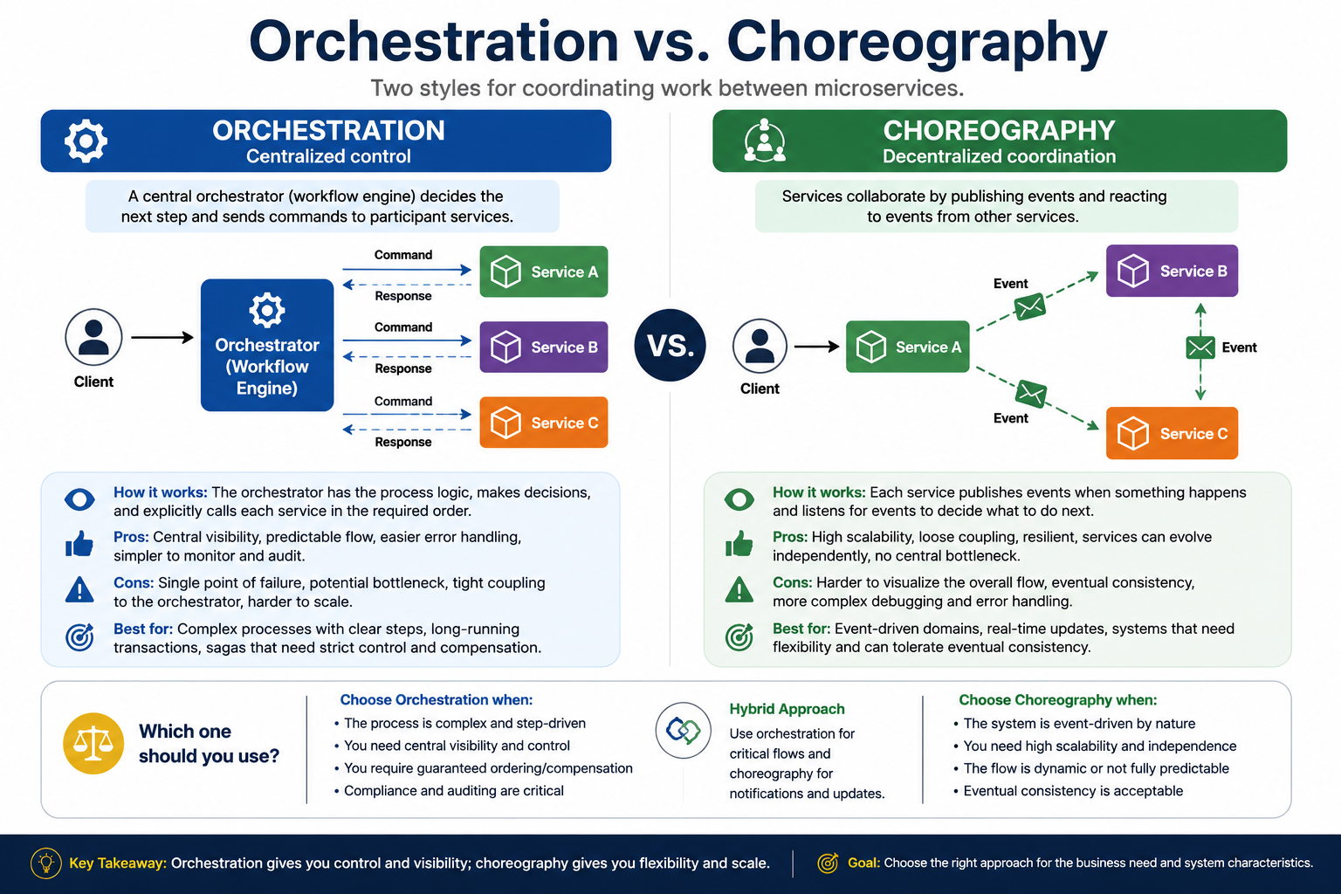
17
© 2026 by Innovation In Software Corporation
Notes:
KEY TALKING POINTS
------------------
- ORCHESTRATION
A saga is a series of local transactions with undo steps.
A saga orchestrator holds the process logic and calls each participant in order.
Each participant commits its own local transaction.
If a later step fails, the orchestrator issues compensating actions, such as releasing a funds hold.
These are needed because there is no distributed database transaction across services.
The diagram lists the pros: central visibility, predictable flow, and easier error handling and audit.
It lists the cons: a potential bottleneck and coupling to the orchestrator.
The panel names Account, Transaction, and Risk Assessment as an example.
Be precise here.
The labs themselves connect those services through events, not an orchestrator.
- CHOREOGRAPHY
Each service publishes events when something happens.
It subscribes to the events it cares about.
There is no conductor.
So services change independently, and there is no central bottleneck.
The diagram lists the cons.
The overall flow is harder to visualize.
You get eventual consistency.
Debugging is more complex.
That is why the correlation IDs and dead-letter handling from Lab 2 are not optional extras in a choreographed system.
They are how you rebuild a flow that nobody drew in one place.
- Which one should you use?
The bottom band gives a decision guide.
Choose orchestration when the process is complex and step-driven.
Also choose it when you need central visibility, guaranteed ordering, or compensation.
It fits too when compliance and auditing are critical.
Choose choreography when the domain is event-driven and needs high scalability and independence.
It also suits a dynamic flow that can accept eventual consistency.
The middle Hybrid Approach is the realistic answer for banks.
Orchestrate the critical money path, and choreograph notifications and updates.
REAL-WORLD EXAMPLES
-------------------
- Uber built and open-sourced the Cadence workflow engine.
Netflix open-sourced Conductor.
Both are used to orchestrate long-running, multi-step workflows.
They suit cases where a central record of each step is valuable.
- A loan approval can be orchestrated.
A coordinator calls credit check, then underwriting, then document generation.
It can also be choreographed.
LoanApplicationSubmitted triggers credit, CreditCheckCompleted triggers underwriting, and so on.
The subtitle's example contrasts exactly these two designs.
USE-CASE SCENARIO
-----------------
The capstone as built is choreography.
Transaction Service publishes TransactionSubmitted.
Risk Assessment Service consumes it on its own.
It calls the model with a timeout and a safe fallback, then stores its decision.
Now picture a new requirement.
A HOLD must freeze the account in Account Service and open a review case.
If the reviewer clears it, the account is reactivated and the transaction is released.
That path has ordering and compensation.
So a team might orchestrate it while leaving notifications choreographed.
That is the hybrid box in practice.

Slide 19
DESIGNING FOR INDEPENDENT DEPLOYMENT · VERSIONING SERVICES WITHOUT BREAKING CONSUMERS
📌
WHAT INDEPENDENT DEPLOYMENT REQUIRES
📌
EVOLVING SERVICE CONTRACTS SAFELY
• Stable, versioned API and event contracts that consumers can rely on
• No shared database with any other service
• Backward-compatible changes as the default deployment mode
• Automated tests and pipelines scoped to the single service
• Prefer additive, backward-compatible changes whenever possible
• Reserve a new major version for genuinely breaking changes
• Communicate deprecation timelines and support old versions for a defined period
KEY TAKEAWAY Independent deployability is the practical test of good boundaries -- stable contracts, owned data, and backward-compatible changes make it possible. • Backward-compatible changes ship freely; breaking changes get an explicit new version and a communicated deprecation timeline.
18
© 2026 by Innovation In Software Corporation
Notes:
TOPIC 1 OF 2: Designing for Independent Deployment
------------------------------------------
KEY TALKING POINTS
------------------
- WHAT INDEPENDENT DEPLOYMENT REQUIRES
Suppose releasing Account Service means releasing Transaction Service the same night.
Then you have a distributed monolith, meaning services that must ship together.
Each bullet removes one cause.
Stable contracts mean consumers do not break when you ship.
No shared database means a schema migration in one service cannot break another's queries.
Backward-compatible changes by default let old and new versions run side by side during a rolling deployment.
A per-service pipeline means a service can be built, tested, and promoted on its own schedule.
You will see this with OpenShift Pipelines later in the course.
REAL-WORLD EXAMPLES
-------------------
- A common anti-pattern in bank modernization is several new services reading the same legacy customer tables.
A column rename then forces a coordinated release across teams.
That is exactly the coupling microservices were meant to remove.
- Amazon has publicly described organizing around small teams that own services behind APIs.
Teams do not reach directly into other teams' data stores.
So each team can release without coordinating with the others.
USE-CASE SCENARIO
-----------------
In the capstone, each service has its own PostgreSQL database with its own Flyway migrations.
Account, Transaction, and Risk Assessment each keep their own tables.
Suppose the Account team adds a nickname column and ships on Tuesday.
Transaction Service keeps working.
It reads account status through the API response.
An extra field in the JSON does not break its DTO.
On OpenShift, a rolling update briefly runs old and new Account pods together.
That is safe only because the change was additive.
TOPIC 2 OF 2: Versioning Services Without Breaking Consumers
------------------------------------------
KEY TALKING POINTS
------------------
- EVOLVING SERVICE CONTRACTS SAFELY
Some changes are compatible.
Adding an optional response field or a new endpoint is fine, as long as consumers ignore unknown fields.
Other changes are breaking.
These include removing a field, renaming it, or changing its meaning.
Making a request field required or changing status code behavior also breaks clients.
The module notes give an example.
Splitting name into firstName and lastName breaks every client that reads name.
Breaking changes get a new version, for instance a /v2 path.
The team announces what changes, why, the replacement, and the end date.
Event schemas need the same care.
That is why Lab 2's envelope carries eventVersion.
REAL-WORLD EXAMPLES
-------------------
- Stripe versions its API by date.
It pins each account to the version it integrated against.
So new versions can change behavior without breaking existing merchants.
Merchants stay unaffected until they choose to upgrade.
- Banks moving a partner API from v1 to v2 usually publish a deprecation notice with a sunset date.
They run both versions in parallel.
That is because partner release cycles are outside the bank's control.
USE-CASE SCENARIO
-----------------
Account Service's path already includes /api/v1.
Say the Risk team asks for the account opening date to help scoring.
Adding openedAt to the response is additive.
So it ships under v1 with no coordination.
Now say someone proposes renaming status to lifecycleState.
Transaction Service checks that status equals ACTIVE.
So that rename would silently reject every transaction.
The design review answer has two options.
Add the new field alongside the old one.
Or introduce v2 and keep v1 running until Transaction Service migrates.

Slide 20
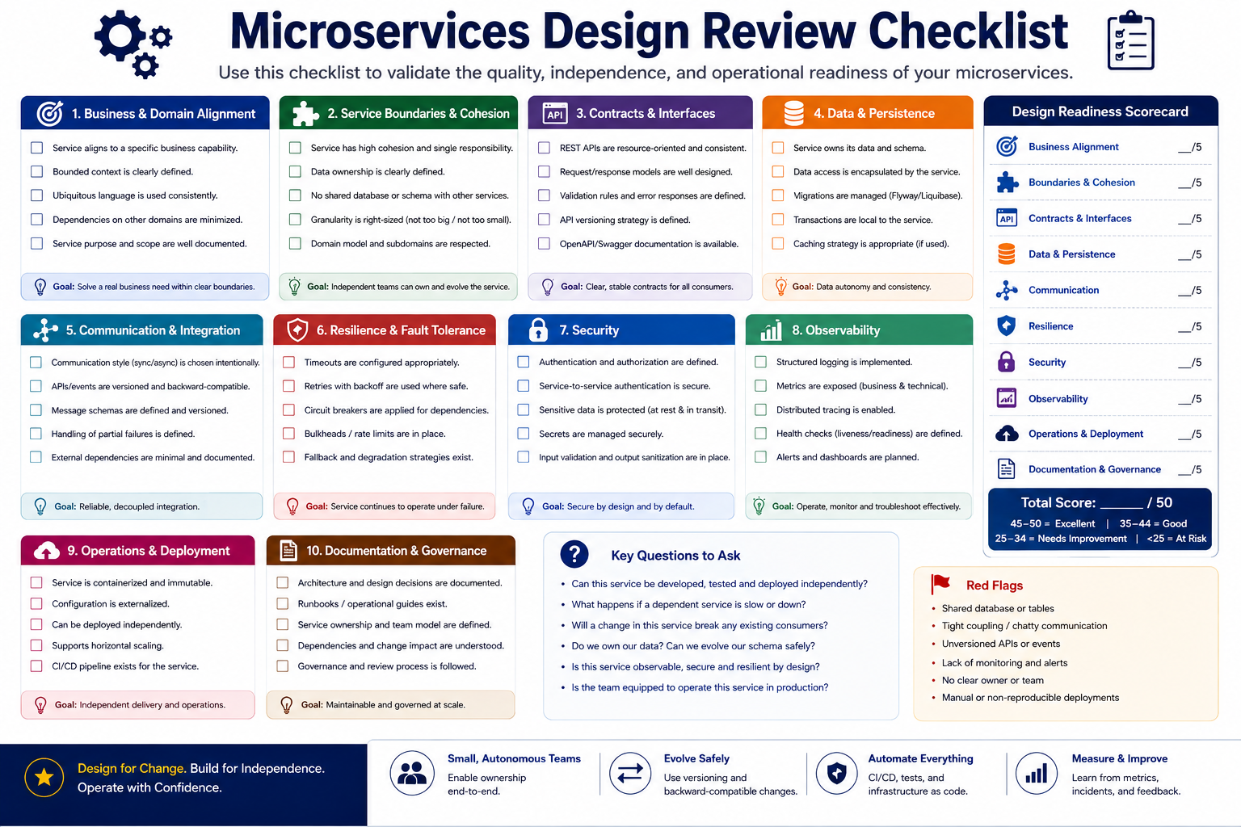
19
© 2026 by Innovation In Software Corporation
Notes:
KEY TALKING POINTS
------------------
- DESIGN REVIEW CHECKLIST
The five slide questions are the minimum bar.
Does the service own one clear business capability, or is it a catch-all?
Is data ownership explicit, with no other service reading its tables?
Are both its REST APIs and the events it publishes documented?
Events are contracts too.
Can it deploy without coordinating with anyone?
And has someone walked a real business workflow through the design end to end?
That last one catches most boundary mistakes.
A workflow that crosses the same boundary back and forth shows the split is in the wrong place.
- Design Readiness Scorecard
The right-hand column turns the ten categories into a score out of 50.
A score of 45 to 50 is Excellent, and 35 to 44 is Good.
A score of 25 to 34 is Needs Improvement, and under 25 is At Risk.
Use it as a conversation tool, not a gate.
A low Resilience score on a service in the money path matters more.
It outweighs a low Documentation score on an internal report job.
The categories after the first four preview later days of this course.
They include Resilience, Security, Observability, and Operations.
- Key Questions and Red Flags
The Key Questions box gives review prompts.
Can it be developed, tested, and deployed independently?
What happens if a dependency is slow or down?
Will a change break consumers?
Do we own our data?
Is it observable, secure, and resilient?
Is the team equipped to run it?
The Red Flags box lists what should stop a review.
The flags are a shared database or tables, chatty communication, and unversioned APIs or events.
They also include missing monitoring, no clear owner, and manual deployments.
REAL-WORLD EXAMPLES
-------------------
- Many enterprise architecture review boards require a short design document before a new service gets production infrastructure.
It covers data ownership, interfaces, failure behavior, and operational ownership.
That mirrors this checklist.
- A frequent finding in bank design reviews is a new service that plans to read another team's database for convenience.
Catch that red flag before code exists.
That is far cheaper than untangling it after two releases.
USE-CASE SCENARIO
-----------------
Run Account Service through the checklist before Lab 1.
Capability: account lifecycle only.
Data: its own PostgreSQL schema, managed by Flyway.
Contracts: POST, GET, PATCH, and the activate, freeze, and close actions.
They are documented in OpenAPI with 400, 404, and 409 cases.
Communication: consumers call it synchronously, and it publishes no events yet.
Resilience and security: honestly low today.
Lab 3 addresses them with JWT and callers' circuit breakers.
Operations: containerized and deployed in Lab 4.
The low scores are not failures.
They are the course roadmap.

Slide 21
REST ARCHITECTURAL PRINCIPLES · RESOURCES, REPRESENTATIONS, AND IDENTIFIERS
📌
REST PRINCIPLES
✅
GOOD VS. POOR REST DESIGN
• Resource-oriented: clients interact with nouns, not actions
• Stateless: each request carries enough information to be processed on its own
• Consistent, predictable, HTTP-native, and cache-aware where appropriate
• Good: GET /customers/101, POST /customers, GET /accounts/5001/transactions
• Poor: /getCustomer, /createAccount, /fetchTransactions, /deleteLoan
• The URI identifies the resource; the HTTP method expresses the action
📌
THREE CORE REST CONCEPTS
✅
GOOD VS. BAD IDENTIFIERS
• Resources: nouns such as Users, Orders, Products, Payments, Shipments
• Representations: JSON, XML, HTML, CSV -- the client chooses via content negotiation
• Identifiers: stable, persistent URIs such as /orders/123 or /customers/7/orders
• Good: /orders/{id}, /customers/{id}/orders, /products/{sku}
• Avoid: /getOrderById/123, /order?id=123, /createUser, /updateProductInfo
KEY TAKEAWAY REST is popular for microservices because it is simple, language-independent, HTTP-native, and easy to test. • A resource is the thing itself, a representation is how it's transferred (JSON, XML), and an identifier (URI) is how it's found.
20
© 2026 by Innovation In Software Corporation
Notes:
TOPIC 1 OF 2: REST Architectural Principles
------------------------------------------
KEY TALKING POINTS
------------------
- REST PRINCIPLES
Resource-oriented means the API is organized around things the business manages, such as accounts and transactions.
It is not organized around procedures.
Stateless means the server keeps no memory of the conversation.
So every request carries its own token and identifiers.
That lets any of three OpenShift pods serve it.
HTTP-native means using methods, status codes, and headers as designed.
It does not mean tunneling everything through POST with an action field.
Cache-aware means safe GET responses can carry caching headers where the data allows.
That suits reference data more than live balances.
- GOOD VS. POOR REST DESIGN
Compare the columns.
The poor endpoints bake the action into the path.
So every new operation needs a new URL.
Every team also invents its own verb, like get, fetch, or retrieve.
The good endpoints use a small, predictable set of nouns.
GET, POST, PUT, PATCH, and DELETE provide the verbs.
A client who knows GET /customers/101 can guess GET /accounts/5001.
Nesting such as /accounts/5001/transactions expresses a real relationship: the transactions that belong to that account.
REAL-WORLD EXAMPLES
-------------------
- The GitHub REST API is a well-known resource-oriented design.
A repository's issues sit in paths nested under the owner and repository.
HTTP methods tell apart reading, creating, and updating those issues.
- Older bank integration layers often exposed RPC-style operations over SOAP, such as getAccountBalance or doFundsTransfer.
Teams modernizing them to REST often remap those operations onto account and transfer resources.
USE-CASE SCENARIO
-----------------
Lab 1 applies these rules to Account Service.
POST /api/v1/accounts creates an account.
GET /api/v1/accounts/{accountId} reads one.
PATCH updates allowed fields, such as a nickname.
Status changes use POST /api/v1/accounts/{accountId}/activate, freeze, and close.
There is deliberately no DELETE, because banking audit needs the closed record.
A participant may ask whether activate is a verb in the URL.
It is.
The lab calls it out as a business action.
It is a deliberate, documented exception rather than a general habit.
TOPIC 2 OF 2: Resources, Representations, and Identifiers
------------------------------------------
KEY TALKING POINTS
------------------
- THREE CORE REST CONCEPTS
Separate three things people blur together.
The resource is the account itself, a business concept.
A representation is one rendering of it at a moment in time.
In this course that is usually JSON.
But the same resource could be served as CSV for an export.
Content negotiation means the client says what it accepts through the Accept header.
The server then picks a matching format.
The identifier is the URI.
It should stay stable for as long as the resource exists.
Other systems store it, log it, and link to it.
- GOOD VS. BAD IDENTIFIERS
Good identifiers put the collection name in the path, then the ID.
They use nesting only for real relationships, such as a customer's orders.
The avoid list shows three different mistakes.
/getOrderById/123 puts a verb in the path.
/order?id=123 uses a singular collection name and hides identity in a query string.
Keep query strings for filtering, sorting, and paging.
/createUser and /updateProductInfo describe operations, not things.
A resource with a stable URI can be bookmarked, logged, cached, and referenced by other services.
REAL-WORLD EXAMPLES
-------------------
- A statement download endpoint can return the same monthly statement resource in different formats.
It can send JSON for the mobile app and PDF or CSV for a customer download.
The Accept header selects the format.
There is no need for separate getStatementPdf and getStatementCsv paths.
- Payment references in banking are long-lived.
A dispute raised weeks later still needs to find the original transaction by its identifier.
That is why identifier URIs must not change when an API is refactored.
USE-CASE SCENARIO
-----------------
In the capstone, the resource is a transaction.
Its representation is the JSON body that Transaction Service returns.
Its identifier is /api/v1/transactions/TXN-A1B2C3D4.
On Day 5, Risk Assessment Service keys its assessment by that same transaction ID at /api/v1/assessments/{transactionId}.
Suppose Transaction Service had exposed /getTransaction?id=...
and later renamed it.
Every stored reference in the risk audit table would break.
So would every operations bookmark.
Stable identifiers are what let three separately owned services refer to the same business fact.

Slide 22
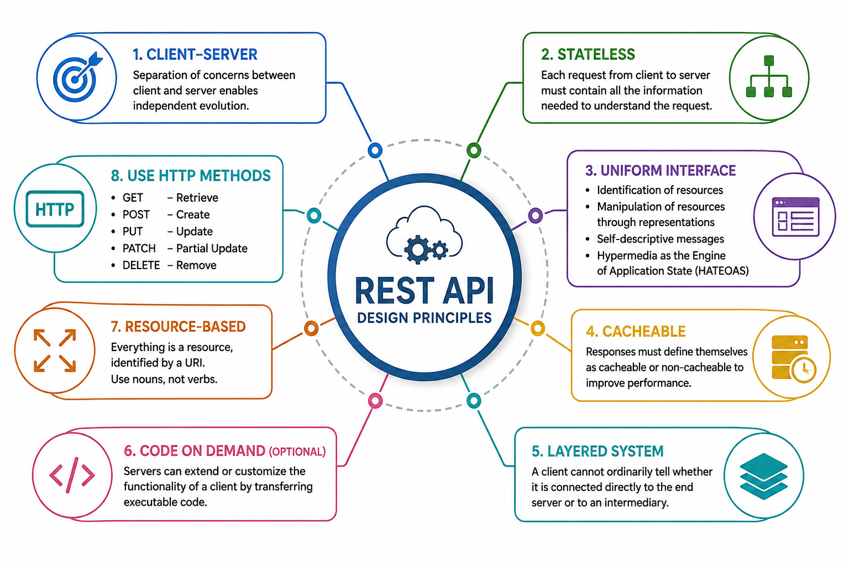
21
© 2026 by Innovation In Software Corporation
Notes:
KEY TALKING POINTS
------------------
- Client-server and stateless (cards 1 and 2)
Client-server means the consumer and the provider are separate.
They meet only at the interface.
So a mobile banking release does not force an Account Service release.
Stateless means the server keeps no conversational memory between calls.
Each request carries its identity token, parameters, and body.
That is what lets OpenShift run several replicas and route any request to any pod.
It is also why Lab 3 has Transaction Service relay the caller's JWT on every call.
It does not rely on a session.
- Uniform interface (card 3)
This constraint makes REST APIs feel familiar from one to the next.
Resources are identified by URIs.
Clients change them by sending representations, usually JSON.
Messages describe themselves through methods, media types, headers, and status codes.
HATEOAS means responses can include links to the next valid actions.
Many enterprise APIs implement the first three thoroughly and hypermedia only partially.
So present HATEOAS as the most advanced part of the interface.
It is not a checkbox every banking API must tick.
- Cacheable and layered system (cards 4 and 5)
Cacheable means responses say whether, and for how long, they can be reused.
They do this through headers such as Cache-Control and ETag.
Reference data like branch lists caches well.
Account status and balances generally should not be cached by intermediaries.
Layered system means a client cannot tell how it reaches the service.
It might talk to the service directly, or through an API gateway, OpenShift router, or proxy.
That is why gateways can add authentication, rate limiting, and TLS termination without clients changing.
- Code on demand (card 6)
Code on demand lets a server send executable code to the client.
The familiar case is a browser downloading and running JavaScript.
It is the only optional REST constraint.
Service-to-service APIs like the ones in this course do not use it.
Mention it so the list matches what learners find in references, then move on.
Time spent here is better used on the practical cards.
- Resource-based and HTTP methods (cards 7 and 8)
Cards 7 and 8 are not among the formal REST constraints.
But they are the habits that make APIs usable.
URIs name resources with nouns, so /accounts/{id} rather than /getAccount.
The method carries the intent.
GET reads, POST creates, PUT replaces, PATCH partially updates, and DELETE removes.
Lab 1 follows this with POST to create, GET to read, and PATCH for the nickname.
It deliberately has no DELETE.
Closed accounts are kept for audit, and closing is a business action instead.
REAL-WORLD EXAMPLES
-------------------
- Stripe's payments API is often cited for consistent resource-oriented design.
It uses noun-based paths such as customers and charges, standard HTTP methods, and meaningful status codes.
It also has an Idempotency-Key header, so a retried POST does not create a duplicate charge.
- Open banking APIs, such as those defined by the UK Open Banking standard, expose accounts, balances, and transactions as REST resources.
They work over HTTPS with token-based authorization.
That lets many third-party apps integrate without sharing sessions or scraping screens.
USE-CASE SCENARIO
-----------------
A legacy team shows the capstone group its proposed account endpoints: /getAccountStatus, /doFreeze, and /updateAccountNickname.
They rely on a server-side session that remembers the current account.
The group redesigns them against the cards.
The resource becomes GET /api/v1/accounts/{accountId}.
A nickname change becomes PATCH on the same URI.
Freezing becomes POST /api/v1/accounts/{accountId}/freeze, a business action on a noun-based path.
The session disappears.
Every call carries a JWT, so any of the running Account Service pods can answer.
The gateway in front is told not to cache account status.
The result matches the Lab 1 contract and scales cleanly on OpenShift.

Slide 23
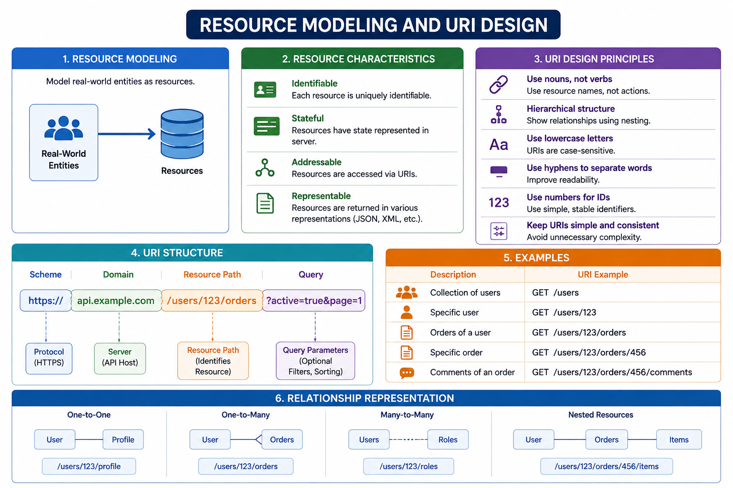
22
© 2026 by Innovation In Software Corporation
Notes:
KEY TALKING POINTS
------------------
- Resource modeling and characteristics (panels 1 and 2)
Resource modeling starts from business nouns, not table names.
Think account, transaction, and risk assessment, not something like tbl_acct.
Each resource must be identifiable with a stable ID.
It must be addressable at a URI and representable, usually as JSON.
The word stateful in panel 2 means the resource itself has state the server holds, such as an account's status.
Separate that clearly from session state.
A resource can have state while the service remains stateless between requests.
- URI design principles (panel 3)
Use nouns, so the HTTP method carries the verb.
Show hierarchy only where the relationship is real.
Keep paths lowercase, because URI paths are case-sensitive.
Use hyphens for multi-word names such as risk-assessments.
The panel says to use numbers for IDs.
The broader point is simple, stable identifiers.
Lab 1 generates IDs of ACC- plus eight hex characters.
That meets the intent without exposing database sequence numbers.
Consistency across services matters more than any single rule.
- URI structure (panel 4)
Break the sample URI into parts.
The scheme is HTTPS, which is mandatory for banking traffic.
The domain identifies the API host.
On OpenShift, that is often a Route hostname.
The resource path identifies what is being addressed.
In Lab 1 it starts with /api/v1/accounts, which adds a version segment.
The query string after the question mark carries optional filters, sorting, and paging.
Rule of thumb: identity goes in the path, and optional narrowing goes in the query.
- Examples and relationship representation (panels 5 and 6)
The examples progress step by step.
They go from a collection, to an item, to a child collection, a child item, and a grandchild collection.
Translate them into banking as you go: /accounts, /accounts/{accountId}, /accounts/{accountId}/transactions.
Panel 6 shows relationships in paths.
One-to-one is a singular sub-resource, and one-to-many is a child collection.
Many-to-many is exposed from one side, and nesting is for true containment.
Warn against nesting deeper than about two levels.
Deep URIs become brittle when relationships change.
REAL-WORLD EXAMPLES
-------------------
- GitHub's REST API is a widely used public example of hierarchical resource URIs.
Repositories sit under their owners.
Issues and pull requests sit under repositories.
Query parameters handle state filters and pagination.
- Bank APIs that expose transaction history typically nest a transactions collection under an account.
Some accept an account filter instead.
They use query parameters for date ranges and paging.
A statement view needs filtered, paged results, not every transaction ever posted.
USE-CASE SCENARIO
-----------------
While designing Transaction Service for Lab 2, a learner proposes /api/v1/accounts/{accountId}/transactions/{transactionId}/risk-assessment/score/details.
The group reviews it against the diagram.
The path is five levels deep.
It also implies that Account Service owns transactions and risk scores.
That contradicts the bounded contexts drawn earlier.
The group settles on top-level resources owned by each service.
POST /api/v1/transactions creates a transaction.
GET /api/v1/transactions/{transactionId} reads one.
An optional accountId query parameter filters by account.
Risk data stays with Risk Assessment Service under its own path.
The URIs are shorter, lowercase, and match ownership.

Slide 24
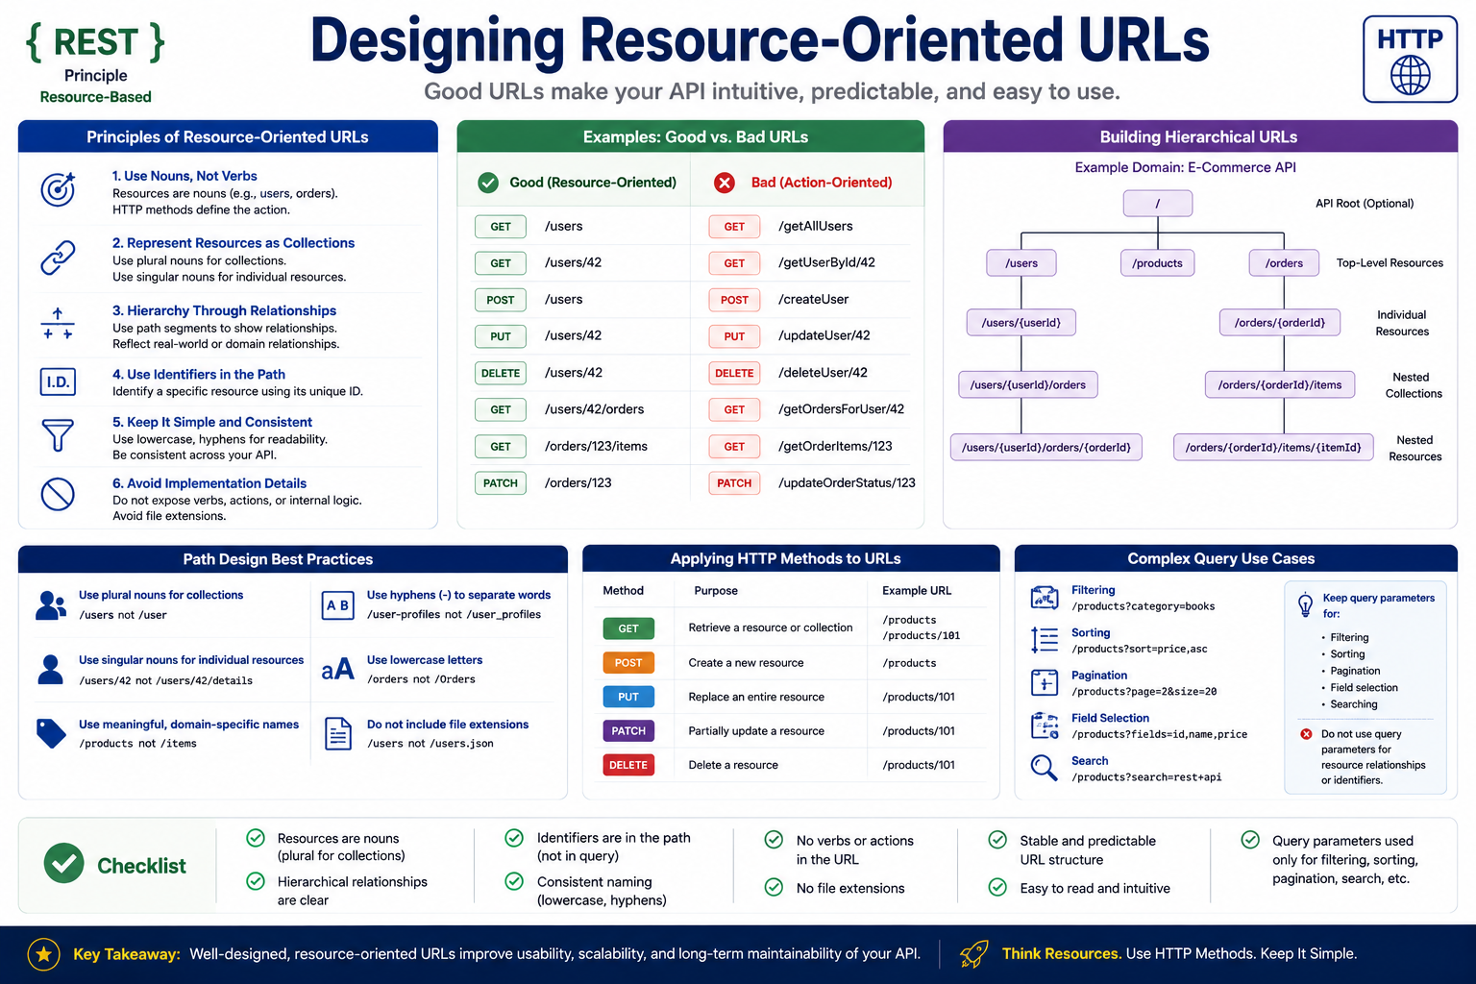
23
© 2026 by Innovation In Software Corporation
Notes:
KEY TALKING POINTS
------------------
- SIX URL DESIGN PRINCIPLES
One, nouns not verbs: the method is the verb.
Two, collections: the collection path is plural, /users.
One item is that collection plus an ID, /users/42.
Read singular for items as one resource, not as a singular path word.
Three, hierarchy: nest to show a real relationship, such as /users/42/orders, but stop at two or three levels.
Four, identifiers go in the path.
Five, use lowercase with hyphens, applied the same way across all services.
Six, no implementation leaks, such as .json extensions, table names, or framework names.
- GOOD VS. BAD URL EXAMPLES
Both pairs show the same operation written two ways.
GET /users/42/orders reads a user's orders through the hierarchy.
GET /getOrdersForUser/42 invents a one-off verb path.
PATCH /orders/123 partially updates the order.
The body says which field changes, such as status.
PATCH /updateOrderStatus/123 repeats the action in the path.
It also implies a separate endpoint for every field.
The full table in the image extends this to GET, POST, PUT, and DELETE on /users.
- Complex Query Use Cases
The lower right panel answers where filtering goes.
Query parameters narrow or shape a collection.
Examples are category filtering, sort=price,asc, and page and size for pagination.
Others are fields for field selection, and search.
The callout says not to use query parameters for resource relationships or identifiers.
So the pattern is /accounts/{id}/transactions?status=HOLD&page=0, with identity and relationship in the path.
Filtering goes in the query.
REAL-WORLD EXAMPLES
-------------------
- Kubernetes and OpenShift APIs follow a strongly resource-oriented path structure.
Collections of pods or deployments are nested under a namespace, with standard verbs applied to them.
Participants will see this in oc commands later in the course.
- A bank transaction search screen maps naturally to a collection query.
An example is an account's transactions filtered by date range and status, with page and size parameters.
There is no need for a separate searchTransactionsByDate endpoint.
USE-CASE SCENARIO
-----------------
Apply the six principles to the capstone APIs.
Account Service uses /api/v1/accounts and /api/v1/accounts/{accountId}.
Transaction Service uses /api/v1/transactions and /api/v1/transactions/{id}.
Risk Assessment Service uses /api/v1/assessments/{transactionId}.
It filters with a query parameter, disposition=HOLD, exactly as the Complex Query panel recommends.
Then ask whether an operations reviewer's decision should be POST /api/v1/assessments/{id}/review.
It is a sub-resource that represents a review record.
That keeps identity in the path and the action as a POST.

Slide 25
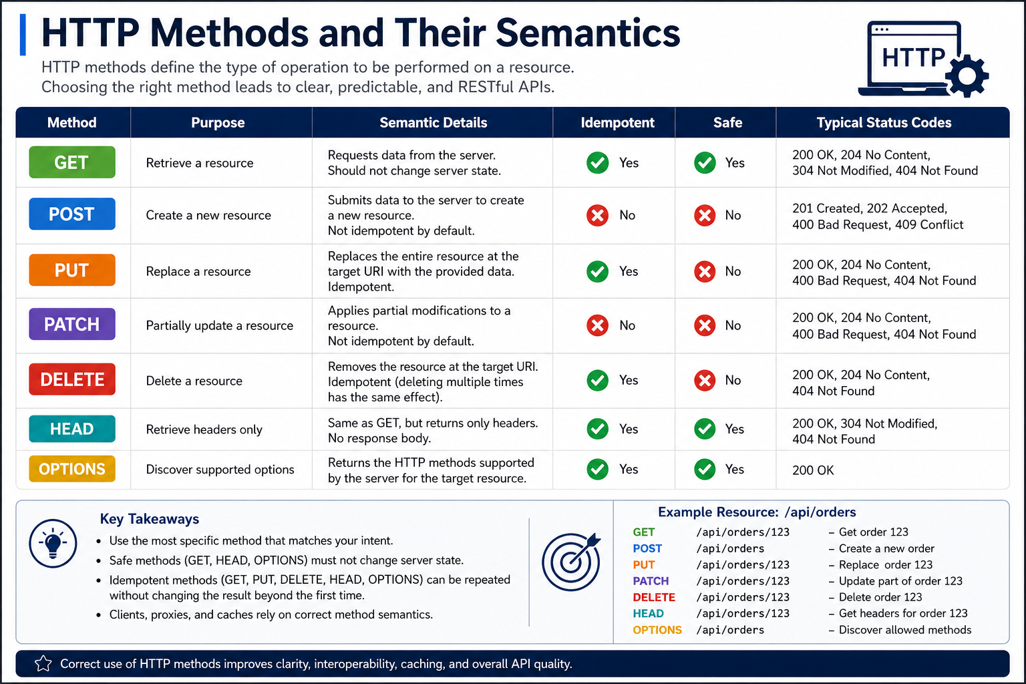
24
© 2026 by Innovation In Software Corporation
Notes:
KEY TALKING POINTS
------------------
- HTTP METHOD SEMANTICS
Walk the table as a set of promises.
GET retrieves data and never changes state.
So it can be cached and retried freely.
POST creates something.
It is neither safe nor idempotent, so a blind retry can create a duplicate.
Idempotent means repeating a call leaves the same end state.
PUT replaces the whole resource.
Sending the same representation twice leaves the same end state.
PATCH changes only part of a resource.
It is not idempotent by default.
DELETE removes a resource.
It is idempotent because the resource is still gone after a second call.
HEAD and OPTIONS return only metadata.
Lab 1 uses POST to create (201), GET to read (200) and PATCH to change the nickname (200).
- KEY TAKEAWAYS
First, use the most specific method for your intent.
A POST that only reads data hides that the call is harmless.
A GET that changes data is dangerous.
Second, safe methods must never change state.
Browsers prefetch links, crawlers follow them and caches replay them.
So a GET that triggers a transfer or flips a flag will fire by accident sooner or later.
Third, idempotent methods can be retried.
That matters when a gateway or a Resilience4j retry repeats a call after a timeout.
Fourth, all of this infrastructure trusts the method name.
If you lie about semantics, you break systems you do not control.
REAL-WORLD EXAMPLES
-------------------
- Card authorisation over unreliable networks: a point-of-sale terminal can lose its connection mid-request.
The acquiring system then must know whether resending is safe.
A balance or status inquiry can be resent freely.
A charge request cannot be resent blindly without a deduplication mechanism, a way to catch repeats.
That is why payment APIs pair POST with idempotency keys.
- Record retention in retail banking: banks generally keep closed accounts for audit and regulatory record-keeping.
They do not erase them.
That is why the Lab 1 Account Service offers POST /api/v1/accounts/{accountId}/close.
It keeps the row with status CLOSED, even though DELETE appears in this generic table.
USE-CASE SCENARIO
-----------------
In the capstone, a mobile banking screen calls the Account Service on port 8081 with GET /api/v1/accounts/{accountId}.
The phone switches from Wi-Fi to cellular, and the client library retries.
Nothing bad happens, because GET is safe.
The customer then renames the account.
The app sends PATCH with only the nickname and gets 200.
Later a teller freezes the account after a risk review.
That is POST /api/v1/accounts/{accountId}/freeze.
It is a business action with its own rules, not a PATCH of the status field.
Ask the room which of the three calls an API gateway could safely retry on its own.
Then ask which one needs more thought.

Slide 26
SAFE AND IDEMPOTENT OPERATIONS
All safe methods are idempotent, but not all idempotent methods are safe -- PUT changes state safely on repeat, GET never changes it at all.
📌
SAFE OPERATIONS
🎯
IDEMPOTENT OPERATIONS
• Does not change server state -- intended for read-only operations
• Multiple identical requests have the same effect as a single request
• Safe methods can be cached, prefetched, and retried automatically
• Safe methods: GET, HEAD, OPTIONS
• Making the same request multiple times has the same effect as making it once
• Enables safe retries when a response is lost or the client is unsure
• Idempotent methods: GET, HEAD, PUT, DELETE, OPTIONS -- POST is neither safe nor idempotent by default
KEY TAKEAWAY All safe methods are idempotent, but not all idempotent methods are safe -- PUT changes state safely on repeat, GET never changes it at all.
25
© 2026 by Innovation In Software Corporation
Notes:
KEY TALKING POINTS
------------------
- SAFE OPERATIONS
Safe means the client is not asking the server to change anything.
The server may still write an access log or increment a metric.
That is fine.
What matters is that the caller requested no state change.
Because nothing changes, sending the request ten times has the same effect as once.
That is why every safe method is automatically idempotent.
It is also what lets browsers, HTTP caches and CDNs store GET and HEAD responses.
It lets clients prefetch them too.
You mostly see OPTIONS as the browser's CORS preflight, a check before a cross-origin call.
Treat safe as a promise to every intermediary in the path.
- IDEMPOTENT OPERATIONS
Idempotent means repeating the request leaves the server in the same end state.
It does not mean the response is identical.
Setting a nickname with PUT twice gives the same nickname.
Deleting twice leaves nothing.
This matters because a timeout does not tell the client whether the server processed the request.
So the only safe move is to retry an operation designed to tolerate repeats.
POST is neither safe nor idempotent by default.
But idempotency is a design property you can add.
Lab 1 does exactly that.
Activating an already ACTIVE account returns 200 with no change.
Closing an already CLOSED account also returns 200.
REAL-WORLD EXAMPLES
-------------------
- Refreshing a balance in online banking: pulling to refresh sends a GET for the account summary.
The customer can repeat it as often as they like.
The app can briefly cache the result too.
Reading a balance never moves money.
- Alert thresholds: a request that sets the low-balance alert to 500 dollars is idempotent.
A duplicated retry still leaves 500.
A request that says increase the threshold by 100 is not idempotent.
Each retry raises it again.
Design APIs around absolute values rather than increments, and retries become safe.
USE-CASE SCENARIO
-----------------
In Lab 2 the Transaction Service calls the Account Service with a GET.
The call confirms an account is ACTIVE before a transaction is accepted.
That call is safe.
So Lab 3 can wrap it in a timeout and circuit breaker without worrying about side effects.
Now picture a teller whose screen is slow and who clicks Activate twice.
Lab 1 designed activate so the second call returns 200.
The account simply stays ACTIVE.
Contrast that with POST /api/v1/transactions: without extra design, a repeated create could record a second transaction.
That second row would be for the same customer intent.
The Idempotency slide shows how to close that gap.

Slide 27
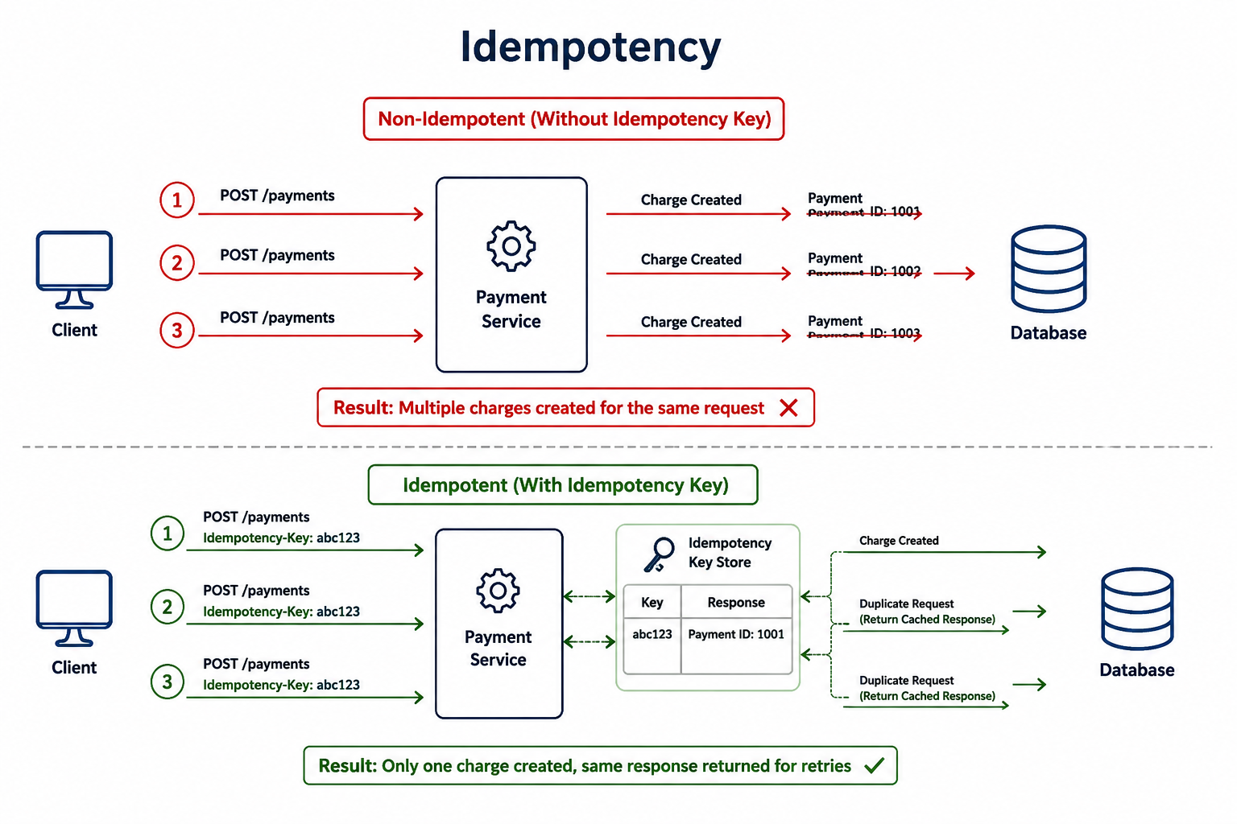
26
© 2026 by Innovation In Software Corporation
Notes:
KEY TALKING POINTS
------------------
- Non-Idempotent (Without Idempotency Key)
The three red requests are not three purchases.
They are one customer intent sent three times.
That could be a double tap, a client timeout and retry, or a gateway resending after a dropped connection.
The Payment Service cannot tell them apart.
So it faithfully creates three charges, and the database holds three payment rows.
In banking this is real customer harm.
Money leaves the account more than once, and the customer calls support.
Reversing charges costs time and trust.
The point for developers: the bug is not in any single line of code.
It comes from treating each HTTP attempt as a new business request.
- Idempotent (With Idempotency Key)
In the green half the client generates one key, abc123, for the business intent.
It sends that key on every attempt.
The Payment Service now has a stable identity for the request.
The first call is processed normally.
The second and third are recognized as duplicates.
The service answers them with the stored result instead of processing them again.
The client cannot tell whether its first attempt succeeded.
Now it does not need to know, because retrying is always safe.
Stress that the key must be created once per intent, for example when the customer confirms the transfer.
It is not created once per HTTP attempt.
- Idempotency Key Store
The pale green box is where the guarantee actually lives.
It maps each key to the response that was returned, here abc123 to Payment ID 1001.
In production it must be durable and shared by every replica.
On OpenShift the retry may land on a different pod.
An in-memory map works for a classroom sketch but not for real payments.
Insert the key atomically, for example with a unique constraint.
Atomically means in one indivisible step, so two simultaneous duplicates cannot both win.
Many teams also record an in-progress state.
They reject a reused key that arrives with a different request body.
- Result banners
The two outlined banners state the business outcome.
They are the part executives and auditors care about.
The red banner, multiple charges for the same request, is a customer-impacting defect.
The green banner, only one charge with the same response for retries, is what regulators and customers expect.
They expect it from any money movement.
Use the banners to frame idempotency as a correctness requirement, not an HTTP curiosity.
It applies to payments, transfers and account opening.
It applies to any other operation that must happen exactly once from the customer's point of view.
REAL-WORLD EXAMPLES
-------------------
- Stripe's public payments API accepts an Idempotency-Key header on POST requests.
When the same key is sent again, it returns the saved result.
So a client that times out while creating a charge can retry.
It will not charge the card twice.
- Mobile transfers: a customer on a weak signal taps Transfer, sees a spinner, and taps again.
Suppose the app generated one key when the transfer was confirmed and reuses it on both requests.
Then the bank moves the money once, and both taps show the same confirmation.
USE-CASE SCENARIO
-----------------
In the capstone, a teller submits a transaction to the Transaction Service.
The service validates the account with the Account Service.
It saves the row and publishes TransactionSubmitted to Kafka.
Suppose the response is lost on the way back and the client retries.
Without a key, a second transaction is recorded.
The Risk Assessment Service then scores two transactions that are really one.
Lab 2 already applies the same principle on the messaging side.
The consumer keeps a processed_events table keyed by event_id.
So a replayed event is a no-op, meaning it does nothing.
Ask participants how they would bring the same protection to the REST entry point.

Slide 28
HTTP STATUS CODES FOR MICROSERVICES · REQUEST AND RESPONSE DESIGN
📌 STATUS CODE CATEGORIES
RANGE | CATEGORY | EXAMPLES
2xx | Success | 200 OK, 201 Created, 204 No Content
4xx | Client Error | 400 Bad Request, 401 Unauthorized, 404 Not Found, 409 Conflict
5xx | Server Error | 500 Internal Server Error, 503 Service Unavailable
✅
BEST PRACTICES
📌
REQUEST KEY ELEMENTS
✅
REQUEST & RESPONSE BEST PRACTICES
• Use the most accurate status code -- never return 200 OK for every response
• Provide meaningful error details and a consistent error body across services
• Never expose stack traces or internal details in an error response
• Include a correlation ID in every error response for traceability
• Method & URL: the correct HTTP method and resource-oriented URL
• Headers: authentication, content type, correlation ID, idempotency key
• Body: structured, validated JSON with clear fields
• Be consistent: same naming, casing, and structure across endpoints
• Be explicit: descriptive field names, only required fields
• Make it traceable: propagate correlation IDs, use idempotency keys for safe retries
KEY TAKEAWAY Choosing the accurate status code, not always 200 OK, is what lets clients handle success, client errors, and server errors correctly. • Every request and response should be efficient, use the correct HTTP method and status code, and carry a correlation ID for tracing.
27
© 2026 by Innovation In Software Corporation
Notes:
TOPIC 1 OF 2: HTTP Status Codes for Microservices
------------------------------------------
KEY TALKING POINTS
------------------
- STATUS CODE CATEGORIES
The first digit tells the client who has to act.
2xx means it worked.
Use 200 for reads and updates.
Use 201 Created for a new resource, along with a Location header.
Use 204 when there is nothing to return.
4xx means the caller must change something.
In the labs that is 400 VALIDATION_FAILED for bad input and 401 for a missing token.
It is also 404 ACCOUNT_NOT_FOUND, and 409 INVALID_ACCOUNT_STATE for freezing a PENDING account.
Add 403 verbally.
Lab 3 returns it when a teller token lacks transaction scopes.
5xx means the server or a dependency failed.
A later retry might succeed.
- BEST PRACTICES
Returning 200 for everything forces every client to parse the body to learn whether it failed.
It breaks retry logic.
It also hides errors from monitoring that counts responses by status.
A consistent error body means a consumer writes one error handler.
That handler works for Account Service and Transaction Service alike.
In Lab 1 that shape comes from a single GlobalExceptionHandler.
Stack traces leak class names, SQL fragments and library versions.
Those help attackers and mean nothing to customers.
Put a correlation ID, a request tracking value, in the error body.
It lets a support engineer jump straight from a customer's complaint to the exact log lines across services.
REAL-WORLD EXAMPLES
-------------------
- A transfer rejected by a business rule, such as insufficient funds, is not a server crash.
Returning 500 would trigger alerts and invite automatic retries.
It could even page on-call engineers.
A 4xx response with a clear code lets the mobile app show a helpful message instead.
- Operations monitoring: Spring Boot's Micrometer metric http.server.requests is tagged with the response status.
Dashboards commonly chart 4xx and 5xx rates per endpoint.
Picture an API that wraps failures in 200.
On those dashboards, an outage looks like a healthy service.
USE-CASE SCENARIO
-----------------
Walk the Lab 1 Account Service through its status codes.
Creating an account returns 201 with status PENDING.
Freezing it while still PENDING returns 409.
Asking for ACC-MISSING returns 404.
An email-style customerId returns 400.
In Lab 2 the Transaction Service consumes those codes.
If the account is missing or not ACTIVE, it rejects the transaction with 409 ACCOUNT_NOT_ELIGIBLE.
It publishes no event.
If the Account Service is down, Lab 3 adds a circuit breaker and a safe fallback.
That fallback never auto-approves money movement.
Correct codes are what let the calling service choose between reject, retry and fall back.
TOPIC 2 OF 2: Request and Response Design
-----------------------------------------
KEY TALKING POINTS
------------------
- REQUEST KEY ELEMENTS
Method and URL name the intent and the resource.
Examples are POST /api/v1/accounts or GET /api/v1/accounts/{accountId}.
Verbs appear only for real business actions like /activate.
Headers carry cross-cutting information that should not clutter the body.
That includes Authorization with a Bearer token (Lab 3) and Content-Type application/json.
It also includes X-Correlation-Id, used in every lab, and an idempotency key for creates that move money.
The body is the business payload.
Spring validates it before the controller runs.
In Lab 1 the CreateAccountRequest record uses @NotBlank and @Pattern.
@Valid on the controller triggers the check.
- REQUEST & RESPONSE BEST PRACTICES
Consistency means a field called accountId in one service is not acctId in another.
The same casing is used everywhere, and errors share one shape.
Explicit means descriptive names and no extra fields.
Return a DTO, a data object designed for consumers, not the JPA entity with its internal columns.
That way you do not leak data or lock yourself into the schema.
Traceable means the correlation ID travels with the request.
Lab 1 echoes X-Correlation-Id back, or generates one if it is missing.
Lab 2 copies it onto the Kafka event.
So one ID follows the work end to end.
REAL-WORLD EXAMPLES
-------------------
- Account opening across channels: web, mobile and branch applications often call the same account-creation API.
Suppose one response says accountNumber and another says acctNo.
Then every channel writes mapping code.
One consistent contract lets a single client library serve all three.
- Support calls: a banking app may show an error with a short reference code.
That reference is often the correlation ID.
Support engineers search centralized logs for it.
They see every service's log lines for that one request, instead of guessing by timestamp.
USE-CASE SCENARIO
-----------------
Show the Lab 1 create call as an anatomy lesson.
The method and URL are POST http://localhost:8081/api/v1/accounts.
The headers are Content-Type application/json and X-Correlation-Id lab1-demo.
The body carries customerId CUST-0001, accountType, currency USD and an optional nickname.
The response is 201 with a Location header pointing at the new account.
The same X-Correlation-Id is echoed back.
The body shows status PENDING.
In Lab 2 the Transaction Service sends the same correlation header when it calls the Account Service.
So both services log one shared ID for a single teller action.

Slide 29
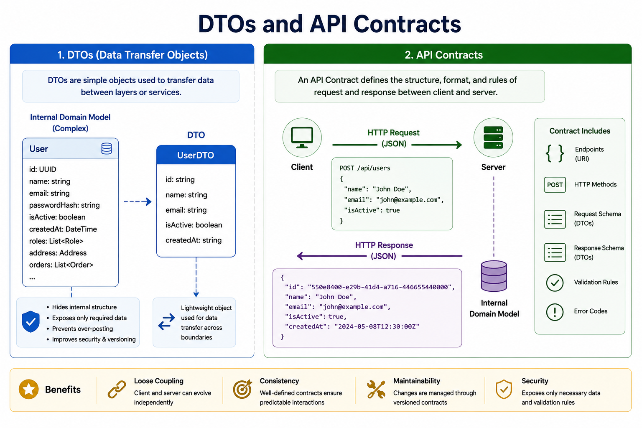
28
© 2026 by Innovation In Software Corporation
Notes:
KEY TALKING POINTS
------------------
- 1. DTOs (Data Transfer Objects)
The internal User model holds everything the service needs.
That includes passwordHash, roles, address, and a list of orders.
The UserDTO exposes only id, name, email, isActive, and createdAt as a string.
The callout lists the reasons.
A DTO hides internal structure and exposes only the data a client needs.
It prevents over-posting, where a client sets fields it should not control.
It also helps security and versioning.
In Spring Boot, controllers accept and return records like AccountRequest and AccountResponse.
They never use JPA entities.
Then a schema change inside the service does not silently change the public payload.
- 2. API Contracts
The contract is the agreement between client and server.
It says what a request and a response look like.
The diagram shows POST /api/users going right with a JSON body.
A JSON response comes back with a generated UUID and a timestamp.
Look at the dashed line from the server down to Internal Domain Model.
That line is the point.
The internal model sits behind the server and never crosses the wire.
Clients code against the contract.
The server is free to change what is behind it.
- Contract Includes
The right-hand column is a checklist.
It shows what a complete contract documents.
It lists the endpoint URI and the HTTP method.
It lists the request schema and response schema, which are both DTOs.
It also lists validation rules and error codes.
Most teams document the happy path and forget those last two.
In this course, the contract is published through OpenAPI at /v3/api-docs with Swagger UI.
In Lab 1, three error codes are part of that contract.
It returns 400 for bad input.
It returns 404 for a missing account.
It returns 409 for an illegal status change.
- Benefits
The bottom band names four payoffs.
Loose coupling means client and server change independently.
Consistency means well-defined contracts give predictable interactions.
Maintainability means changes are managed through versioned contracts.
Security means only necessary data and validation rules are exposed.
Tie each one back to a failure participants have seen.
For example, a mobile app broke because a backend renamed a database column.
That column was leaking straight through an entity.
REAL-WORLD EXAMPLES
-------------------
- Mass-assignment or over-posting bugs happen when a framework binds request JSON straight onto an entity.
A caller can then set fields they should never control, such as role or isAdmin.
A dedicated request DTO with only permitted fields closes that gap.
- Public payment APIs such as Stripe's publish detailed documentation.
It covers requests, responses, and errors.
Client libraries are built against those documented shapes.
They are not built against the provider's internal data model.
USE-CASE SCENARIO
-----------------
In Lab 1, the Account entity carries status, timestamps, and audit fields that the service manages.
The create request DTO accepts only what a caller may supply.
The response DTO returns what consumers need.
Now suppose a teammate returns the entity directly to save time.
Weeks later, someone adds an internal column for the risk team.
That column appears in every GET response that Transaction Service parses.
Future Risk Assessment Service parses those responses too.
With DTOs, the column stays internal until someone deliberately adds it to the contract.

Slide 30
JSON PAYLOAD DESIGN GUIDELINES · API VALIDATION AND ERROR HANDLING
📌
GUIDING PRINCIPLES
✅
BEST PRACTICES
• Be consistent in naming, structure, and data types across all APIs
• Use clear, descriptive names that reflect the domain, not abbreviations
• Keep it simple: include only necessary fields, avoid deep nesting
• Design for evolution: add new fields without breaking existing consumers
• Use camelCase property names and plural names for collections
• Use ISO 8601 format for dates, and IDs as strings even when numeric
• Use null sparingly -- prefer omitting a field over sending null
📌
VALIDATION FLOW
✅
ERROR HANDLING PRINCIPLES
1. Request received from the client
2. Validate syntax, structure, and business rules
3. Is it valid?
4. If yes: process the request and return a success response
5. If no: return a standardized error response with details
• Use a consistent error format across all services
• Provide clear, actionable messages that help the client fix the issue
• Never expose stack traces or sensitive internals
• Log errors with correlationId and sufficient context
KEY TAKEAWAY Clear naming, the right data types, ISO 8601 dates, and no unnecessary nesting turn a JSON payload into a payload teams can trust. • A five-step validation flow -- receive, validate, check, process or reject -- keeps bad data out and gives clients actionable errors.
29
© 2026 by Innovation In Software Corporation
Notes:
TOPIC 1 OF 2: JSON Payload Design Guidelines
------------------------------------------
KEY TALKING POINTS
------------------
- GUIDING PRINCIPLES
Consistency means a date, an amount and an ID look the same in every API.
Consumers then learn the pattern once.
Domain names such as availableBalance read like the business.
They survive staff turnover better than avBal.
Simplicity means returning what the consumer needs, flat where possible.
Three levels of nesting make every client brittle.
Designing for evolution means new optional fields should never break an old client.
Spring Boot's default Jackson setup ignores unknown properties when deserializing, that is, when turning JSON into objects.
So a Spring consumer tolerates additions out of the box.
Ask whether every consumer is that tolerant.
- BEST PRACTICES
camelCase matches Java record components and Jackson's defaults, so there is no mapping friction.
Plural collection names such as /accounts read naturally as a set of resources.
ISO 8601 timestamps with an offset remove time zone guesswork.
The module notes use 2026-08-02T14:30:00Z as an example.
Spring Boot writes java.time values that way by default.
IDs as strings keep formats like ACC- or CUST- prefixes and leading zeros.
They also avoid JavaScript precision loss on large numbers.
Omitting a field instead of sending null keeps payloads smaller.
It also avoids ambiguity.
For money, add that amounts should be decimals, BigDecimal in Java, with a separate currency code.
REAL-WORLD EXAMPLES
-------------------
- Account and routing numbers can begin with zero.
A payload that sends them as JSON numbers silently drops the leading digit.
The downstream payment then fails or is misrouted.
Sending identifiers as strings keeps them exactly.
- Statement cut-off: a card transaction made shortly before midnight in one time zone can land on a different statement date.
This happens if a service sends local times without an offset.
ISO 8601 timestamps with an explicit offset let every service agree on when it happened.
USE-CASE SCENARIO
-----------------
In Lab 5 the Risk Assessment Service becomes the consumer of the TransactionSubmitted event.
The Transaction Service produces that event.
Imagine the producer sends the amount as a floating-point number.
It also sends the timestamp as local time without an offset, and the account identifier as a number.
The risk logic now sees rounding errors, mistimed activity and mangled IDs.
Its scores become unreliable in ways nobody notices at first.
Agree up front on string IDs, decimal amounts with a currency code and ISO 8601 UTC timestamps.
That costs one design meeting and prevents weeks of debugging.
TOPIC 2 OF 2: API Validation and Error Handling
------------------------------------------
KEY TALKING POINTS
------------------
- VALIDATION FLOW
Think of validation as layers.
Syntax checks whether the body is even parseable JSON.
Lab 1 returns 400 MALFORMED_JSON when it is not.
Structure checks shape and field rules on the DTO with Jakarta Validation.
That gives 400 VALIDATION_FAILED.
Business rules live in the service layer and need domain knowledge.
An unsupported currency is 400 UNSUPPORTED_CURRENCY.
An illegal status change is 409 INVALID_ACCOUNT_STATE.
Rejecting before any database write or event keeps bad data out of every downstream system.
In Lab 2 an ineligible account means no transaction row and no Kafka event.
- ERROR HANDLING PRINCIPLES
One error format across services means consumers write one parser.
Lab 1 centralizes it in a @RestControllerAdvice class named GlobalExceptionHandler.
Actionable messages tell the caller what to change.
An example is the Lab 1 message saying currency must be a 3-letter ISO code such as USD.
Never return stack traces or internal exception text.
They help attackers and confuse users.
Log each failure with the correlationId and enough context to diagnose it.
Follow Lab 1's log hygiene while you do.
Log accountId and status, but never request bodies, emails or card-like numbers.
REAL-WORLD EXAMPLES
-------------------
- Online loan applications: someone submits a form with letters in the income field.
The structural layer rejects it with a field-level message, before any eligibility rules run.
Only well-formed applications reach business checks.
That avoids wasted downstream work, such as requesting a credit report for an application that was never valid.
- Transfer amounts: a zero or negative amount can be rejected at the DTO with a simple constraint.
An amount above the customer's daily limit is a business rule that needs account data.
So it is checked in the service.
It returns a specific code the app can explain.
USE-CASE SCENARIO
-----------------
Lab 1 Step 6 makes the two layers concrete.
Post an email address as the customerId, and it fails at the DTO with 400 VALIDATION_FAILED.
The pattern expects a synthetic ID like CUST-0001.
Post currency EUR, and it passes the three-letter pattern.
But it fails in the service with 400 UNSUPPORTED_CURRENCY.
The bank's policy for this service accepts only USD.
The DTO guards shape and the service guards banking policy.
The lab guide notes a benefit of the shared code, message and correlationId shape.
It lets later consumers, including the Day 5 AI tooling, parse failures reliably.

Slide 31
STANDARDIZED API ERROR RESPONSES · PAGINATION, FILTERING, AND SORTING
📌
STANDARD ERROR RESPONSE FIELDS
📌
THREE QUERY CAPABILITIES
✅
BEST PRACTICES
• timestamp, status, error, message -- when, what code, and why
• path -- the request path that caused the error
• errorCode -- an application-specific code for programmatic handling
• correlationId -- ties the error back to logs and traces
• details / fieldErrors -- field-level validation messages when relevant
• Pagination: page/size or cursor-based, e.g. ?page=2&size=20&sort=orderDate,desc
• Filtering: operators like eq, ne, gt, lt, in, like, between, e.g. ?status=in:NEW,PAID
• Sorting: sort=field,direction, supporting multiple fields for stable sort order
• Always paginate large datasets -- never return unbounded lists
• Set a maximum page size to prevent abuse (for example, max 100)
• Return pagination metadata (totalElements, hasNext) in every paginated response
• Whitelist allowed fields for filtering and sorting
KEY TAKEAWAY Every error response should carry a timestamp, status, message, path, error code, and correlation ID so clients can handle it reliably. • Query parameters for page, filter operators, and sort direction keep large collections usable, performant, and predictable.
30
© 2026 by Innovation In Software Corporation
Notes:
TOPIC 1 OF 2: Standardized API Error Responses
------------------------------------------
KEY TALKING POINTS
------------------
- STANDARD ERROR RESPONSE FIELDS
Each field answers a question.
Timestamp says when it happened.
Status repeats the HTTP code for clients that log only bodies.
Error is the standard reason phrase, and message is a human-readable explanation.
Path shows which endpoint failed.
Programs should branch on the application code.
Messages get reworded, but codes stay stable.
The slide calls it errorCode, while the Lab 1 body names it code.
So pick one name per platform.
CorrelationId links to logs.
Details carries per-field problems, so a form can highlight the exact input.
RFC 9457 Problem Details is a standard alternative.
Spring supports it through ProblemDetail.
REAL-WORLD EXAMPLES
-------------------
- Mobile banking apps map stable error codes to localized, friendly screens.
One message appears when an account is not found.
Another appears when an action is not allowed in the account's current state.
Branching on codes rather than English message text keeps the app working when wording changes.
- Incident triage: an operations engineer sees a spike of failed transfers.
The correlationId in a sample error body lets them follow that request through Transaction Service and Account Service logs.
Within minutes, that shows which dependency actually failed.
USE-CASE SCENARIO
-----------------
Show the Lab 1 error body for GET /api/v1/accounts/ACC-MISSING.
It includes timestamp, status 404, error Not Found and code ACCOUNT_NOT_FOUND.
It also has a message naming the account, the path, a correlationId and an empty details array.
Now view it from the Transaction Service in Lab 2, which calls this endpoint before accepting a transaction.
The shape is predictable.
So its client can map ACCOUNT_NOT_FOUND and INVALID_ACCOUNT_STATE to a clean rejection and record the correlationId.
When Lab 3 adds security, the 401 and 403 responses also come back as JSON.
So consumers never need a second, special error parser.
TOPIC 2 OF 2: Pagination, Filtering, and Sorting
------------------------------------------
KEY TALKING POINTS
------------------
- THREE QUERY CAPABILITIES
Pagination returns a slice of the results.
With page and size, Spring Data's Pageable binds page, size and sort parameters directly.
The page index is zero-based by default.
Cursor pagination returns a token for the next slice.
It holds up better on large or constantly changing data, such as transaction histories.
Filtering narrows the set.
The in: syntax shown is a convention, not a standard, so pick one grammar for the platform.
Sorting uses field and direction.
Always add a unique tiebreaker such as the ID.
Otherwise rows with equal dates can shuffle between pages and appear twice or never.
- BEST PRACTICES
An unbounded list works in development and fails in production.
That happens when one customer has years of history, and the response exhausts memory or times out.
Cap the page size, for example at 100, so a client cannot request everything in one call.
Return metadata so clients know whether to ask for more.
Spring Data's Page exposes the total element count and whether a next page exists.
Computing an exact total needs an extra count query.
So consider a slice when totals are not needed.
Whitelist filter and sort fields, meaning allow only named fields.
That blocks unindexed, slow queries and avoids passing user input straight into query construction.
REAL-WORLD EXAMPLES
-------------------
- Transaction history in online banking: customers scroll back through months of activity.
The app loads one page at a time, newest first.
It sorts by posting date and then transaction ID.
So entries never jump between pages as the customer scrolls.
- GitHub's public REST API paginates its list endpoints.
It accepts a page size parameter and returns a Link header that points to the next page.
So clients never receive unbounded result sets.
USE-CASE SCENARIO
-----------------
The capstone labs do not build a list endpoint, so this makes a good design extension.
Suppose operations asks the Transaction Service for a screen of recent transactions for one account.
The screen filters by status and shows newest first.
A naive GET that returns every row works with ten test records.
It times out on an account with years of activity.
A well-designed version accepts page and size with a sensible maximum.
It whitelists status and submission time as filter and sort fields.
It adds the transaction ID as a tiebreaker.
It returns hasNext so the screen knows when to stop.

Slide 32
PARTIAL UPDATES WITH HTTP PATCH · CONTENT NEGOTIATION
📌
WHY USE PATCH
📄
COMMON PATCH FORMATS
• Partial update: send only the fields that need to change
• Smaller payloads, less bandwidth, and lower risk of overwriting unrelated fields
• Works well with optimistic locking via ETags for safe concurrent updates
• JSON Patch (RFC 6902): operation-based -- {"op": "replace", "path": "/price", "value": 1099.99}
• JSON Merge Patch (RFC 7386): document-based partial body; fields set to null are removed
• PATCH is not idempotent by default -- design idempotent operations when possible
📌
HOW CONTENT NEGOTIATION WORKS
💡
BEST PRACTICES
1. Client sends a request with an Accept header listing supported media types
2. Server evaluates and selects the best match it can produce
3. Server responds with the selected representation and a matching Content-Type
4. Client consumes the response in the agreed format
• Always specify and honor Content-Type in responses
• Prefer JSON as the default representation unless clients need something else
• Use the Vary header for correct caching and proxy behavior
KEY TAKEAWAY JSON Patch and JSON Merge Patch let a client update one or two fields on a resource without resending the entire representation. • The Accept header tells the server what formats a client can handle; the server picks the best match and returns it.
31
© 2026 by Innovation In Software Corporation
Notes:
TOPIC 1 OF 2: Partial Updates with HTTP PATCH
------------------------------------------
KEY TALKING POINTS
------------------
- WHY USE PATCH
With PUT the client must send the whole resource, so it must first read it.
Any field someone else changed in between gets silently overwritten.
That is the lost update problem.
PATCH sends only the intended change.
So the payload is smaller and unrelated fields stay untouched.
For real concurrency safety, add optimistic locking.
The server returns an ETag, a version tag for the resource.
The client sends it back in If-Match.
The server answers 412 Precondition Failed if the resource changed in the meantime.
On the database side, the JPA @Version annotation gives the same protection.
- COMMON PATCH FORMATS
JSON Patch, RFC 6902, uses media type application/json-patch+json.
It is a list of operations such as add, remove, replace, move, copy and test.
So it can express precise changes, including conditional ones.
JSON Merge Patch uses application/merge-patch+json.
You send a partial document.
Present fields overwrite, and null deletes.
It was first published as RFC 7386 and quickly reissued as RFC 7396, which is the one to cite.
Many teams simply accept a partial JSON DTO.
PATCH is not idempotent by default.
Operations like appending to an array change the result on every repeat.
Setting absolute values makes it effectively idempotent.
REAL-WORLD EXAMPLES
-------------------
- Paperless statements: when a customer switches on paperless delivery, the app sends only that preference.
A full PUT built from a stale copy could do harm.
It could overwrite a mailing address that the branch updated minutes earlier.
- Two branch staff members edit the same customer record at once.
With ETags and If-Match, the second save is rejected with 412 Precondition Failed.
That employee reloads the latest data.
They do not silently erase the first employee's change.
USE-CASE SCENARIO
-----------------
Lab 1 uses PATCH /api/v1/accounts/{accountId} for exactly one attribute, the nickname.
Sending nickname Business checking returns 200, and sending it again leaves the same result.
So this PATCH is effectively idempotent.
The same call on a CLOSED account returns 409.
Notice what Lab 1 does not allow: changing status through PATCH.
The guide explains that activate is a state change, not a field you PATCH blindly.
So status moves only through POST .../activate, .../freeze and .../close.
There the service enforces the PENDING, ACTIVE, FROZEN and CLOSED rules.
TOPIC 2 OF 2: Content Negotiation
---------------------------------
KEY TALKING POINTS
------------------
- HOW CONTENT NEGOTIATION WORKS
Accept lists what the client can read.
It can add weights with q values, such as application/json first and text/csv as a fallback.
In Spring MVC, the produces attribute on a mapping declares what an endpoint can return.
Message converters handle the serialization.
If nothing matches, Spring answers 406 Not Acceptable.
The mirror image applies to request bodies.
Content-Type says what the client sent.
A type the endpoint cannot consume gets 415 Unsupported Media Type.
The response's Content-Type confirms what the server actually produced.
So the client never has to sniff the body.
- BEST PRACTICES
Always send an accurate Content-Type.
Use application/json for normal bodies, or application/problem+json if you adopt Problem Details for errors.
Default to JSON, because every consumer in a microservice platform can read it.
Add other representations only when a real consumer needs them, such as CSV for an export.
When the response varies by Accept, send Vary: Accept.
Otherwise a shared cache may store the JSON version and serve it to a client that asked for CSV.
That is a confusing bug to trace.
REAL-WORLD EXAMPLES
-------------------
- Statement downloads: the same statement resource can be served as JSON for the mobile app.
It can also be a PDF or CSV file for a customer who wants to download it.
The Accept header selects the representation.
So the bank does not maintain three separate endpoints.
- GitHub's REST API documents application/vnd.github+json as the recommended Accept value.
Clients state exactly which representation they expect.
The vendor media type leaves room to evolve the format over time.
USE-CASE SCENARIO
-----------------
Every Lab 1 curl command that sends a body includes Content-Type: application/json.
The lab's troubleshooting table shows what happens when the body is mangled: 400 MALFORMED_JSON.
Now imagine audit asks for a CSV export of transactions that the Risk Assessment Service flagged.
You do not need a new URL.
The export endpoint could honor Accept: text/csv alongside JSON and return Content-Type: text/csv.
It could also send Vary: Accept so a caching layer does not confuse the two.
Ask the room how the client should react if the server returns 406.

Slide 33
API VERSIONING STRATEGIES
URI, query parameter, header, media type, and domain versioning each solve the same problem with different tradeoffs.
📌
FIVE COMMON VERSIONING STRATEGIES
✅
WHEN TO VERSION
• URI path versioning: /v1/orders/123 -- clear and explicit, widely understood
• Query parameter versioning: /orders/123?version=2 -- keeps the base URL clean
• Header versioning: Accept-Version: 2 -- keeps the URL itself clean
• Media type versioning: Accept: application/vnd.myapi.order+json;v=2
• Domain versioning: v1.api.example.com -- strong separation, more operational overhead
• Version for breaking changes: removed fields, changed types, new required fields
• Do not version for additive, backward-compatible changes
KEY TAKEAWAY URI, query parameter, header, media type, and domain versioning each solve the same problem with different tradeoffs.
32
© 2026 by Innovation In Software Corporation
Notes:
KEY TALKING POINTS
------------------
- FIVE COMMON VERSIONING STRATEGIES
URI path versioning is the most visible, and the easiest to route, log and test.
That is why the labs use /api/v1.
Query parameters keep the base path clean but are easy to forget.
A custom header keeps URLs clean.
But it hides the version from browser address bars and casual logs.
The header name varies, and the next diagram shows X-API-Version.
Media type versioning is the most HTTP-purist, but harder to implement and to call by hand.
Domain versioning isolates versions at the infrastructure level.
The cost is separate routes, certificates and deployments.
None is universally right.
Consistency across services matters most.
- WHEN TO VERSION
A new version is justified when existing clients would break unless they change their code.
Examples are removing or renaming a field, or changing its type or meaning.
Making an optional field required counts too.
So does changing status code behavior unexpectedly, as the module notes add.
Adding an optional response field or a new endpoint does not need a version.
Well-behaved clients ignore what they do not use.
Versioning every small change multiplies the code you must maintain and test.
The module notes warn against two things.
One is breaking clients without notice.
The other is supporting too many versions forever.
REAL-WORLD EXAMPLES
-------------------
- Kubernetes and OpenShift version their APIs in the manifest itself.
A Deployment declares apiVersion apps/v1.
Older beta versions were deprecated and later removed on a published schedule.
Participants will see these apiVersion lines in OpenShift YAML later in the course.
- Stripe uses date-named API versions.
An account has a default version.
A request can pin a specific version with a Stripe-Version header.
So integrations upgrade on their own schedule rather than all at once.
USE-CASE SCENARIO
-----------------
The Lab 1 Account Service publishes /api/v1/accounts, and the Lab 2 Transaction Service depends on it.
Suppose the account team later wants to replace the free-text nickname with a structured displayName.
They also want to change a response field's meaning.
That breaks the Transaction Service's client.
The team does not force a coordinated release.
Instead it adds /api/v2/accounts next to v1.
The Lab 1 guide notes you can do this without breaking Lab 2.
The transaction team migrates when ready.
The team retires v1 only after monitoring shows no remaining callers.

Slide 34
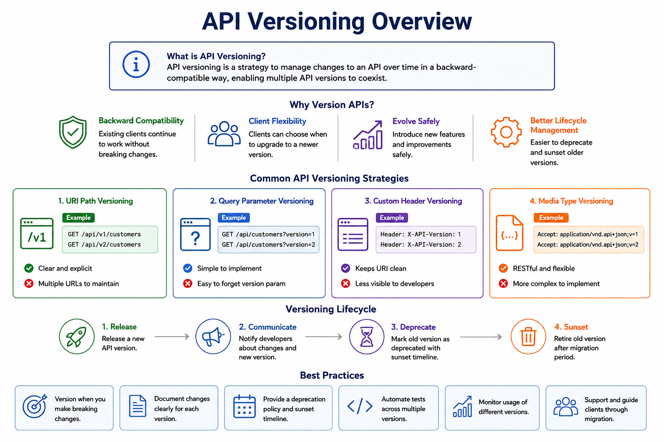
33
© 2026 by Innovation In Software Corporation
Notes:
KEY TALKING POINTS
------------------
- What is API Versioning banner
The information banner defines versioning as a strategy for managing change over time.
It lets multiple versions coexist.
Emphasize coexistence.
The whole point is that v1 keeps serving existing consumers while v2 is adopted.
A microservice platform has many teams.
There, coexistence turns a risky coordinated release into independent deployments.
It is also why versioning is closely tied to the backward-compatible evolution rules covered on the next slide.
- Why Version APIs?
The four benefits are Backward Compatibility, Client Flexibility, Evolve Safely and Better Lifecycle Management.
Backward compatibility means existing clients keep working without breaking changes.
Client flexibility means each consumer chooses when to upgrade.
That matters when a mobile app release or another team's sprint schedule is outside your control.
Evolving safely means the provider can still ship new features.
Lifecycle management means old versions can be deprecated and retired on purpose.
They do not linger forever.
- Common API Versioning Strategies
The four colored cards pair each approach with an example and a tradeoff.
URI Path Versioning is clear and explicit, but means multiple URLs to maintain.
Query Parameter Versioning is simple, but the version parameter is easy to forget.
Custom Header Versioning, shown as X-API-Version, keeps the URI clean.
But it is less visible to developers.
Media Type Versioning uses an Accept header with v equals 1 or 2, and it is RESTful and flexible, but more complex to implement.
The previous slide also listed domain versioning, which this diagram omits.
The labs use URI path versioning with /api/v1.
- Versioning Lifecycle
Four icons are connected by arrows.
Release a new version, and Communicate the change to developers.
Deprecate the old version with a sunset timeline.
Sunset it after the migration period.
Most real problems happen in the middle two steps.
Teams release v2 and forget to tell consumers.
Or they deprecate without a date, so nobody migrates.
The module notes list what to communicate.
That is what is changing, why, and the migration timeline.
It also covers the replacement endpoint and the support end date.
- Best Practices
The bottom row has six tiles.
Version only when you make breaking changes.
Document changes clearly for each version.
Publish a deprecation policy and sunset timeline.
Automate tests across all supported versions.
Monitor usage of each version, and support and guide clients through migration.
Monitoring usage is what makes sunsetting safe.
You retire v1 when metrics show no remaining traffic, not when you hope nobody uses it.
Automated tests across versions keep a fix in v2 from quietly breaking v1.
REAL-WORLD EXAMPLES
-------------------
- Kubernetes publishes a deprecation policy for its APIs.
Beta API versions, such as older extensions and beta groups, were marked deprecated.
They were announced in release notes and removed in later releases.
Stable versions like apps/v1 remained.
This is Release, Communicate, Deprecate and Sunset applied at massive scale.
- In retail banking, partner integrations such as aggregators or payroll providers usually cannot upgrade on the bank's schedule.
Run the old and new API versions side by side.
Add a published sunset date and usage monitoring per partner.
That avoids cutting off a partner's customers overnight.
USE-CASE SCENARIO
-----------------
Picture the capstone a year later.
The Account Service team needs v2 of the account resource to support joint ownership.
That changes the response shape.
They release /api/v2/accounts and announce it to the Transaction Service and Risk Assessment Service teams with a migration guide and a sunset date for v1.
Using Micrometer metrics tagged by URI, they watch v1 traffic fall as each team migrates.
When v1 traffic reaches zero and contract tests pass, they remove v1.
Nobody had to coordinate a big-bang release across three teams.

Slide 35
BACKWARD-COMPATIBLE API EVOLUTION · IDEMPOTENCY KEYS
📌
SAFE (BACKWARD-COMPATIBLE) CHANGES
❌
CHANGES THAT BREAK COMPATIBILITY
• Add new optional fields to requests or responses
• Add new resources or endpoints that don't affect existing ones
• Add new enum values that old clients can gracefully ignore
• Removing or renaming fields or endpoints
• Changing the meaning, type, or default behavior of a field
• Making a previously optional field required
📌
HOW IDEMPOTENCY KEYS WORK
💳
COMMON USE CASES
1. Client sends a unique Idempotency-Key header with the request
2. Server checks whether that key has already been processed
3. If new: process the request and store the response keyed by that value
4. If it exists: return the original stored response instead of reprocessing
• Payment processing -- avoid double charges on retry
• Order creation -- prevent duplicate orders from network retries
• Scope keys to the resource or tenant and set a reasonable TTL
KEY TAKEAWAY New optional fields and new endpoints are safe; removing fields, renaming fields, or changing meaning are breaking changes that need a version. • Same key, same result: a client-generated idempotency key lets the server return the original response instead of processing a duplicate.
34
© 2026 by Innovation In Software Corporation
Notes:
TOPIC 1 OF 2: Backward-Compatible API Evolution
------------------------------------------
KEY TALKING POINTS
------------------
- SAFE (BACKWARD-COMPATIBLE) CHANGES
Additive changes are safe because a well-behaved client ignores what it does not use.
This is often called being a tolerant reader.
Spring Boot's Jackson defaults ignore unknown properties.
So a new optional response field does not break a Spring consumer.
New endpoints leave existing ones untouched.
Treat new enum values with care.
An enum is a fixed list of allowed values.
Jackson fails by default when it meets an enum constant it does not know.
The exception is when the consumer opts into a default value or null.
So a new account status can break a strict client.
Write consumers to tolerate unknown values.
- CHANGES THAT BREAK COMPATIBILITY
Removing or renaming a field breaks every client that reads it, even if the data is still there under a new name.
Changing type breaks deserialization, for example a numeric ID becoming a string.
Changing meaning is the most dangerous, because nothing fails loudly.
The field name and type stay the same while the value means something different.
Changing a default alters behavior for clients that never sent the field.
Making an optional request field required turns previously valid requests into 400 errors.
All of these need a new version or a coordinated migration.
REAL-WORLD EXAMPLES
-------------------
- Amount units: suppose an API switches a field from dollars to cents without renaming it.
Every consumer's totals become one hundred times too large.
No parser error warns anyone.
Changing meaning is a breaking change, even when the JSON schema looks identical.
- The module notes give a customer example.
v1 returns a single name field, and v2 splits it into firstName and lastName.
Any client that displays name breaks.
So this change needs a new version, even though no data was lost.
USE-CASE SCENARIO
-----------------
The Account Service team adds an optional field showing when an account was last activated.
The Transaction Service reads only accountId and status, so it keeps working.
This change is safe.
Next the team proposes a new status value, DORMANT.
The Transaction Service maps status into a Java enum.
It would fail to deserialize the unknown value.
So this seemingly additive change is breaking for that consumer.
The fix is to coordinate.
The transaction team first makes its client tolerate unknown statuses.
Contract tests on both sides confirm it before DORMANT ships.
TOPIC 2 OF 2: Idempotency Keys
------------------------------
KEY TALKING POINTS
------------------
- HOW IDEMPOTENCY KEYS WORK
The client generates a unique value, typically a UUID, once for each business intent.
It sends that value on every attempt.
The server must check and record the key atomically, in one indivisible step.
For example, insert it into a table with a unique constraint.
Then two simultaneous duplicates cannot both proceed.
On first use the server processes the request.
It stores the status code and response body against the key.
On a repeat it returns that stored response.
Good implementations also handle a key that is still in progress.
They reject a key reused with a different request body, instead of returning an unrelated result.
- COMMON USE CASES
Payments and order creation are the classic cases, because a duplicate means real money or real goods.
The same applies to account opening and loan applications.
Scope keys to the caller, tenant or resource.
Then two different clients who happen to generate the same value never collide.
Keep keys for a time to live long enough to cover any realistic client retry window.
Then expire them so the store does not grow forever.
The stored record also becomes useful evidence when you investigate a disputed duplicate transaction.
REAL-WORLD EXAMPLES
-------------------
- Stripe documents Idempotency-Key support on its POST endpoints.
The first request's result, success or failure, is saved.
It is returned for later requests with the same key.
The keys are eventually removed.
A reused key with different parameters is rejected.
- Account opening: an applicant submits a long online application and double-clicks Submit on a slow connection.
Suppose a key was generated when the application form was loaded.
Then the second submission returns the original application reference.
It does not create a duplicate customer and account.
USE-CASE SCENARIO
-----------------
As a design extension to Lab 2, add an Idempotency-Key header to POST /api/v1/transactions on the Transaction Service.
That service runs on port 8082.
The teller UI generates the key when a transaction is confirmed.
On the first request the service validates the account and stores the transaction.
It publishes TransactionSubmitted and saves the 201 response against the key.
Suppose the UI times out and retries.
The service finds the key and returns the same transaction ID.
It writes no new row and publishes no second event.
Point out the parallel with Lab 2's Kafka consumer.
Its processed_events table gives the same guarantee for events.

Slide 36
CORRELATION AND TRACE IDENTIFIERS · API DOCUMENTATION WITH OPENAPI
📌
WHAT AND WHY
✅
BEST PRACTICES
• Correlation and trace identifiers uniquely tag a request as it flows across services
• They let teams correlate logs, metrics, and traces for faster troubleshooting
• Essential when a single user request touches many services
• Generate the trace ID at the edge (API gateway or entry point)
• Propagate it in HTTP headers and messaging metadata everywhere downstream
• Log the trace ID consistently in every log statement across every service
📌
WHAT OPENAPI PROVIDES
✅
BEST PRACTICES
• A standard (formerly Swagger) format for describing REST APIs
• Documents endpoints, methods, request/response schemas, and status codes
• Powers interactive documentation (Swagger UI), client generation, and contract testing
• Keep the spec versioned alongside the code
• Define all responses, including errors, with clear descriptions
• Validate the spec in CI/CD (for example, with Spectral)
KEY TAKEAWAY A trace ID created at the API gateway and propagated through every downstream call turns scattered logs into one connected story. • Define, serve, visualize, automate, and collaborate: OpenAPI documentation keeps a REST API discoverable and its contract enforceable.
35
© 2026 by Innovation In Software Corporation
Notes:
TOPIC 1 OF 2: Correlation and Trace Identifiers
------------------------------------------
KEY TALKING POINTS
------------------
- WHAT AND WHY
In a monolith, where everything runs as one application, one stack trace tells the whole story.
In microservices, one teller action might touch the Transaction Service, the Account Service, Kafka and the Risk Assessment Service.
Each has its own logs on different pods.
A correlation ID is a single value attached to the request, so that every service logs it.
Search for that ID and you rebuild the whole path.
Distributed tracing extends the idea with trace and span IDs that also record timing.
Metrics show that something is slow.
Traces show where, and correlated logs show why.
- BEST PRACTICES
Generate the ID once at the entry point, whether that is the gateway or the first service.
Keep any ID the caller already sent.
Lab 1 does this: it echoes X-Correlation-Id or generates one when it is absent.
Propagate it on every outbound HTTP call and in messaging metadata.
Lab 2 copies it onto the Kafka event.
Put it in every log line automatically through the logging context, not by hand.
The Lab 4 guide notes it still appears as correlationId= in logs.
OpenTelemetry uses the W3C traceparent header.
Micrometer Tracing puts trace IDs in the logging context.
REAL-WORLD EXAMPLES
-------------------
- Disputed card payment: a customer reports that an online purchase showed as declined, but money seems to be held.
An engineer takes the correlation ID from the failed response.
They follow the request through authorisation, fraud screening and ledger services.
They find which step timed out after the hold was placed.
- Distributed tracing grew out of large-scale service architectures.
Google described its Dapper tracing system in a published paper.
Open-source successors led to today's OpenTelemetry standard.
OpenShift environments commonly use it to collect traces.
USE-CASE SCENARIO
-----------------
In Lab 3 a participant posts a transaction with X-Correlation-Id: lab3-demo.
The Transaction Service logs it.
It relays the ID with the JWT, the access token, when calling the Account Service.
The Account Service logs the GET with the same ID.
The event on Kafka carries it too, and in Lab 5 the Risk Assessment Service consumes that event.
When a risk score looks wrong, an engineer searches one value and sees the whole journey.
That covers the transaction received, the account check, the event published and the score produced.
Without it, they would be matching timestamps across three services by eye.
TOPIC 2 OF 2: API Documentation with OpenAPI
------------------------------------------
KEY TALKING POINTS
------------------
- WHAT OPENAPI PROVIDES
OpenAPI grew out of the Swagger specification, which was donated to the OpenAPI Initiative.
From version 3 onward the specification is named OpenAPI.
Swagger remains the name of a family of tools.
A spec in YAML or JSON describes every path, method, parameter, schema, status code and security requirement.
It is machine-readable, so tools can render interactive docs and generate client SDKs and server stubs.
They can also run mock servers and verify that an implementation matches.
In Lab 1, springdoc generates the spec at /v3/api-docs.
It serves Swagger UI at /swagger-ui/index.html on port 8081.
- BEST PRACTICES
Keep the spec in the same Git repository as the service.
Then a change to the API and a change to its contract are reviewed in the same pull request.
Document error responses as carefully as the happy path.
The 400, 404 and 409 bodies are exactly what consumers need to code against.
The module notes list happy-path-only docs as a common mistake.
Lint the spec automatically, which means checking it against rules.
Spectral, an open-source OpenAPI linter, can enforce naming, required descriptions and error schemas.
A step in an OpenShift Pipelines run can fail the build when the contract breaks the rules.
REAL-WORLD EXAMPLES
-------------------
- Many banks run internal developer portals where teams publish OpenAPI specs for their services.
A team building a new mobile feature finds the account API.
It reads the error responses and generates a client.
It does this without scheduling a meeting with the owning team.
- Postman can import an OpenAPI document and generate a ready-to-run collection of requests.
So QA engineers get a starting test suite for a banking API straight from its specification.
USE-CASE SCENARIO
-----------------
At the end of Lab 1, participants open Swagger UI on port 8081 and expand POST /api/v1/accounts and its request body.
They confirm the body lists customerId, accountType, currency and nickname.
The lab's stretch goal is to run create and activate straight from Swagger UI.
Now switch perspective.
The Transaction Service team in Lab 2 needs to call this API.
They do not read Account Service code.
They read /v3/api-docs to learn the paths, the 404 and 409 error shapes and the status codes.
The spec is the handshake between the two capstone teams.

Slide 37
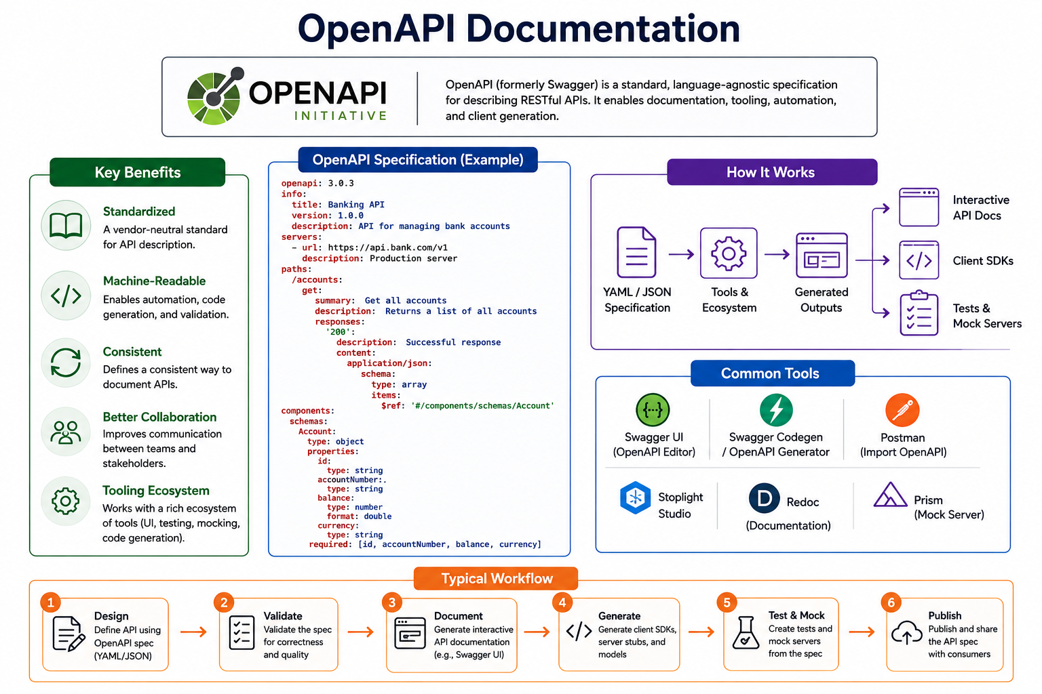
36
© 2026 by Innovation In Software Corporation
Notes:
KEY TALKING POINTS
------------------
- Header
The top banner pairs the OpenAPI Initiative logo with a definition.
OpenAPI is a standard, language-agnostic specification for describing RESTful APIs, formerly Swagger.
It enables documentation, tooling, automation and client generation.
Stress language-agnostic, meaning it works with any programming language.
The Account Service is Java.
But a spec it publishes can generate a TypeScript client for a web front end.
It can also generate a Python client for a data science notebook in OpenShift AI later in the course.
- Key Benefits
The green panel lists Standardized, Machine-Readable, Consistent, Better Collaboration and Tooling Ecosystem.
Standardized means it is vendor-neutral, so there is no lock-in to one gateway or tool.
Machine-readable is the benefit that powers everything else: automation, code generation and validation.
Consistent means every team documents APIs the same way.
Better collaboration means providers and consumers discuss one concrete artifact.
The tooling ecosystem means UI, testing, mocking and generation tools already exist.
So teams do not build their own.
- OpenAPI Specification (Example)
The central code panel shows openapi 3.0.3, an info block for a Banking API, and a production server URL.
It has a /accounts path whose GET returns 200 with an array of Account objects.
Those objects are referenced through $ref.
The components section defines the Account schema with id, accountNumber, balance and currency, all marked required.
Point out the reuse: the schema is defined once and referenced by any path.
Also flag a teaching moment: balance is typed as number with format double.
For money, a bank should not rely on binary floating point.
Prefer a decimal representation, with BigDecimal in Java.
- How It Works
The purple panel is a pipeline.
A YAML or JSON specification goes into the tools and ecosystem.
They produce generated outputs that fan out into three results: Interactive API Docs, Client SDKs, and Tests and Mock Servers.
The message is that the spec is a source artifact, like code.
Change the spec and rerun the tools.
Docs, clients and mocks then all update together instead of drifting apart.
- Common Tools
The blue panel lists six tools.
Swagger UI renders interactive documentation.
The label says OpenAPI Editor, but the separate Swagger Editor is the authoring tool.
Swagger Codegen and OpenAPI Generator produce clients and server stubs.
Postman imports OpenAPI to build request collections.
Stoplight Studio is a visual design tool, and Redoc renders reference documentation.
Prism runs a mock server from a spec.
In Lab 1, springdoc supplies Swagger UI automatically.
So participants use the first tool without installing anything.
- Typical Workflow
The orange strip runs six numbered steps.
Design the API in the spec.
Validate it for correctness and quality.
Document it with interactive docs.
Generate client SDKs, server stubs and models.
Test and Mock by creating tests and mock servers from the spec.
Publish it to consumers.
This is the contract-first flow that the next slide compares with code-first.
The Validate step is where a linter such as Spectral fits.
Publish is where a developer portal or API catalog comes in.
REAL-WORLD EXAMPLES
-------------------
- Mock servers unblock parallel work.
A mobile team building a new account-summary screen can run Prism against the agreed spec.
They develop against realistic responses weeks before the real service is deployed.
Then they switch the base URL when it is ready.
- Generated clients reduce integration bugs.
Say a payments team generates its Java client from the account team's published spec with OpenAPI Generator.
Then field names, types and paths come straight from the contract.
Nobody retypes them by hand.
USE-CASE SCENARIO
-----------------
In the capstone, the Account Service publishes its spec at /v3/api-docs.
The Transaction Service team could generate a typed client from it, instead of writing request classes by hand.
Later, the Risk Assessment Service team works in Python for model experiments in OpenShift AI.
They could generate a Python client from the same spec.
Suppose the account team lints the spec in their OpenShift Pipelines run and publishes it to a shared catalog.
Then all three teams work from one source of truth.
A breaking change shows up as a failed pipeline instead of a production incident.

Slide 38
CONTRACT-FIRST VS. CODE-FIRST API DEVELOPMENT · CONSUMER-DRIVEN API DESIGN
📌
CONTRACT-FIRST
💻
CODE-FIRST
📌
THE CDAD CYCLE
• Define the OpenAPI contract, review and agree with consumers, then implement
• Strong collaboration and alignment; enables true parallel development
• Best when multiple teams or external consumers depend on the API
• Implement the API in code, then generate the OpenAPI spec from it
• Faster start, documentation always reflects the code
• Best for internal, simple CRUD-style APIs owned end to end by one team
1. Consumer identifies a need: a use case and required data
2. Consumer writes a contract defining the expected request/response
3. Provider implements the API to satisfy the contract
4. Provider runs contract verification tests to confirm compliance
5. Deploy and monitor, feeding real usage back into future contracts
KEY TAKEAWAY Contract-first suits multi-team, business-critical APIs; code-first suits fast-moving internal APIs owned end to end by one team. • Consumers define the contract as executable tests; providers implement to satisfy it, catching breaking changes before deployment.
37
© 2026 by Innovation In Software Corporation
Notes:
TOPIC 1 OF 2: Contract-First vs. Code-First API Development
------------------------------------------
KEY TALKING POINTS
------------------
- CONTRACT-FIRST
The team writes the OpenAPI document before any controller exists.
They review it with consumers, much like reviewing a design document.
Once it is agreed, the provider can generate server interfaces, for example with the OpenAPI Generator Maven plugin.
Meanwhile consumers generate clients or run a mock server.
So both sides build in parallel.
The cost is upfront design time, and the discipline to keep the implementation faithful to the contract.
It pays off for business-critical APIs, cross-team platforms and anything exposed to external partners.
In those cases a late change is expensive.
- CODE-FIRST
The team writes Spring controllers and DTOs first.
Then a library such as springdoc generates the OpenAPI document from the code and its annotations.
The start is faster.
The docs cannot drift from what actually runs, because they are produced from it.
The risk is that the API's shape follows implementation convenience.
Consumers see changes only after they ship.
It fits internal, straightforward APIs owned by one team.
Lab 1 is code-first.
Participants write the Account Service, and springdoc publishes /v3/api-docs and Swagger UI.
REAL-WORLD EXAMPLES
-------------------
- Partner-facing banking APIs are usually designed contract-first.
Examples are APIs consumed by aggregators or corporate treasury systems.
External developers need a stable, reviewed specification before any code is written.
Changes after publication are costly for everyone.
- Take an internal operations tool that lets one team manage its own reference data.
It has a single consumer that the same team builds.
That is a reasonable code-first candidate.
Speed matters more than cross-team negotiation, and generated docs are enough.
USE-CASE SCENARIO
-----------------
Lab 1 builds the Account Service code-first, because the goal is learning Spring Boot.
springdoc gives accurate docs for free.
Now scale the capstone to a real bank.
The Account Service will be consumed by the Transaction Service, the Risk Assessment Service, the mobile app and branch systems.
Each is owned by a different team.
Here the account team would likely switch to contract-first.
They would publish a reviewed openapi.yaml and let consumers build against a mock.
They would generate server interfaces from it.
They would also add a pipeline check that fails when the implementation drifts from the agreed contract.
TOPIC 2 OF 2: Consumer-Driven API Design
----------------------------------------
KEY TALKING POINTS
------------------
- THE CDAD CYCLE
Start from the consumer's real use case, not the provider's data model.
That keeps APIs lean.
The consumer writes a contract describing only the requests it makes and the response fields it reads.
This is often a test, using a tool such as Pact or Spring Cloud Contract.
The provider implements the API to satisfy every consumer contract.
It then runs those contracts as verification tests in its own build.
If a change would break a consumer, the provider's pipeline fails before release.
After deployment, monitoring shows how the API is really used.
That feeds the next round of contracts.
REAL-WORLD EXAMPLES
-------------------
- Pact is a widely used open-source contract testing tool.
Consumer tests record the interactions they expect.
The resulting pact files are shared with the provider, which verifies them in its own build.
Teams can then see which consumer versions are safe to deploy against which provider versions.
- Spring Cloud Contract supports consumer-driven contracts in the Spring ecosystem.
Contracts are written in Groovy or YAML.
They generate provider-side tests and consumer-side stubs.
So a Spring Boot provider's Maven build fails if it stops honoring a contract.
USE-CASE SCENARIO
-----------------
In the capstone, the Transaction Service is a consumer of the Account Service.
It needs only one thing: GET /api/v1/accounts/{accountId} returning accountId and status, with 404 for unknown accounts.
The transaction team writes that down as a contract.
The account team adds the contract to its build.
Months later someone renames status to accountStatus in a refactor.
The Account Service pipeline fails on the Transaction Service contract before the change reaches OpenShift.
The teams then discuss a versioned change.
They do not discover a broken transaction flow in production.

Slide 39
REST API SECURITY CONSIDERATIONS · REST API DESIGN ANTI-PATTERNS
📌
COMMON API THREATS
🔒
SECURE API DESIGN PRINCIPLES
• Broken authentication and broken authorization (IDOR)
• Injection attacks, sensitive data exposure, security misconfiguration
• Insufficient logging and monitoring
• Validate everything -- all inputs, headers, and parameters
• Use HTTPS everywhere and enforce TLS 1.2 or higher
• Minimize data exposure -- return only what's necessary
• Rate limit and throttle to prevent abuse
❌
ANTI-PATTERNS TO AVOID (1 OF 2)
❌
ANTI-PATTERNS TO AVOID (2 OF 2)
• CRUD-everywhere naming (/getUsers) instead of resource nouns
• Over-using query parameters instead of clean filters and pagination
• Exposing internal database structures directly in responses
• Ignoring HTTP status codes and always returning 200 OK
• Over- or under-fetching data with no field selection
• No pagination on large collections
• Inconsistent naming, casing, and error formats across endpoints
• Using GET for operations that have side effects
• Tunneling every verb through POST with a _method override
• Leaking sensitive information in stack traces or error details
• Versioning in the wrong way, locking the API into one rigid scheme
• Chatty, overly fine-grained APIs that require many round trips
KEY TAKEAWAY Authenticate, authorize, validate, and encrypt at every layer -- from the client request through business logic to data access. • From CRUD-everywhere naming to always returning 200 OK, each anti-pattern has a simple, resource-oriented fix.
38
© 2026 by Innovation In Software Corporation
Notes:
TOPIC 1 OF 2: REST API Security Considerations
------------------------------------------
KEY TALKING POINTS
------------------
- COMMON API THREATS
Broken authentication means callers are not reliably identified.
Broken authorization, or IDOR, means an authenticated user changes an ID in the URL and reaches someone else's account.
The OWASP API Security Top 10 ranks broken object level authorization first.
Injection happens when input is pasted straight into SQL or commands.
Spring Data JPA parameterizes queries.
Sensitive data exposure is returning full account numbers or personal data nobody needed.
Misconfiguration includes exposing every Actuator endpoint or allowing any CORS origin.
Insufficient logging means an attack goes unnoticed.
In banking that is also an audit failure.
- SECURE API DESIGN PRINCIPLES
Validate everything, including headers and path variables, not just bodies.
That is the same layered validation from Lab 1.
Encrypt in transit with modern TLS.
On OpenShift, routes can terminate or re-encrypt TLS, so traffic is never plain text.
Minimize exposure by returning DTOs with masked or omitted sensitive fields, not entities.
Rate limit at the gateway or edge to blunt credential stuffing and scraping.
Lab 3 adds authentication and authorization.
A call with no token gets 401.
A token without the right scope gets 403, and production would use an identity provider such as Keycloak.
REAL-WORLD EXAMPLES
-------------------
- IDOR in banking: a customer viewing a statement notices the URL contains an account identifier and changes it.
The API might check only that the caller is logged in, not that the account belongs to them.
Then another customer's statement is exposed.
The fix is an ownership or scope check on every object access.
- Credential stuffing: attackers replay username and password pairs leaked from other sites against a bank's login API.
Rate limiting per client and per account slows the attack.
Combine it with monitoring for bursts of failed logins, and the security team gets alerted.
USE-CASE SCENARIO
-----------------
Lab 3 hardens the capstone.
The Account and Transaction APIs now require a Bearer JWT.
A teller token carries accounts.read and accounts.write.
So it can create and activate accounts, but posting a transaction returns 403.
An ops token carries transaction scopes and can submit transactions.
Calls with no token get 401, while health checks stay open.
The Transaction Service relays the token when calling the Account Service.
The lab checks that no log line contains the word Bearer.
The circuit breaker fallback never auto-approves money movement.
That is itself a security decision.
TOPIC 2 OF 2: REST API Design Anti-Patterns
------------------------------------------
KEY TALKING POINTS
------------------
- ANTI-PATTERNS TO AVOID (1 OF 2)
Verb URLs like /getUsers repeat what the HTTP method already says.
Use nouns such as GET /users.
Stuffing actions and options into query parameters makes URLs unreadable.
Reserve them for filtering, sorting and paging.
Returning JPA entities couples consumers to your schema and leaks internal columns, so return DTOs.
Always returning 200 hides failures from clients and monitoring.
Over-fetching sends data nobody needs.
Under-fetching forces extra calls.
Design responses around consumer use cases.
Unpaginated collections eventually time out when data grows, so page and cap them.
- ANTI-PATTERNS TO AVOID (2 OF 2)
Inconsistent naming and error shapes force every consumer to special-case each endpoint.
One convention and one error body fix it.
GET with side effects breaks under caching, prefetching and retries.
Tunneling everything through POST with a _method override hides intent from every intermediary.
Stack traces in responses leak internals.
Some teams version inconsistently, or lock the API into one rigid scheme.
That makes evolution painful, so choose a strategy and a deprecation policy.
Chatty APIs need many round trips for one screen.
They multiply latency and failure points.
Offer coarser, use-case-oriented resources instead.
REAL-WORLD EXAMPLES
-------------------
- Picture a statement screen that calls one endpoint for account details.
It calls another for each of fifty transactions, and another for each merchant name.
That is over a hundred calls to render one page.
On a mobile network that is slow and fragile.
One paginated transactions resource with the needed fields solves it.
- An email link that performs an action through a plain GET, such as confirming an address change, is risky.
Corporate email security scanners that follow links automatically can trigger it.
That is a real reason why GET must never change state.
USE-CASE SCENARIO
-----------------
Run a quick design review of an imaginary first draft of the capstone APIs.
The draft has POST /getAccount.
It has a GET /api/v1/accounts/{id}/close that closes the account.
It returns JPA entities with internal columns.
Every error comes back as 200 with success false.
Ask the room to fix it using Lab 1.
The draft becomes GET /api/v1/accounts/{accountId}.
Closing becomes POST /api/v1/accounts/{accountId}/close with no physical delete.
It returns DTO responses, with real 400, 404 and 409 codes and one error body.
Every fix maps to a slide from this module.

Slide 40
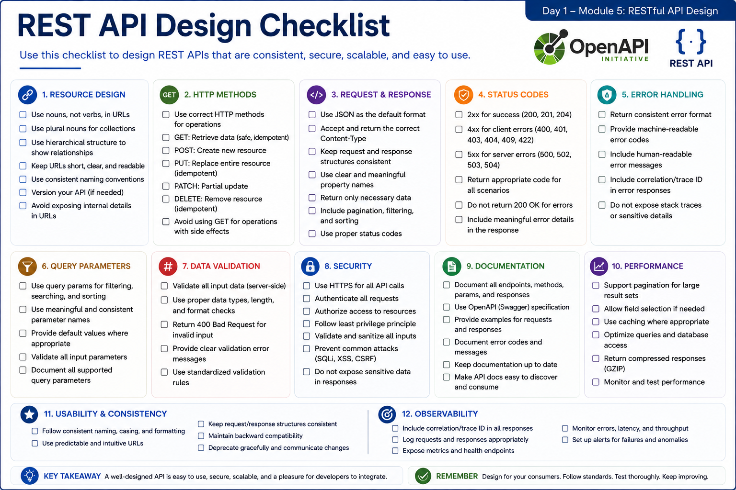
39
© 2026 by Innovation In Software Corporation
Notes:
KEY TALKING POINTS
------------------
- CHECKLIST -- SECTIONS 1 TO 6
The first six sections cover the shape of the contract.
URLs name nouns in the plural, like /api/v1/accounts, and the hierarchy shows real relationships.
The HTTP method carries the action.
GET reads, POST creates, and PATCH updates part of a resource.
Payloads are consistent JSON with clear field names.
Status codes tell the truth.
Return 201 on create and 404 when something is missing.
Never return 200 for an error.
Errors share one format with a correlation ID and no stack traces.
A correlation ID is a tracking number for one request.
Query parameters for filtering and sorting are named consistently and documented.
- CHECKLIST -- SECTIONS 7 TO 12
The second six sections cover running the contract safely at scale.
Validation happens on the server.
Its messages tell the caller what to fix.
Security means HTTPS, calls that are authenticated and authorized, and sanitized, or cleaned, input.
OpenAPI documentation stays current.
It includes examples, and error examples too.
Performance covers pagination for large lists, caching where it is safe, and compressed responses.
Usability means predictable URLs and backward-compatible change.
Announce any deprecation ahead of time.
Observability closes the loop.
It means correlation IDs, request logs without sensitive data, metrics, health endpoints, and alerts on failures.
REAL-WORLD EXAMPLES
-------------------
- A card authorization API might return 200 OK with a declined flag in the body.
Then every client must parse the body before it knows something failed.
Clear status codes plus a machine-readable error code fix this.
A mobile app, a branch system, and a fraud dashboard can then all react the same way.
- Say a customer calls support about a failed account update.
The agent can quote the correlation ID from the error screen.
Operations can then find that exact request in the logs.
They can follow it across every service it touched.
The error response never exposes a stack trace or account details.
- A statements endpoint might return every transaction for a long-lived account in one response.
That response becomes slow and uses a lot of memory.
Add pagination with documented page and size parameters, plus a sort order.
That keeps the response small and predictable for online banking screens.
USE-CASE SCENARIO
-----------------
Before Lab 1, a team reviews its Account Service contract against this checklist.
POST /api/v1/accounts returns 201 with a Location header.
GET on an unknown id returns 404 with code ACCOUNT_NOT_FOUND and a correlationId.
Trying to freeze a PENDING account returns 409, not 500.
There is no DELETE, because closed accounts are kept for audit.
Swagger UI documents the operations.
Actuator exposes health.
On Day 2 the Transaction Service calls this API before it accepts a transaction.
On Day 5 the Risk Assessment Service and AI tooling parse the same error shape.
Every checklist box ticked today saves a rework conversation later in the week.

Slide 41
EXERCISE 1.2 — DESIGN ACCOUNT SERVICE APIS AND BOUNDARIES
Module 2 checkpoint B — REST resources, status transitions, OpenAPI sketch.
🎯
OBJECTIVE
📝
DO THIS
✅
EXPECTED RESULT
• REST resources, status transitions, OpenAPI sketch
• 15 min · design checkpoint
• Worksheet: curriculum/day-01/exercises/exercise-1.2-account-apis.md
1. Resource is an account. Sketch POST / GET / PATCH and activate / freeze / close (no DELETE)
2. Status machine: PENDING → ACTIVE → FROZEN or CLOSED; freeze PENDING is 409; FROZEN can activate; retries return 200
3. List 400 / 404 / 409 cases; note OpenAPI + Actuator as Lab 1 deliverables
4. Draw the bounded context: Account owns accounts only — not transactions, not risk scores
• A one-page Account API sketch that Lab 1 can implement without changing URLs tomorrow.
• Use this contract in Lab 1. Do not add Customer or Notification services.
KEY TAKEAWAY A one-page Account API sketch that Lab 1 can implement without changing URLs tomorrow.
40
© 2026 by Innovation In Software Corporation
Notes:
KEY TALKING POINTS
------------------
- OBJECTIVE
The objective is a design artifact, not code.
It covers REST resources, the status machine, and a rough OpenAPI outline for Account Service.
A status machine is the set of allowed status changes.
This is a 15-minute checkpoint.
So the aim is agreement on the contract, not polish.
Point people to the worksheet path on the slide.
There they can see the success criteria.
Every task is discussed, and a sketch is ready for review.
Scope stays at Account, Transaction, and Risk Assessment, with no extra services.
- DO THIS
First, treat the account as the resource.
Use POST to create, GET to read, and PATCH to update the nickname.
Use POST actions for activate, freeze, and close.
There is no DELETE, because the closed record is kept for audit.
Second, draw the Lab 1 status machine.
New accounts start PENDING.
Activate moves them to ACTIVE.
Freeze is allowed only from ACTIVE; freeze PENDING returns 409.
FROZEN can be activated back to ACTIVE.
Close keeps the row. Repeating an action that already succeeded returns 200.
Third, list the 400, 404, and 409 cases.
Note OpenAPI and Actuator as Lab 1 deliverables.
Fourth, draw the boundary.
Account owns accounts only.
- EXPECTED RESULT
A strong one-page sketch lists /api/v1/accounts and /api/v1/accounts/{accountId}.
It puts actions under that path.
It gives 201 for create and 200 for everything else.
Retries are safe.
Activate on ACTIVE, freeze on FROZEN, and close on CLOSED all return 200.
The first 400 case is a customerId that is not a synthetic CUST-0001 style id.
The second 400 case is an unsupported currency.
The 404 case is an unknown account.
The 409 cases are freezing a PENDING account and renaming a CLOSED one.
The boundary excludes balances, transactions, and risk scores.
It adds no Customer or Notification service.
REAL-WORLD EXAMPLES
-------------------
- In retail banking, closing an account rarely erases it.
Records are kept for audit, dispute handling, and regulatory reporting.
That is why Account Service models close as a status change, not a DELETE.
It is also why GET on a closed account still returns the record.
- Payment and account apps retry requests on flaky mobile networks.
Say a customer taps twice to freeze an account linked to a lost card.
The second call should confirm the account is FROZEN, not return an error.
That is why this design makes repeated actions return 200.
USE-CASE SCENARIO
-----------------
Run the checkpoint in pairs or groups of three.
Give each group a whiteboard area or a shared page.
Spend 2 minutes framing, 8 minutes designing, and 5 minutes on debrief.
Walk the room at minute 4.
A group may have drawn DELETE /accounts/{id} or added a balance field.
If so, ask what a regulator would want to see after an account is closed.
Also ask which service will own money movement tomorrow.
For the debrief, pick one group to present its status machine.
Pick another group to present its error table.
Then ask: what happens if Transaction Service calls this API with a FROZEN account?
Close by pointing out that Lab 1 uses these exact paths on port 8081.

